Slide 1
European Seniors’ Union
Conference
The era of digitalization: from communication highways to disinformation and infodemic
Presentation 23 March, 2021
Patrick Penninckx Head of Information Society Department

Slide 2
Digitalisation and older persons
PRESENTATION TOPICS:
European institutional architecture
Challenges of the digital world
Council of Europe action
Future developments

Slide 3
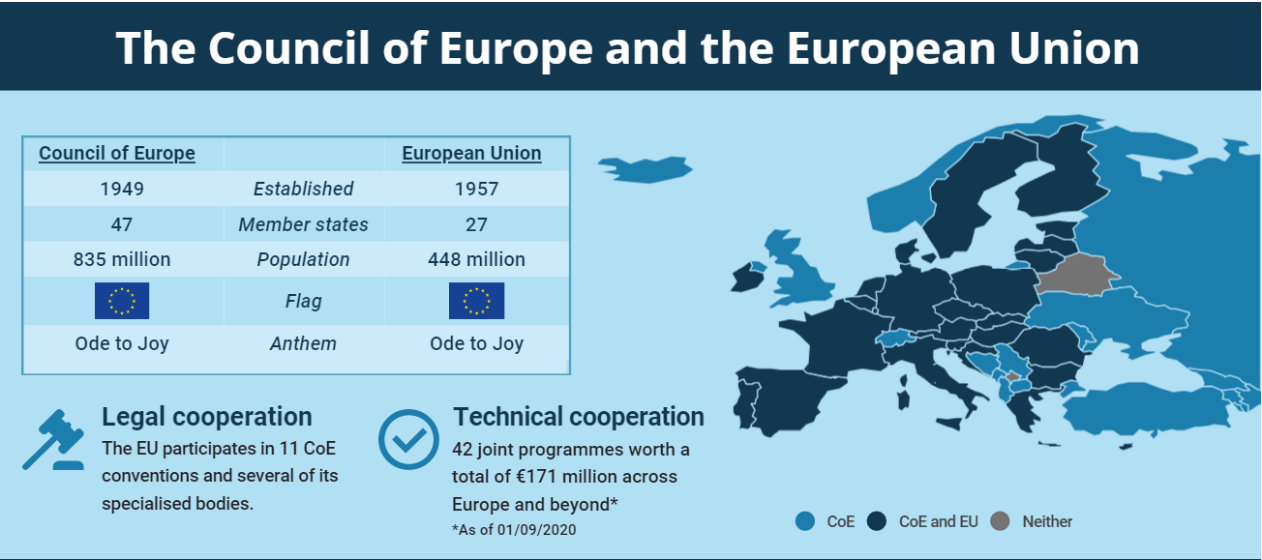
Two sister institutions

Slide 4
Two sister institutions
COURT OF JUSTICE OF THE EUROPEAN UNION
COUR DE JUSTICE DE L’UNION EUROPÉENNE
Complaints from Member States and individuals asserting that another signatory state has breached its Convention obligations.
Only a direct victim of a violation of a Convention obligation can apply to the ECtHR.
Actions by individuals, companies or organisations against EU decisions or actions by EU institutions.
Requests from Member States’ courts for “preliminary rulings” asking for an interpretation of EU law.
Actions by the European Commission for Member State’s failure to fulfil its obligations under EU law.
Requests to annul EU law concerning alleged violations of human rights or EU treaties.
Source: clarionsolicitors

Slide 5
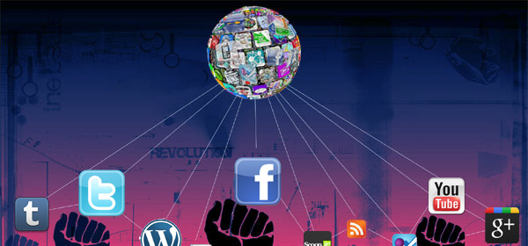
The world is turning digital

Slide 6
Technological revolution unites…
Notes:
https://www.nytimes.com/2019/01/03/technology/personaltech/tech-2019-overhyped.html

Slide 7
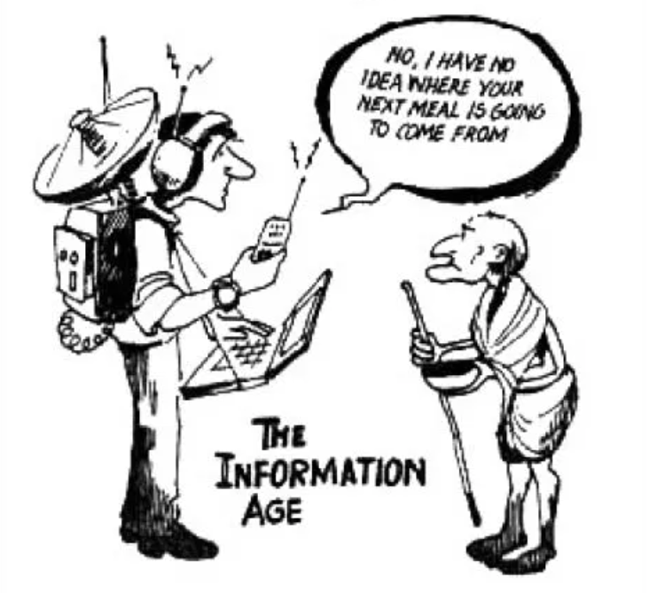
…but technology also divides
Notes:
The technology divide
https://globalab.wordpress.com/2007/10/14/knowledge-politics-quarterly-journal-launched/

Slide 8
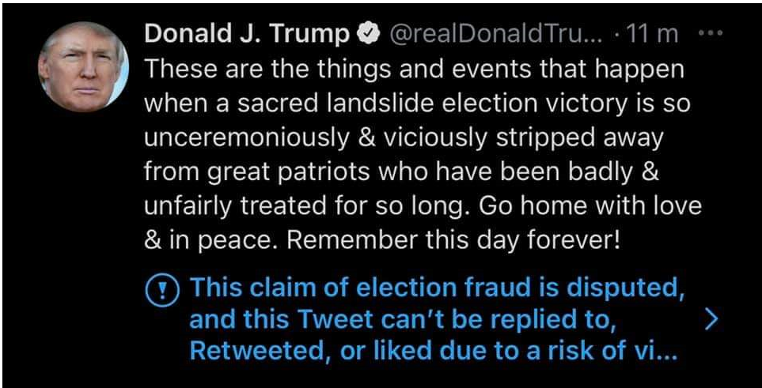
… while fake news proliferate

Slide 9
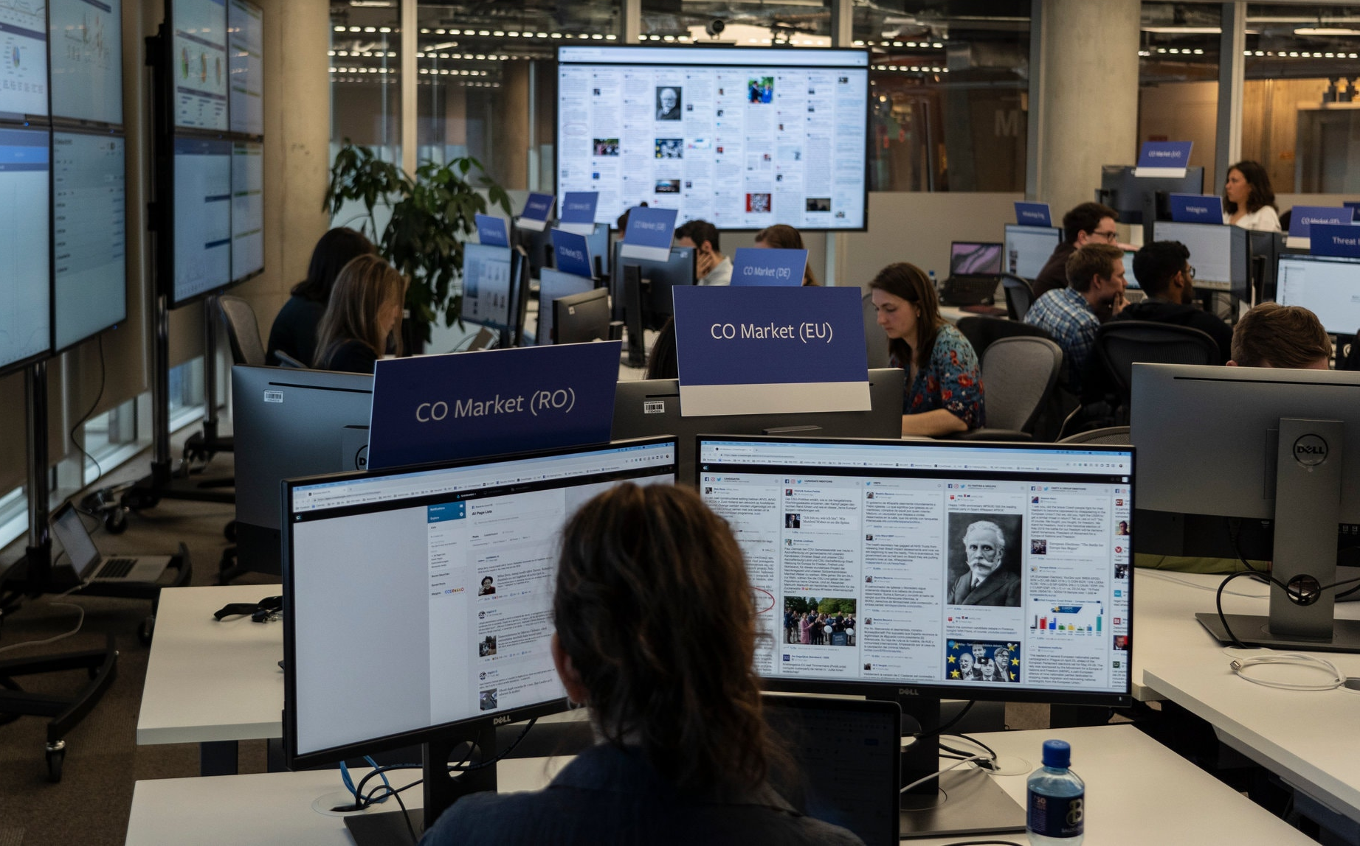
… as well as disinformation campaigns
At Least 70 Countries have had Disinformation Campaigns

Slide 10
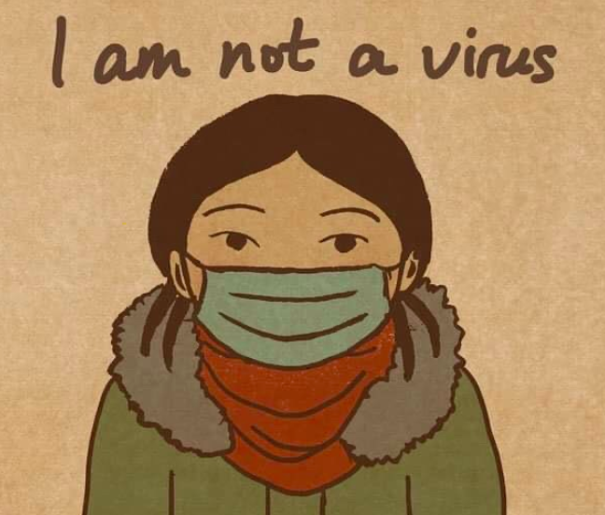
… and hate speech

Slide 11
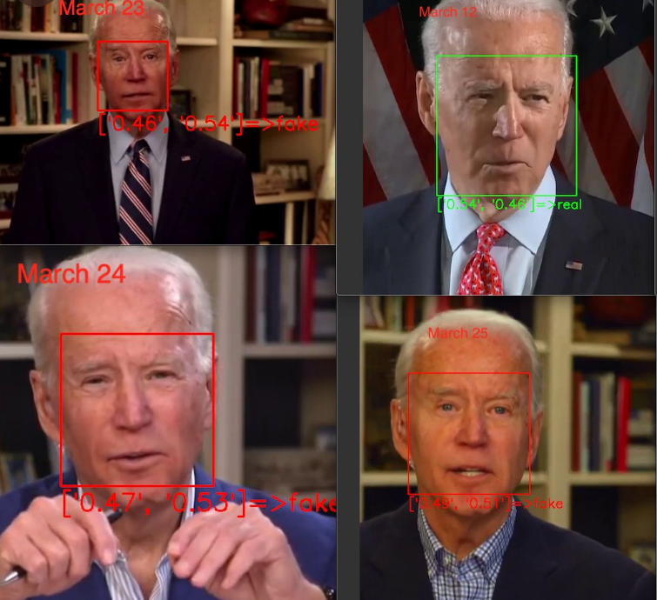
Deep fakes distort reality
The Guardian
11

Slide 12
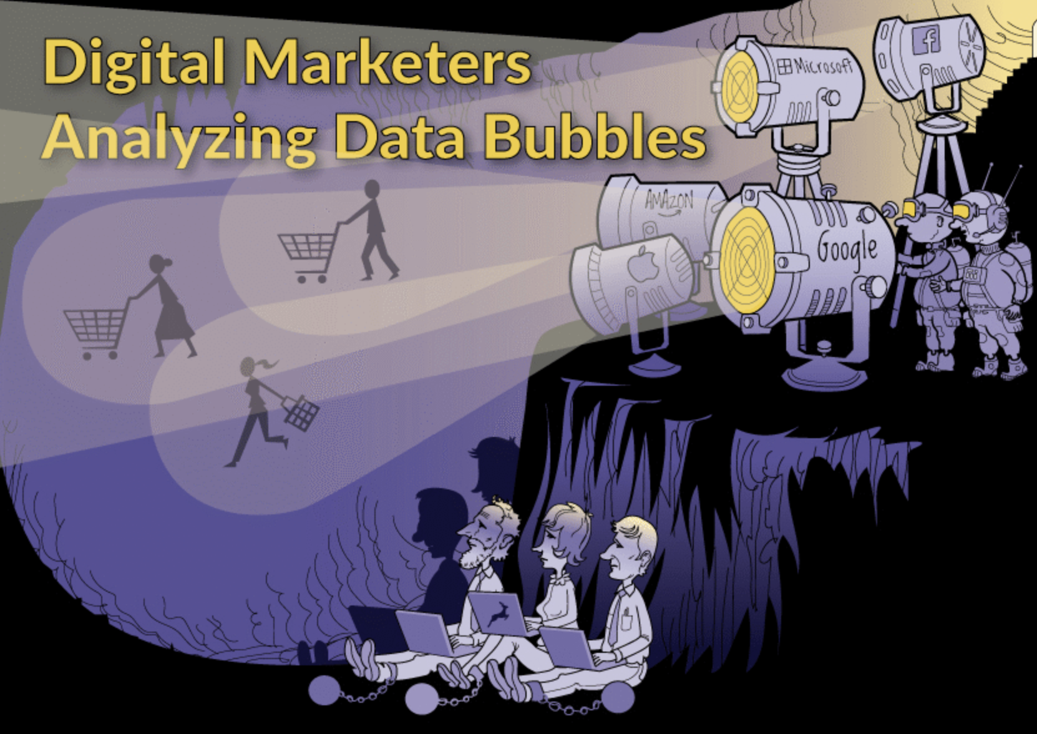
Do I still have access to information?
Notes:
Picture 1:
https://leverageedu.com/blog/types-of-mass-media/
Picture 2:
https://toth-illustration.com/is-it-time-to-emerge-from-platos-cave/

Slide 13
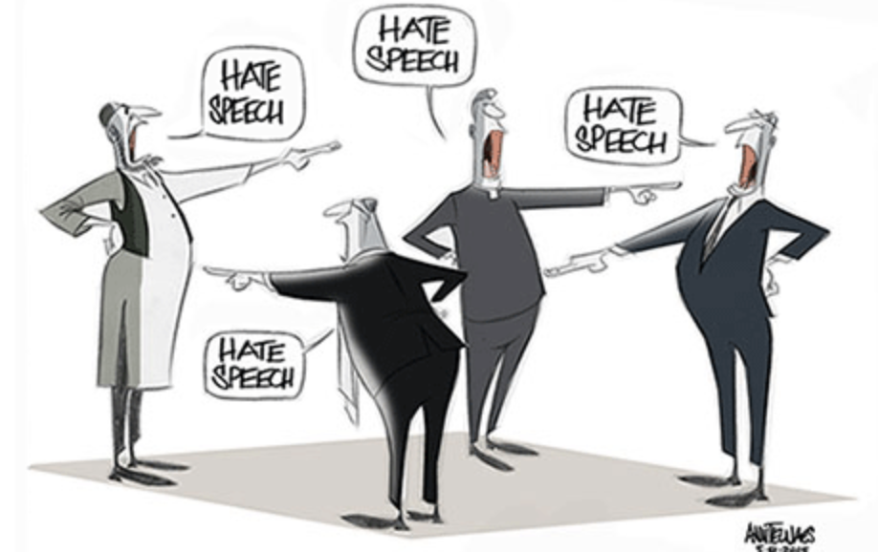
Am I free to speak?
Notes:
https://www.washingtonpost.com/gdpr-consent/?next_url=https%3a%2f%2fwww.washingtonpost.com%2fnews%2fopinions%2fwp%2f2015%2f05%2f08%2fhate-speech-vs-free-speech%2f

Slide 14
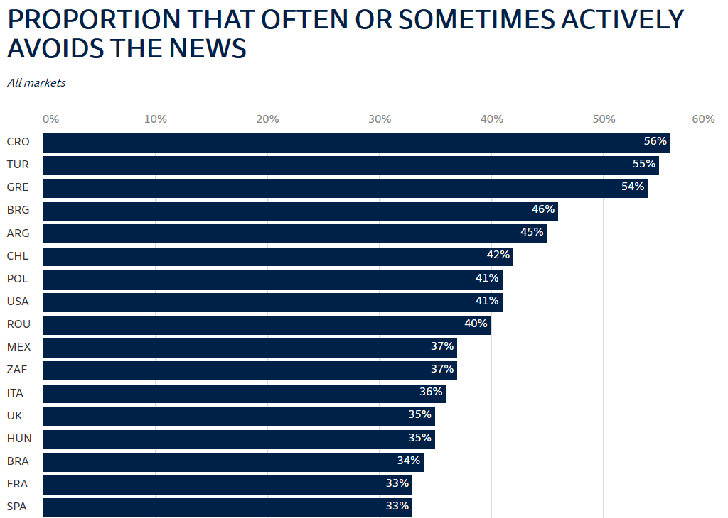
News avoidance extends
News avoidance is highest in Croatia (56%), Turkey (55%), and Greece (54%)
Source: Digital News Report 2020, Reuters Institute

Slide 15
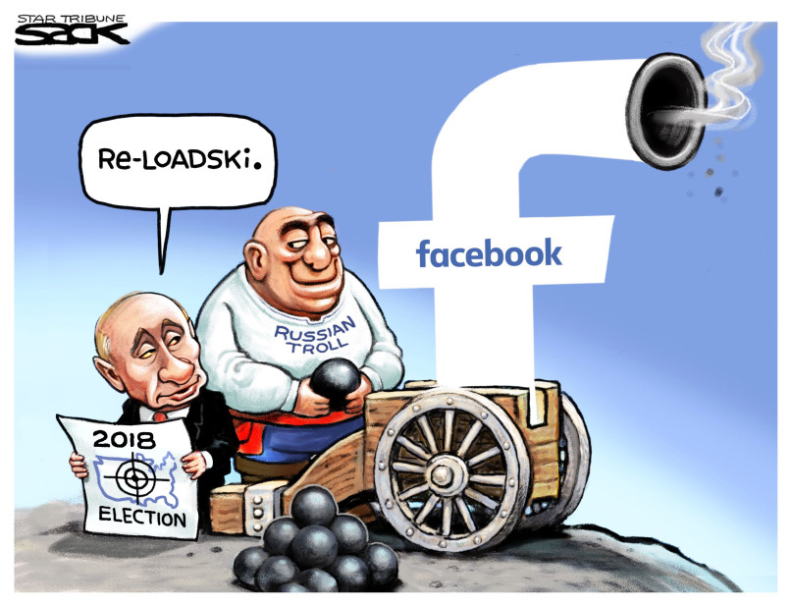
Disinformation rigs elections
Source: The Journal

Slide 16
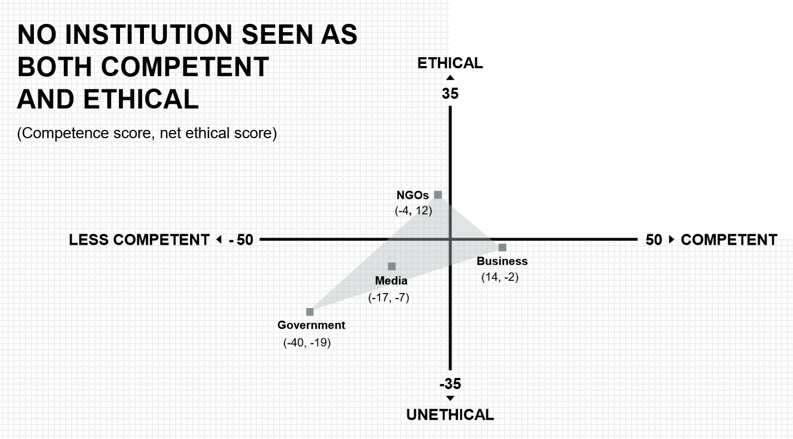
Disinformation brings distrust
Source: Edelman Trust Barometer 2020

Slide 17
Censorship goes private

Slide 18
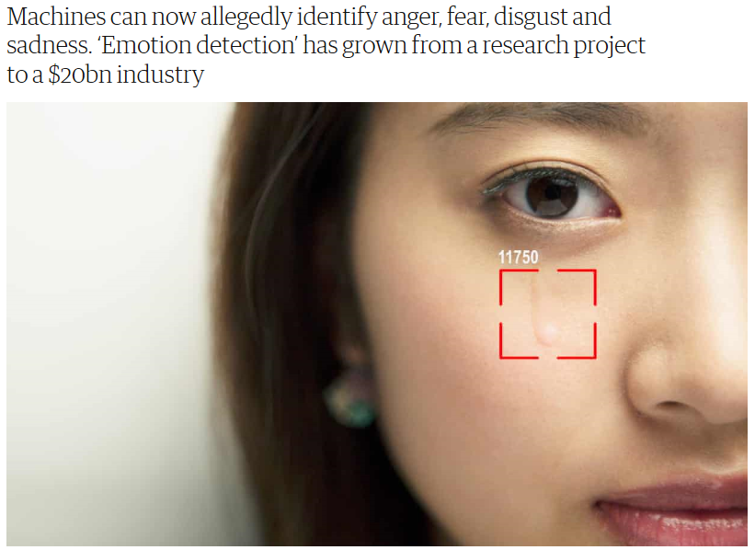
Machines are getting smarter
The Guardian

Slide 19
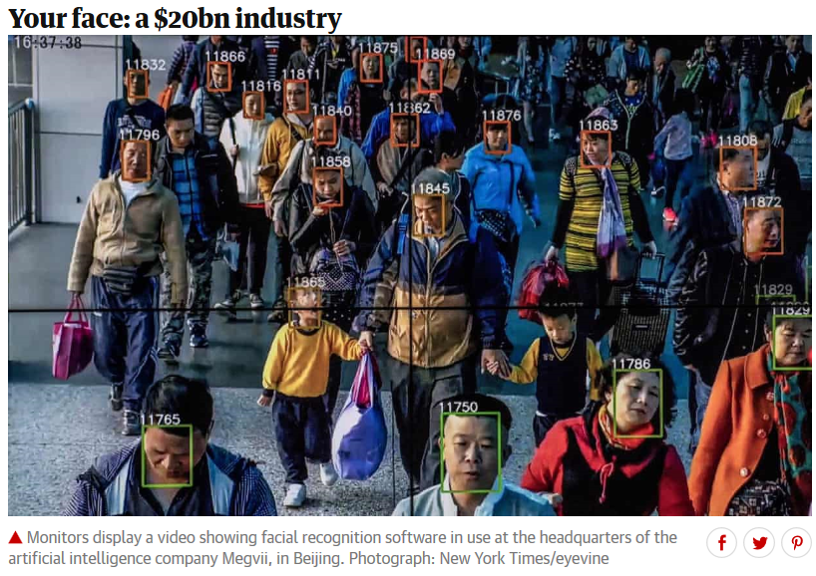
I am always watched
The Guardian
The Guardian

Slide 20
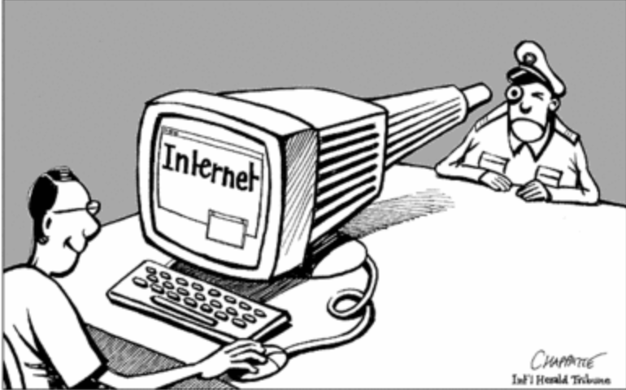
Surveillance becomes ubiquitous
Notes:
Picture 1:
https://foreignpolicy.com/2018/12/19/the-war-torn-web-internet-warring-states-cyber-espionage/
Picture 2:
https://rm.coe.int/internet-literacy-handbook/1680766c85

Slide 21
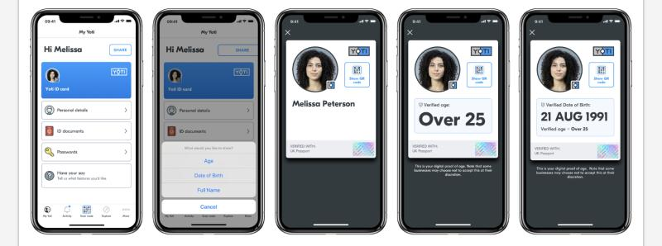
My personal data are public

Slide 22
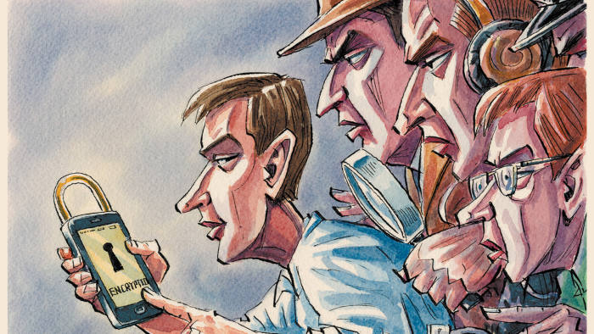
Privacy and public safety collide
Source: Do not let the spies weaken encryption, FT

Slide 23
AI selects my content
Source: Facebook Transparency Report
NUDITY
21 million removals
99,8% by AI
HATE SPEECH
2,5 million removals
38% by AI
Need clarity on boundaries
TERRORIST CONTENT
1,9 million removals
99,5% by AI
GRAPHIC VIOLENCE
3,4 million removals
85,6% by AI

Slide 24
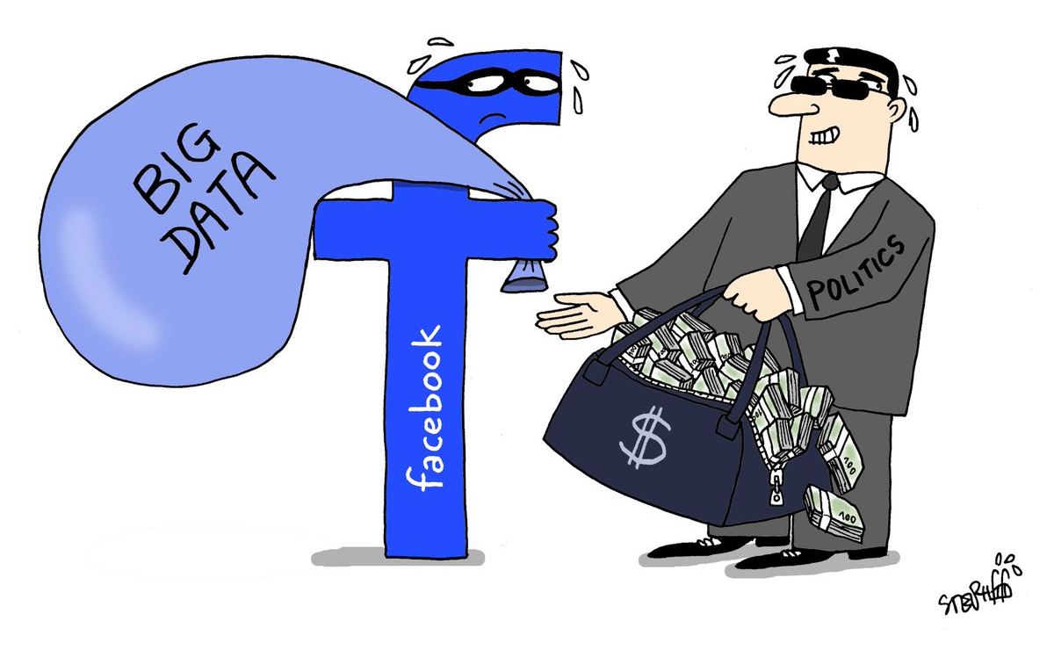
Big data becomes a commodity
Notes:
Picture 1:
https://gonsoeg.wordpress.com/journalism-2-0/an-information-society/
Picture 2:
https://rm.coe.int/internet-literacy-handbook/1680766c85

Slide 25
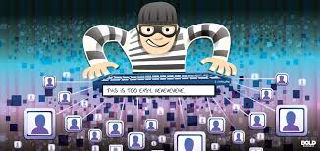
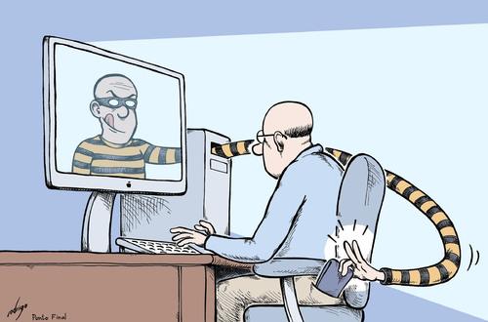
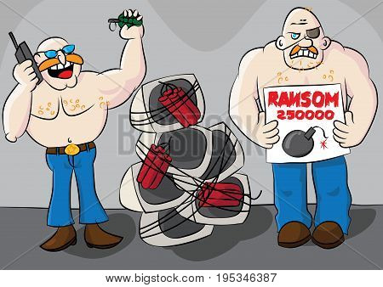
Cybercrime proliferates
Notes:
Picture 1:
https://foreignpolicy.com/2018/12/19/the-war-torn-web-internet-warring-states-cyber-espionage/
Picture 2:
https://rm.coe.int/internet-literacy-handbook/1680766c85

Slide 26
Vaccine data are hijacked
European Medicines Agency (EMA) documents on Moderna’s COVID-19 vaccine candidate were unlawfully accessed in a cyberattack.
The EMA, had been targeted in a cyberattack, which also gave hackers access to documents related to the development of the Pfizer Inc and BioNTech COVID-19 vaccine.
Moderna said its submission to the EMA did not include any information identifying individual study participants and there is no information at present that any participants had been identified in any way.
Source: Europol.Europa.eu
Notes:
Picture 1:
https://foreignpolicy.com/2018/12/19/the-war-torn-web-internet-warring-states-cyber-espionage/
Picture 2:
https://rm.coe.int/internet-literacy-handbook/1680766c85

Slide 27
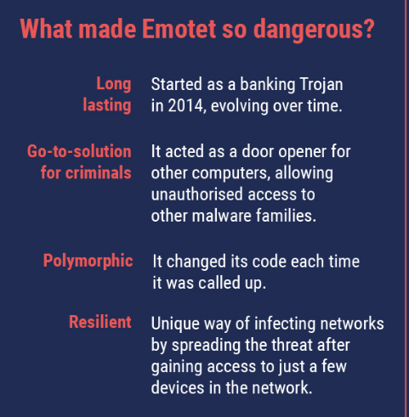
EMOTET attacks on 27 January 2021
Source: Europol.Europa.eu
Notes:
Picture 1:
https://foreignpolicy.com/2018/12/19/the-war-torn-web-internet-warring-states-cyber-espionage/
Picture 2:
https://rm.coe.int/internet-literacy-handbook/1680766c85

Slide 28
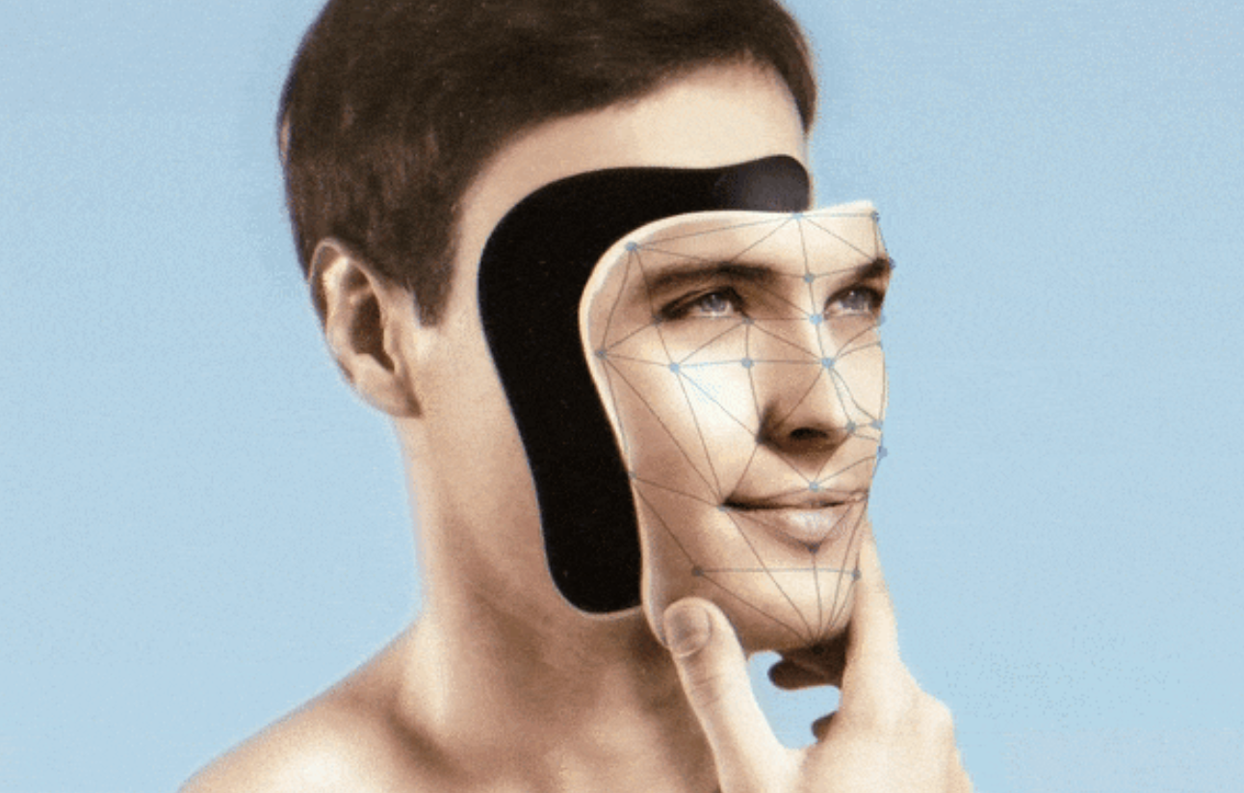
Is AI shaping humanity or saving it?
Notes:
AI
Picture 1:
https://www.newyorker.com/magazine/2018/11/12/in-the-age-of-ai-is-seeing-still-believing
Picture 2:
https://www.ozy.com/news-and-politics/artificial-intelligence-will-save-humanity-but-does-anyone-care/90195/

Slide 29
Am I a customer or a product?
29
Notes:
Picture 1:
https://www.jayzuubar.com/post/ielts-attention-economy
From IETLS textbooks
Picture 2:
https://www.theatlantic.com/health/archive/2016/07/can-this-app-make-me-happier/490049/

Slide 30
The new world is challenging
The world has never felt more unequal.
Will machine learning and robotics make humans economically redundant ?
Am I moral if I do nothing when there is a refugee crisis?
Algorithms already control much of our daily lives.
Societies are volatile...
No one knows what the future will look like !

Slide 31
Tomorrow will be different…
Artificial intelligence, quantum computing, 5G and the rise of the Internet of Things are just some of the emerging technologies that influence the way our society operates.
31

Slide 32
What is at risk?
Right to private and family life
Freedom of Expression
Right to participate in democratic processes, such as elections, free from undue influences

Slide 33
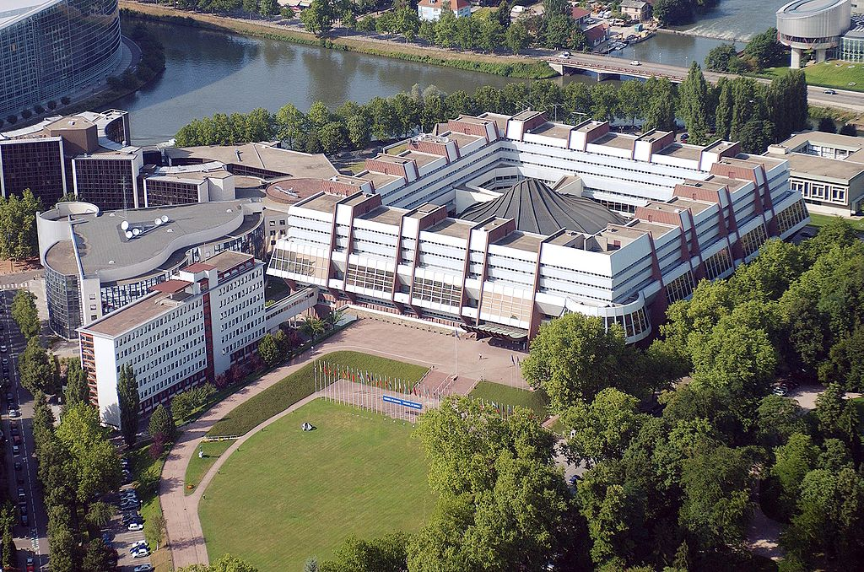
Information Society Department
TRIANGULAR
Methodology
STANDARDS
Recommendations
Conventions
Projects
Programmes
ASSISTANCE
Surveys Mechanisms
MONITORING

Slide 34
Managing the Information Society
Safeguarding Freedom of Expression
Protecting Privacy
5 expertise
areas
Combating Cybercrime
Developing Digital Governance
Framing Artificial Intelligence

Slide 35
Enhancing digital governance
Standards
Recommendation with regard to network neutrality
Recommendation on Internet freedom
Recommendation on the roles and responsibilities of internet intermediaries
Awareness raising
Study “Liability and jurisdictional issues in online defamation cases”
Cooperation
Partnership with Digital Companies
25 companies and associations

Slide 36
Priority Policy Development
2020 2021
Prepare a draft recommendation with guiding principles for media and communication governance in order to address the shift from established channels to social networks and of related risks (manipulation of public opinion, lack of public trust, information disorder)
Prepare a guidance note on regulatory/policy requirements, on prioritisation of public interest content on relevant social and search platforms and other news aggregators
Prepare a draft recommendation on election communication and media coverage of electoral campaigns
Promote diversity within the media
Strategy on media environment and reform

Slide 37
Digital Governance
2020 2021
Prepare a draft recommendation on the impacts of digital technologies on freedom of expression
Activities on possible responses to the phenomenon of misinformation and manipulation in the digital information ecosystem (“fake news”)
Prepare a guidance note on best practices by and with internet intermediaries and other stakeholders towards effective legal and procedural frameworks for self-regulatory and co-regulatory mechanisms for the restriction or moderation of illegal or harmful content
Contribute to the implementation of the Council of Europe Digital Governance Strategy 2020+
Strategy on the freedom of expression and digital technologies

Slide 38
Artificial Intelligence
2020 2021
Develop a feasibility study and potential elements based on broad multi-stakeholder consultations, of a legal framework for the development, design and application of artificial intelligence based on Council of Europe standards.
CAHAI Intergovernmental Ad Hoc Committee on Artificial Intelligence
Strategy on human rights impacts of artificial intelligence

Slide 39
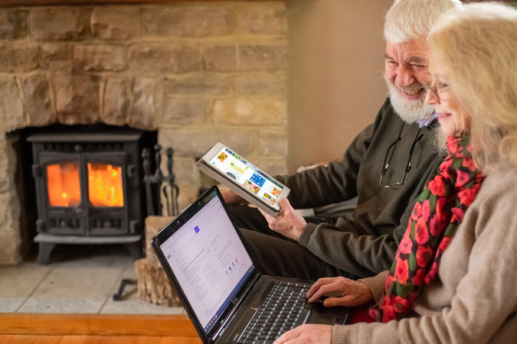
Digital developments bring opportunities…
healthcare services
smart watches (health-monitoring)
medical video-consultation
communication with the loved ones
self-driving cars
online services (travel booking, online shopping, finances planning, household expenses)
studying and access to information (kindle, podcasts)
Notes:
Picture 1:
https://www.jayzuubar.com/post/ielts-attention-economy
From IETLS textbooks
Picture 2:
https://www.theatlantic.com/health/archive/2016/07/can-this-app-make-me-happier/490049/

Slide 40
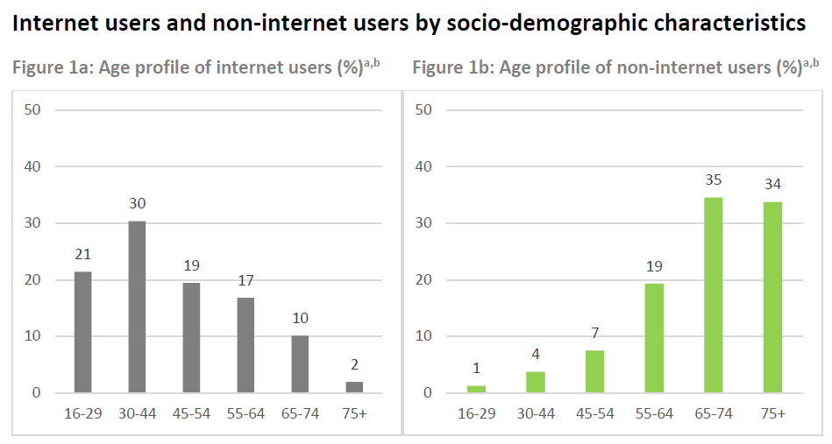
But seniors are less connected…
20% of people aged 75 years and older use the internet at least occasionally, in comparison with
98% of 16-29-year-olds
Source: FRA’s Fundamental Rights Survey

Slide 41
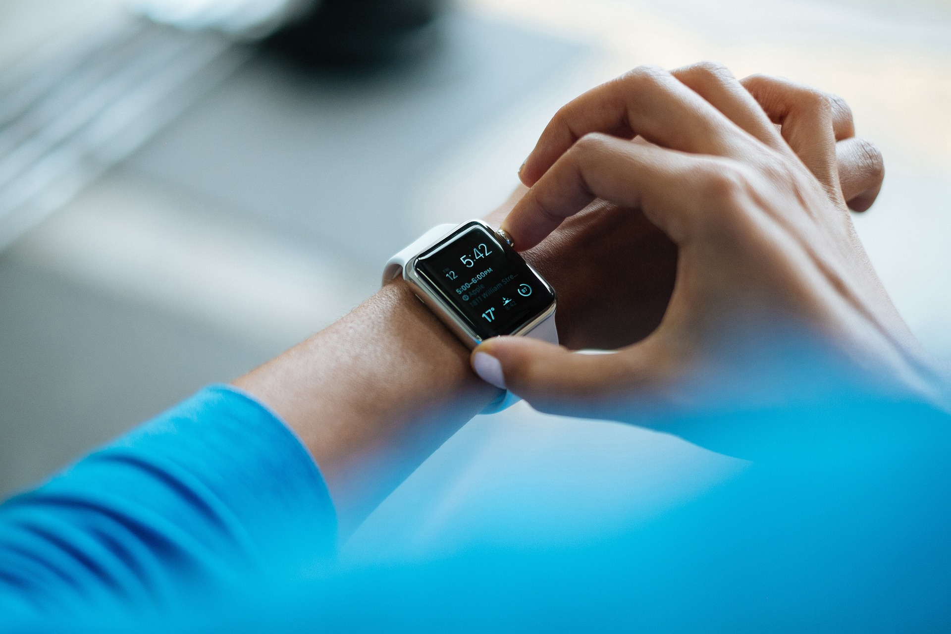
Technology facilitates access to medical services
Notes:
Picture 1:
https://www.jayzuubar.com/post/ielts-attention-economy
From IETLS textbooks
Picture 2:
https://www.theatlantic.com/health/archive/2016/07/can-this-app-make-me-happier/490049/

Slide 42
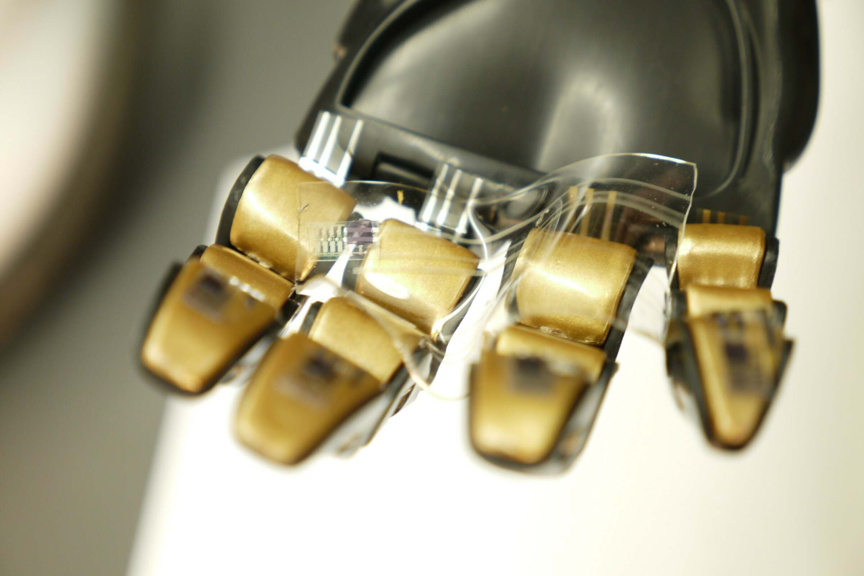
“Electronic skin can not only supplement our human skin but can also genuinely replace it”
Source: KU Leuven
© Bao Lab, Stanford
Notes:
Picture 1:
https://www.jayzuubar.com/post/ielts-attention-economy
From IETLS textbooks
Picture 2:
https://www.theatlantic.com/health/archive/2016/07/can-this-app-make-me-happier/490049/

Slide 43
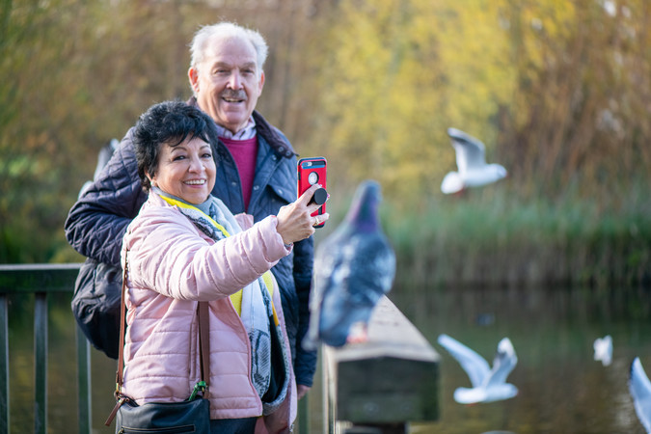
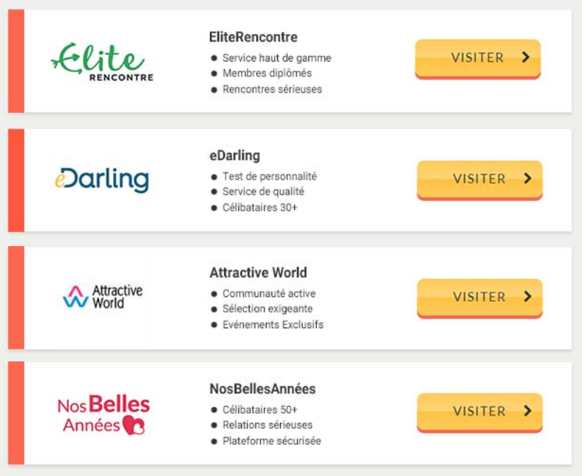
and communication…
43
Notes:
Picture 1:
https://www.jayzuubar.com/post/ielts-attention-economy
From IETLS textbooks
Picture 2:
https://www.theatlantic.com/health/archive/2016/07/can-this-app-make-me-happier/490049/

Slide 44
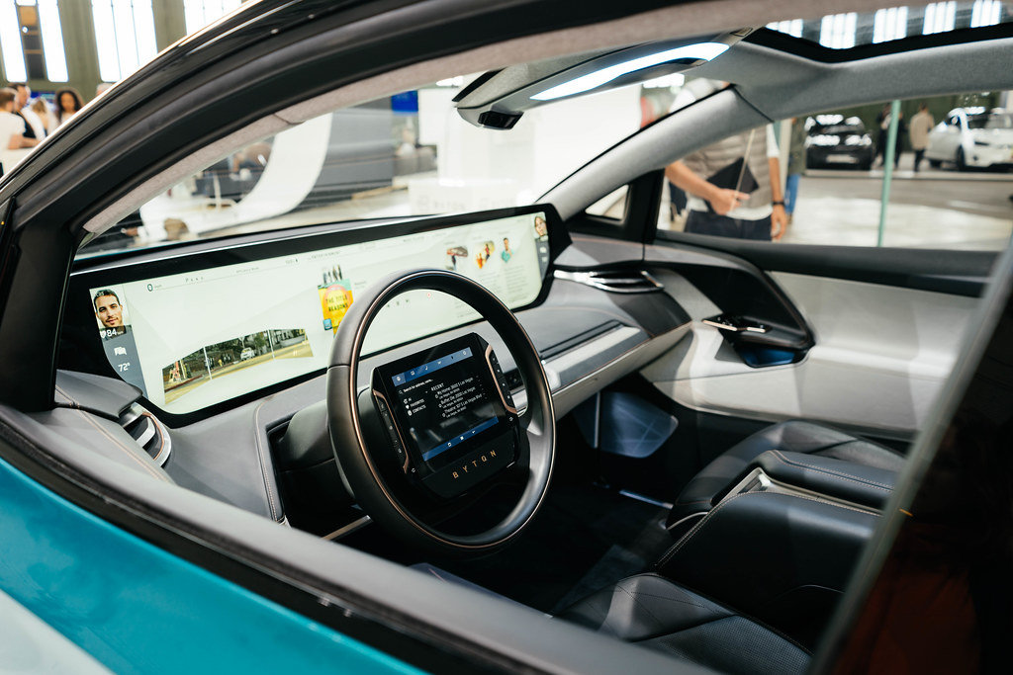
A future of driverless cars?
a future of driverless cars
Automated technologies assist drivers and help to prevent accidents
Notes:
Picture 1:
https://www.jayzuubar.com/post/ielts-attention-economy
From IETLS textbooks
Picture 2:
https://www.theatlantic.com/health/archive/2016/07/can-this-app-make-me-happier/490049/

Slide 45
There is a whole range of online services accessible
Notes:
Picture 1:
https://www.jayzuubar.com/post/ielts-attention-economy
From IETLS textbooks
Picture 2:
https://www.theatlantic.com/health/archive/2016/07/can-this-app-make-me-happier/490049/

Slide 46
Council of Europe and seniors
Commissioner for Human Rights, Ms Dunja Mijatović’s statement on the older persons in the age of the Covid-19 pandemic
Recommendation 2014/2 of the Committee of Ministers on the promotion of human rights of older persons
CDDH Report on the implementation of the Committee of Ministers’ Recommendation CM/Rec(2014)2
Compilation of the member States‘ replies regarding the implementation of Recommendation CM/Rec(2014)2
CDDH Workshop on the promotion of human rights of older persons (Strasbourg, June 2018)
ECHR case-law on older people and ageing

Slide 47
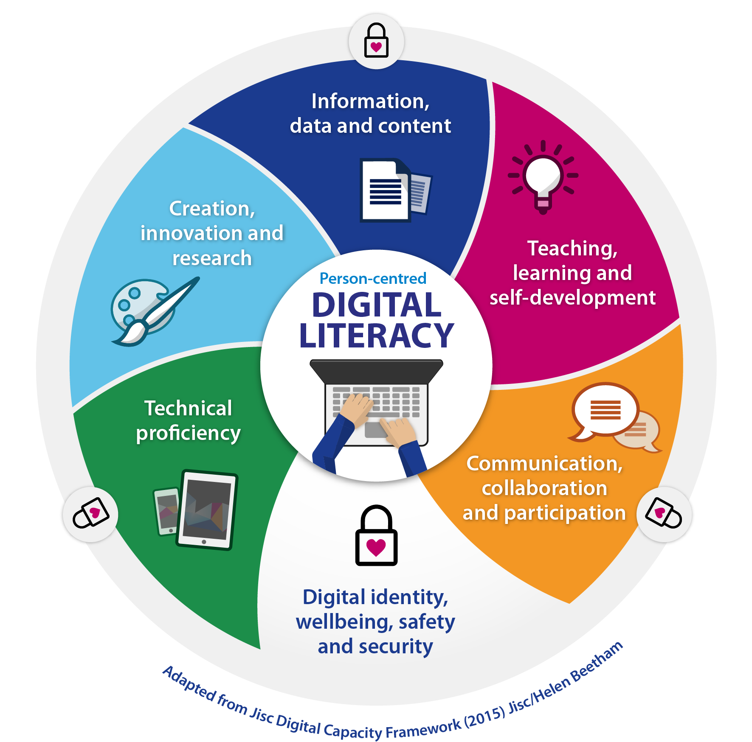
Rights of seniors in the digital world
Recommendations by the Committee of Ministers
Internet freedom
The right to private life with regard to network neutrality
Guide to Human Rights for Internet Users
Studies
Algorithms and Human Rights
Internet and Electoral Campaigns
Spaces of Inclusion
Media Literacy for All

Slide 48
What’s next?
acknowledge the challenges that the users of the older generation are facing in dealing with the digital environment
enhance media and information literacy for all, including older people

Slide 49
The Ministerial Conference “Artificial intelligence - Intelligent politics: Challenges and opportunities for media and democracy” (10-11 June 2021) will lead to the adoption of a final declaration and four resolutions:
the impact of AI-powered products and processes on freedom of expression;
possible regulation to ensure more transparency in the dissemination of news and information;
safety of journalists and other media actors;
impact of the COVID-19 pandemic on freedom of expression - media and information literacy empower individuals to recognise and develop resilience against crisis-related mis- and disinformation (“infodemic”)

Slide 50
Information Society Department
Thanks for your attention !
further resources:
www.coe.int/freedomofexpression
www.coe.int/internetgovernance
www.coe.int/dataprotection
www.coe.int/cybercrime
www.coe.int/AI
Facebook Page Information Society Group

