Slide 1

Estonian e-government and e-health
Peeter.Ross@taltech.ee
Prof. Peeter Ross, MD, PhD
Health Care Technology – DMK1021
Tallinn University of Technology
East Tallinn Central Hospital, Radiologist
The World Bank, Asian Development Bank, KfW German Development Bank - Consultant
SMIS International OÜ, SafeToAct OÜ – Owner

Slide 2

Content
Estonian ID and e-government architecture
Short overview about Estonian public e-services
Estonian Nation-wide Health Information System (EHIS)
Main findings of 15 years experience
Future trends and motivation to innovate

Slide 3
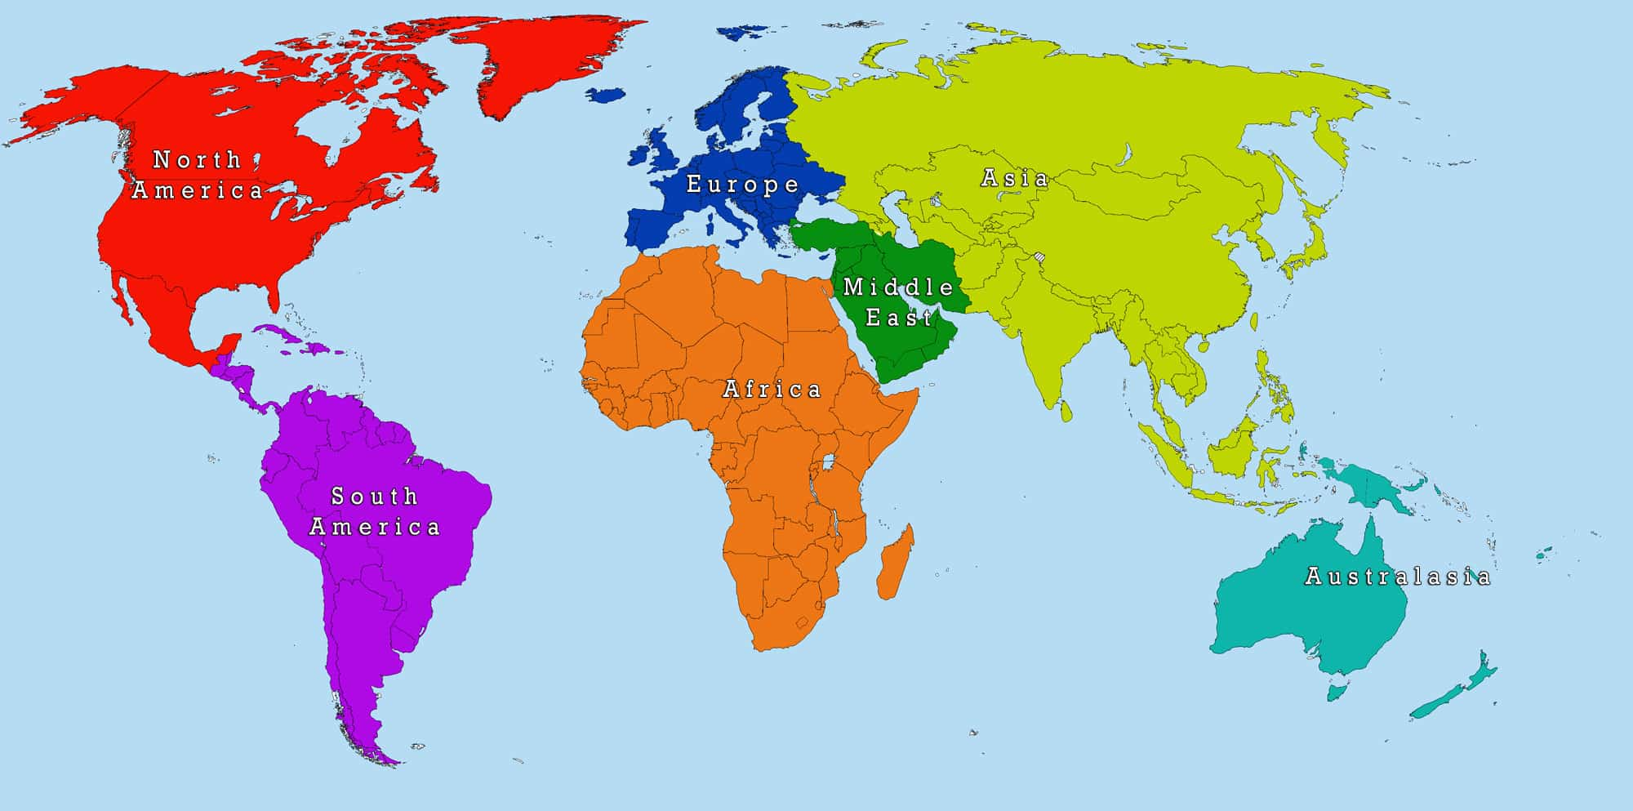
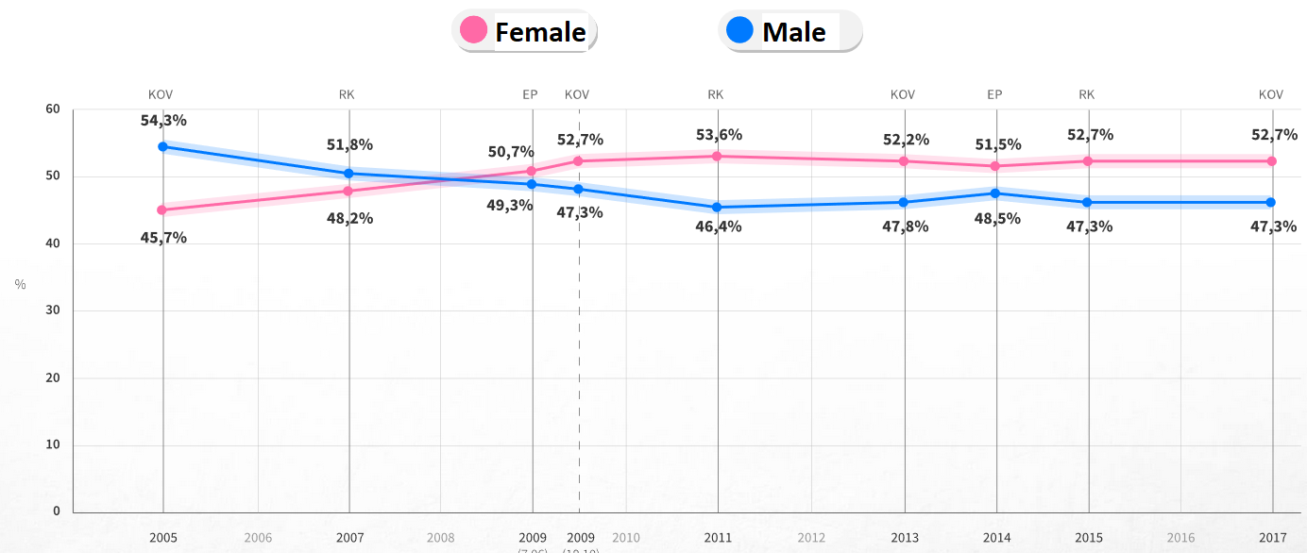
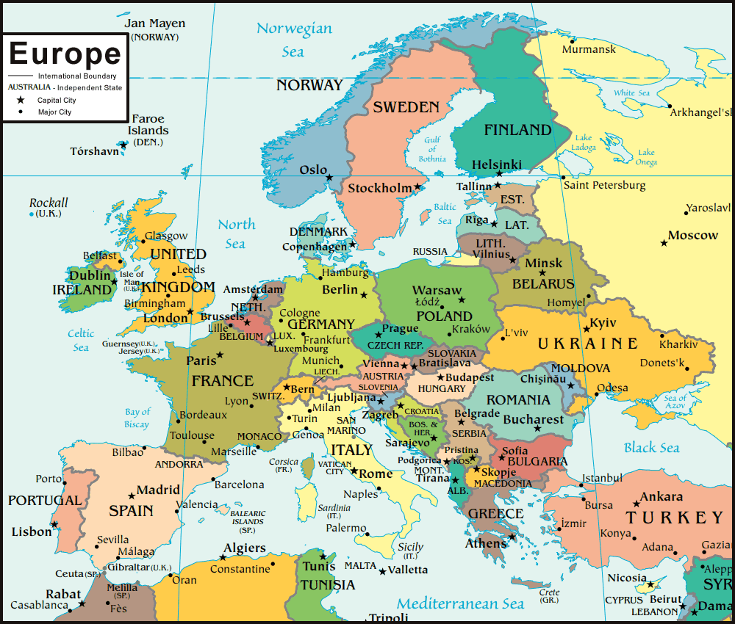
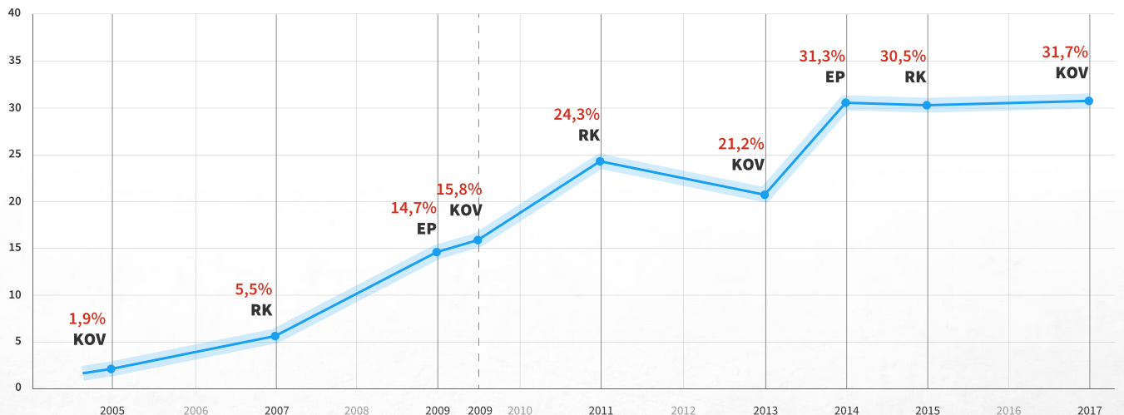
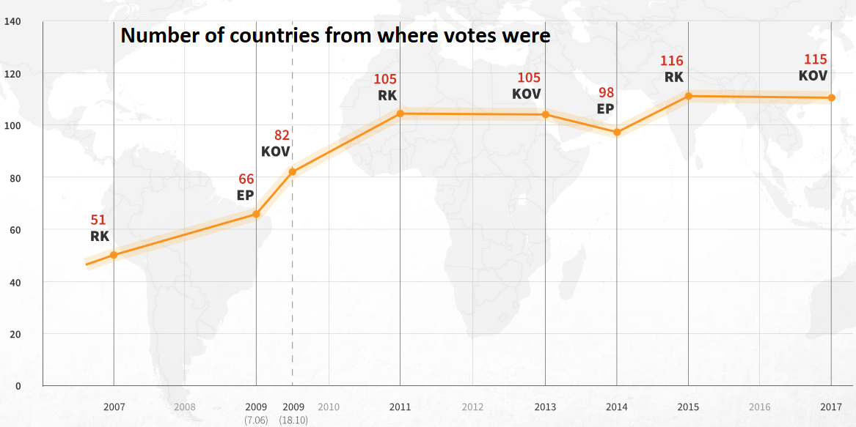






Facts about Estonia
Basic facts
  Population is 1.3 million
  Every citizen has unique ID-code – similar to Aadhaar
Health care system
  Compulsory solidarity-based health insurance
  paid by employers; 13% of payroll tax (95%)
Health spending as a share of GDP make up to 6.7% in 2019 (9% in OECD)
  Healthcare providers are private, municipal or governmental
  Hospital system – publicly owned private hospitals
  General practitioners are private entrepreneurs
Facts about e-services
  99% of public services are online
  99% financial transactions (bank transfers) carried out electronically
  98% of income tax declarations are made via the E-Tax Board (2020)
  46.6% of votes were cast over the internet on (2021)
  >80 000 e-Residents from around the world
      General
      NATO Cooperative Cyber Defense Centre is located in Estonia (2008)
      Skype, Wise, Bolt, etc. are made in Estonia
Notes:
Estonia has solidarity based, mandatory health insurance covering 95% of the population.

Slide 4
Estonian ID-code.
Public Key Infrastructure – PKI (1)
Citizens and residents are each assigned a unique personal identification code (isikukood)
The Estonian technical standard describing the structure of a “isikukood” (in English, “personal id code”) is dated with 1990
  ID-code consists of 11 digits
Personal numbers are the most important identifiers in an e-State
  these IDs are the only correct way to distinguish persons with the same name from each other

Slide 5
Estonian ID-code.
Public Key Infrastructure – PKI (2)
The Estonian identity card
  Compulsory smart card issued by the Police and Border Guard Board
  Card´s chip stores: Name, Gender, ID-code, cryptographic keys and public key certificates
  Enables secure digital authentication and signing.
The infrastructure also allows forwarding data by using an encrypting key pair: a public encryption key and a private decryption key.
  In Estonia, this technology is used in relation with electronic identity (ID card, mobile ID, digital ID)

Slide 6
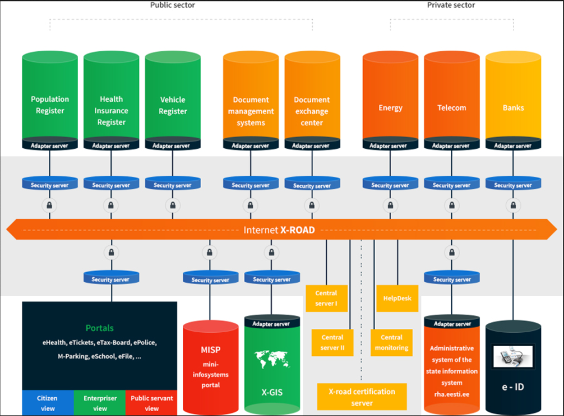
Estonian e-state architecture
https://www.ria.ee/public/x_tee/X-road-factsheet-2014.pdf

Slide 7
X-road – Secure Internet Based Data Exchange Environment
Provides confidentiality
  Who can access the information and on what conditions
Avoids uncontrolled centralization of data into a single database
Ensures data integrity
  Data will stay only in one „original“ location
Distributes power of information ownership
  The more data, the bigger power
All the X-Road communications are encrypted
  X-Road puts up TLS/SSL tunnels only when data is actually being exchanged

Slide 8
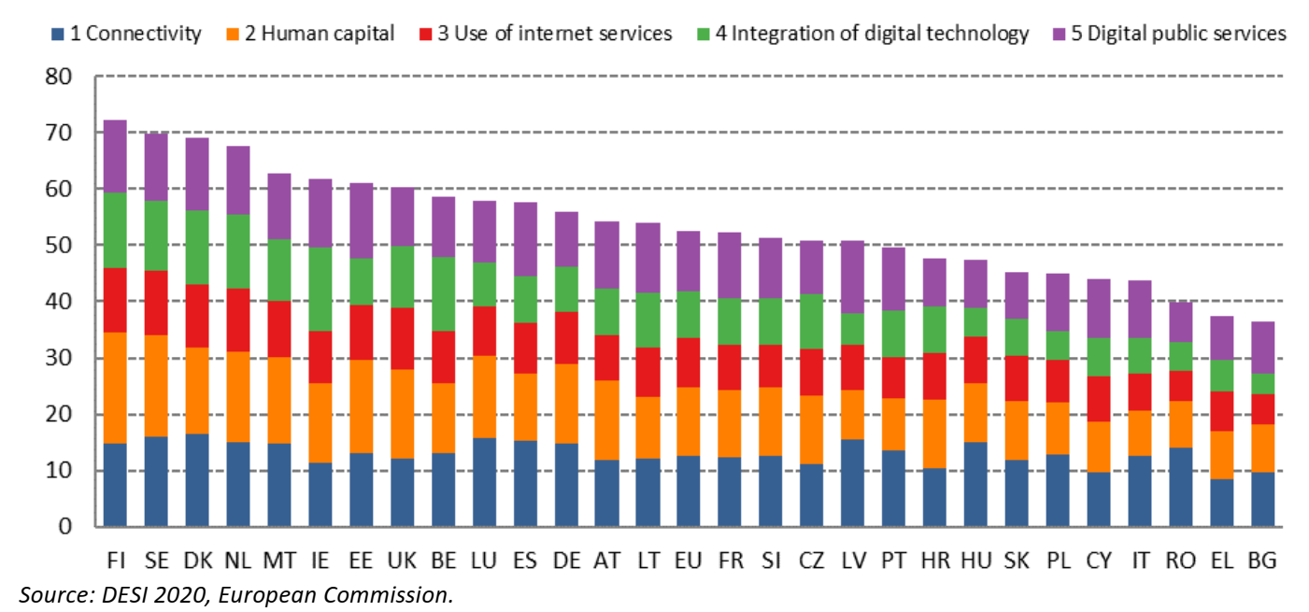
EU Digital Economy Scoreboard (2020 survey)
SOURCE: European Commission DESI Index https://ec.europa.eu/digital-single-market/en/desi

Slide 9

Estonian Nation-wide Health Health Information System
Since 2008

Slide 10
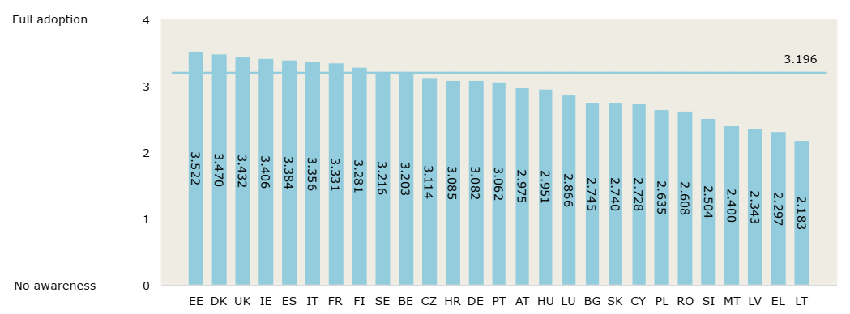
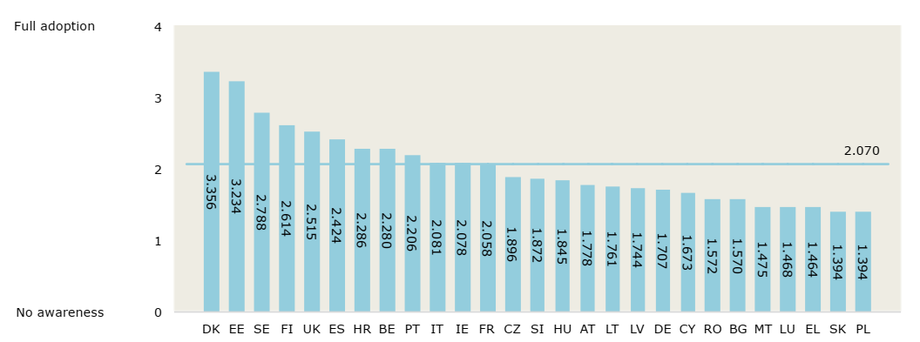
Estonian Health Information System (EHIS) ranked first in EU
Benchmarking Deployment of e-Health among
General Practitioners. EU (2018)
Electronic Health Record Adoption
The Estonian Health Information System is unique as it:
  Encompasses the whole country
  Registers virtually all residents’ health history from birth to death, and
  Is based on the comprehensive standard-based IT infrastructure
  Medical data exchange is mostly digital in all healthcare levels.
Health Information Exchange Adoption
Healthcare professionals
Patients / Individuals

Slide 11
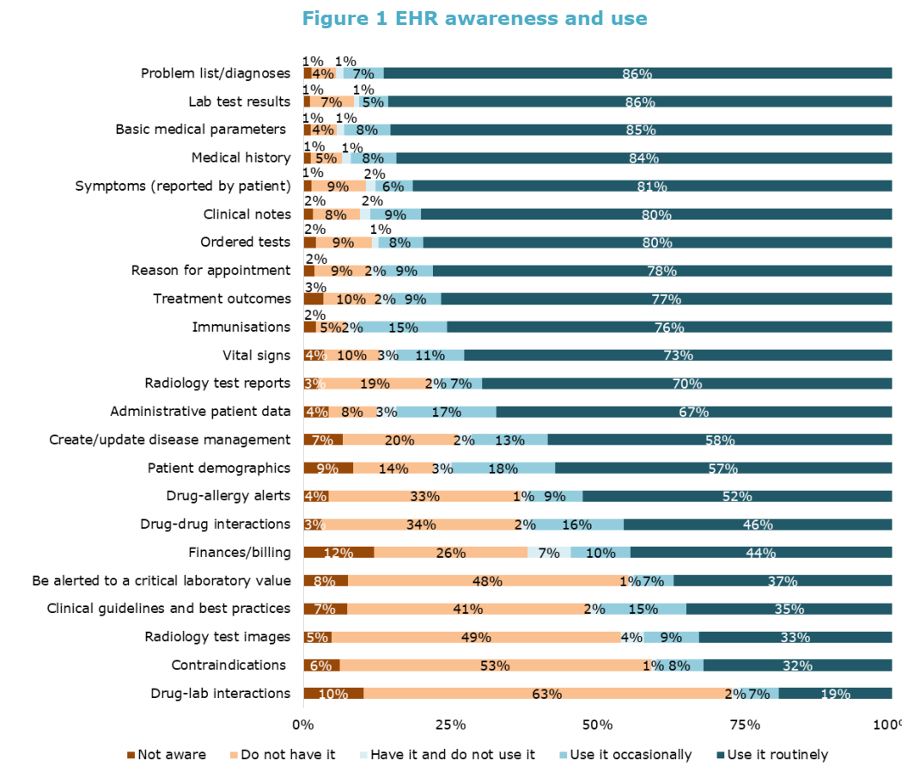
Benchmarking Deployment of e-Health among General Practitioners. EU (2018)
Benchmarking Deployment of e-Health among General Practitioners. EU (2018)

Slide 12
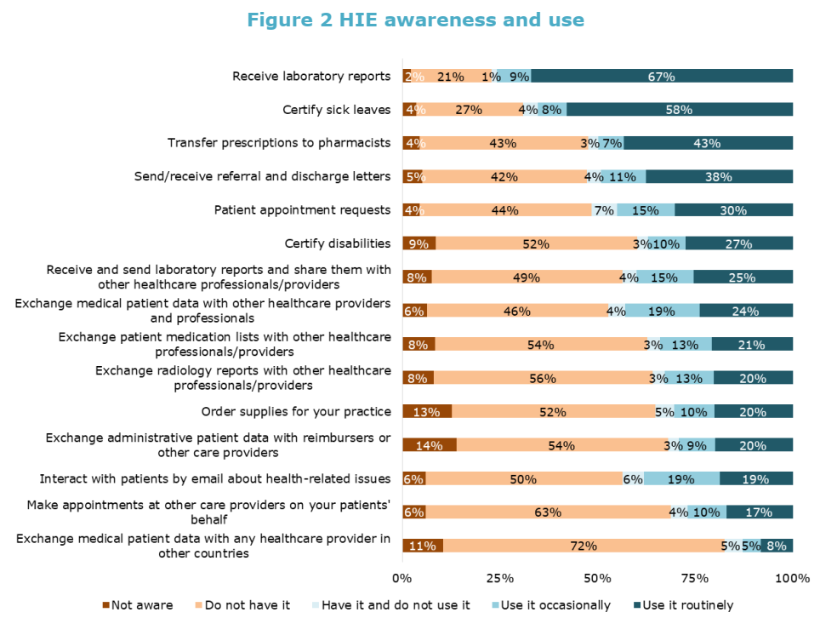
Benchmarking Deployment of e-Health among General Practitioners. EU (2018)

Slide 13
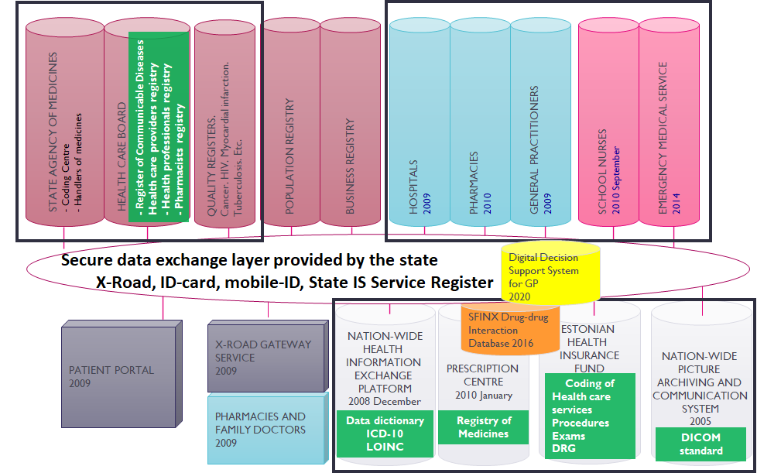
Architecture and services of estonian health information system (since 2008)
DRIVING LICENCE
HEALTH CERTIFICATE
APPLICATION 2015

Slide 14
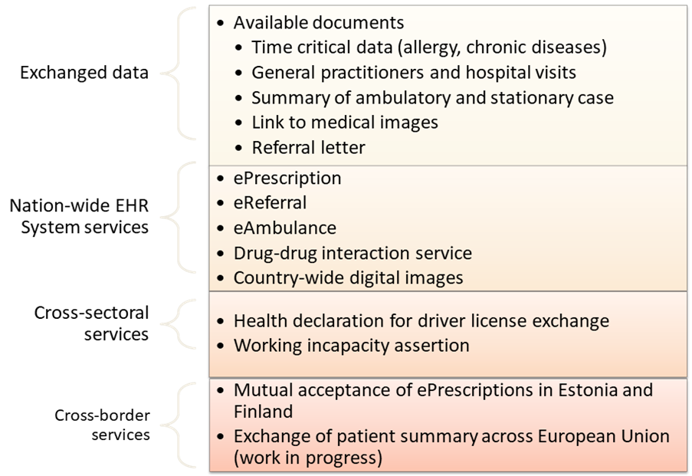
Estonian Health Information System – available data and services

Slide 15
Main drivers
Computerization and computer skills in grass root level
Hospitals and Primary Care Physicians had mature information systems
Secured financing
Ministry of Economy and Communication
  Not Ministry of Health (eHealth is not in top 3 priority)
Clear governance of Estonian eHealth services
  Estonian Health and Welfare Information Centre (Estonian E-Health Foundation)
Legal clarity
Mature ecosystem for e-services in Estonia
Secure data exchange platform provided by the state
Established on-line identification methods
ID-card
Mobile-ID
Agreement about access rights
Standardization
Medical and health data
Data exchange

Slide 16
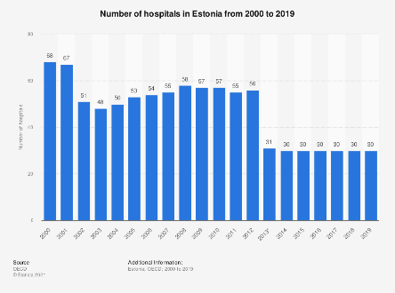
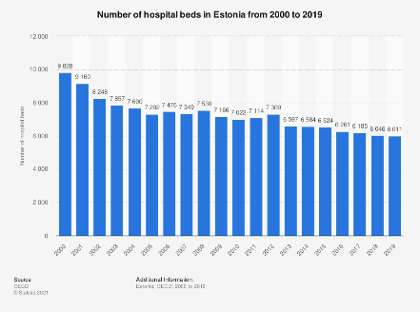
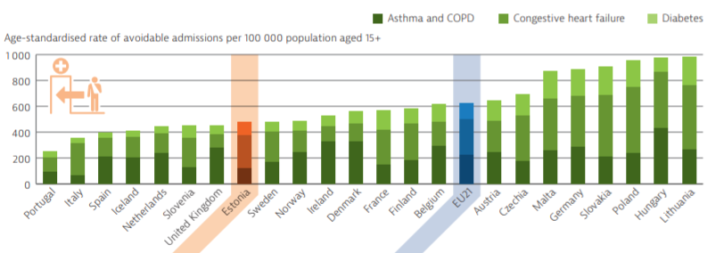
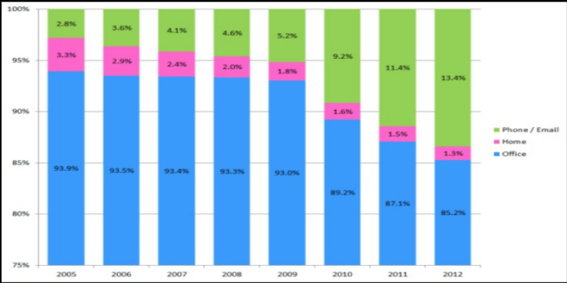
Digital health Improving efficiency
Less hospitals and hospital beds
More treatment is provided by primary healthcare and out-patient settings
Avoids unnecessary hospital admissions
Shorter visits
Lower costs of healthcare by removing duplications in diagnostics and treatments, fictive treatments and wrong prescriptions, errors in diagnostic, treatments and prescriptions.
Lower costs of administrative activities
In Estonia, healthcare digitalization reduced the need for physical infrastructure and made the requirements for physical infrastructure different.
Proportion of primary health care consultations by type.

Slide 17
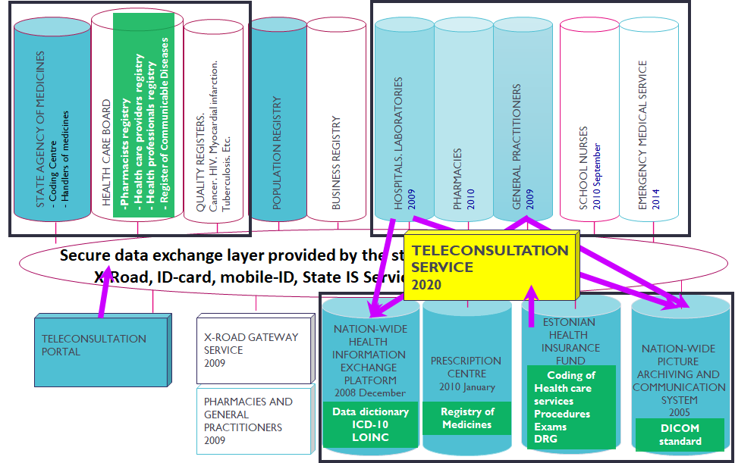
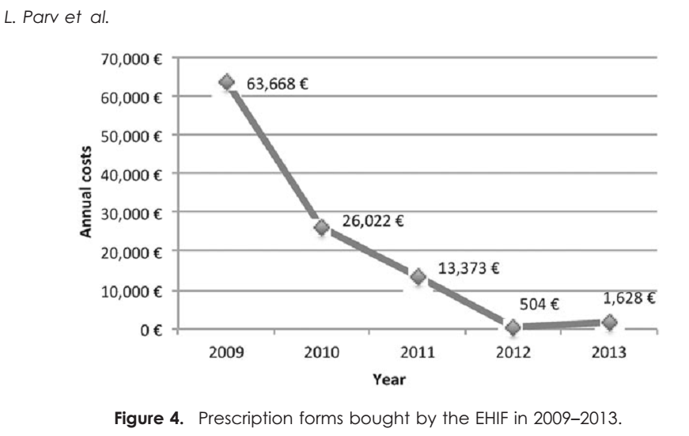
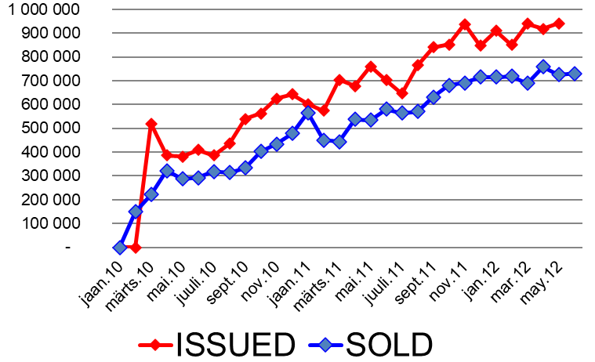
Digitalization enables new services – improved Effectiveness
Access to medical records and life-long health records is reliable and efficient
New widely accepted e-services:
  Digital prescription (100%)
  E-referral
  E-consultation
  Online issuance of health certificates and incapacity for work certificates
Instant share of information between providers and levels of care allows integrated care
  Patient empowerment
Increased patient and health professionals’ mobility (telemedicine)

Slide 18
Drug-drug Interaction Database service (since 2016)
STATE AGENCY OF MEDICINES
- Coding Centre
- Handlers of medicines
HEALTH CARE BOARD
- Health care providers
- Health professionals
- Dispensing chemists
QUALITY REGISTERS.
Cancer. HIV. Myocardial infarction.
Tuberculosis. Etc.
POPULATION REGISTER
BUSINESS REGISTER
HOSPITALS
INFORMATION SYSTEMS
2009
FAMILY DOCTORS
INFORMATION SYSTEMS
2009
PHARMACIES
2010 January
SCHOOL NURSES
2010 September
AMBULANCE
MOBILE
WORK
STATIONS
INTERACTION
ALERT
A, B, C, D
PRESCRIBED INGREDIENT
CURRENT MEDICINE
PRESCRIPTION
PRESCRIBED INGREDIENT
EMERGENCY
MEDICAL
SERVICE
2014
Secure data exchange layer provided by the state
X-Road, ID-card, mobile-ID, State IS Service Register
SFINX
Drug-drug
Interaction database
2016
X-Road, ID-card, State IS Service Register
NATION-WIDE
HEALTH
INFORMATION
EXCHANGE
PLATFORM
(EHIS)
2008 December
ESTONIAN
HEALHT
INSURANCE
FUND
2001
PRESCRIPTION
CENTRE
2010 January
NATION-WIDE
PICTURE
ARCHIVING AND
COMMUNICATION
SYSTEM
2005
NO
VPN
PATIENT PORTAL
2009
X-ROAD GATEWAY SERVICE
2009
YES
ESTONIAN
GENOME
CENTER
UNIVERSITY
OF
TARTU
PHARMACIES AND FAMILY DOCTORS
2009

Slide 19
eServices crossing institutional borders
STATE AGENCY OF MEDICINES
- Coding Centre
- Handlers of medicines
HEALTH CARE BOARD
- Health care providers
- Health professionals
- Dispensing chemists
QUALITY REGISTERS.
Cancer. HIV. Myocardial infarction.
Tuberculosis. Etc.
POPULATION REGISTER
BUSINESS REGISTER
HOSPITALS
INFORMATION SYSTEMS
2009
FAMILY DOCTORS
INFORMATION SYSTEMS
2009
PHARMACIES
2010 January
SCHOOL NURSES
2010 September
AMBULANCE
MOBILE
WORK
STATIONS
EMERGENCY
MEDICAL
SERVICE
2014
Secure data exchange layer provided by the state
X-Road, ID-card, mobile-ID, State IS Service Register
SFINX
Drug-drug
Interaction database
2016
X-Road, ID-card, State IS Service Register
DRIVING LICENCE
HEALTH CERTIFICATE
APPLICATION
2015
NATION-WIDE
HEALTH
INFORMATION
EXCHANGE
PLATFORM
(EHIS)
2008 December
ESTONIAN
HEALHT
INSURANCE
FUND
2001
PRESCRIPTION
CENTRE
2010 January
NATION-WIDE
PICTURE
ARCHIVING AND
COMMUNICATION
SYSTEM
2005
PATIENT PORTAL
2009
X-ROAD GATEWAY SERVICE
2009
VPN
ESTONIAN
GENOME
CENTER
UNIVERSITY
OF
TARTU
PHARMACIES AND FAMILY DOCTORS
2009

Slide 20
lEvels of digitalization in different health care domains in estonia
Content and main users | Properties | Level of implementation | Responsible organization
Provision of health care services – diagnostics and treatmment PHYSICIANS and PATIENTS | Operational data – Electronic Medical Records, RIS, LIS, PACS | +++ | Ministry of Social Affairs, E-health Foundation
Health care institution management HOSPITAL MANAGERS | Business intelligence, performance indicators | + | Ministry of Social Affairs, E-health Foundation
Health data analytics – research, reporting, public health data RESEARCHERS | Disease prevalence, health indicators, disease registries | + | National Institute for Health Development
Health care and policy indicators GOVERNMENT and LOCAL AUTHORITIES | Health care services’ planning, key performance indicators and reports, and healthcare policy making | - | Ministry of Social Affairs, Statistics Estonia
Health care financing INSURANCE | Reimbursement, reporting of medical activities | ++ | Estonian Health Insurance Fund
Third party services for patient CITIZEN / PATIENT DIGITAL HEALTH INDUSTRY | Provision of tools and services for patient, e.g., activity monitoring, diet, etc. | +- | Ministry of Social Affairs, E-health Foundation

Slide 21

Motivation to create new services – lessons learnt and what are Estonia’s challenges?
Analytical services are difficult to implement due to poor data quality – a lot of free text and limited amount of structured data
  Data exchange dominated over data quality
Third-party involvement is cumbersome because of single owner of digital health platform
  Estonian digital health platform is limited mostly to government provided services
  Development of new services is slow
  Consent mechanisms are not available for third party services
  Medical data is not what people are looking for – they are looking for services

Slide 22
NEXT opportunities for digital health platform
Data services – high data quality is a prerequisite
Decision support for data entering – increased data quality
Health, medical and social care services
Cross-sectoral or cross-border services
Integration of social and health care services
Creation of specialty specific registries, classifications, terminologies
Analytics – care quality and performance
Integration of different personal health/activity/life-style records with governmental health care services
Creation of market for medical services
Opening medical market for innovation from other sectors
Wider use of apps in health and medical care
Consent engine for users

Slide 23
SUMMARY OF THE EVOLUTION IN THE DIGITALIZATION OF HEALTH DATA TO DATE
  Paradigm change in healthcare professional´s mindset – primary data users
  Data ownership change
  Formalization of entered data
  Gradual change of data usage
  Acceptance of more extensive involvement of citizen/patient
  Use of shared health, social and medical data
  Important to understand different use cases of digital health data
    Enter once and use multiple times
  Change of workflows and pathways in healthcare
  From linear to matrix
  More pre-analyzed data – big data services
  Distributed digital system must prevent malicious modifications – hashchain.
  Estonian EHIS has designed for the use of medical data

Slide 24
Aspects of large-scale Health Information System implementation
Implementation of large-scale Digital Health Platform is incredibly complex
  usually involves several organizations, multiple sectors of the health care system, and multiple departments within a single large organization;
Competency in building of good working relationships and forming partnerships is a prerequisite for the ability to collaborate
  Digital Health Platform involves a wide variety of data sources and data users:
    Healthcare professionals, patient, relatives, scientists, policy makers, healthcare managers and financers, entrepreneurs, etc.;
The importance of common capacity building as a foundation for effective collaboration applies to all aspects of implementation, as well as formulation of strategy and policy, development of specifications, and service design.
Effective collaboration and governance allow quick resolution of issues, and more efficient implementation.

Slide 25
Conclusions
Governance is critical – importance of responsible organization
  Government must walk a fine line between control and delegation
Important to address privacy and consent issues early with broad input
Agree about the unambiguous personal/patient identification system
It is essential to ensure clinician involvement throughout all steps
  Do not underestimate the importance of change management
Education and training cannot be overemphasized
Build a critical mass of business cases for use of the system
  Make sure these are based on real business needs to ensure adoption and sustainability
Adopt international data standards and data exchange standards early in the program and ensure they are fully enabled in the interoperability platform architecture
Start small and build incrementally
  Don’t go for a “big bang” approach. Don’t go for a “one size fits for all” approach but allow for institutional tailoring.

Slide 26

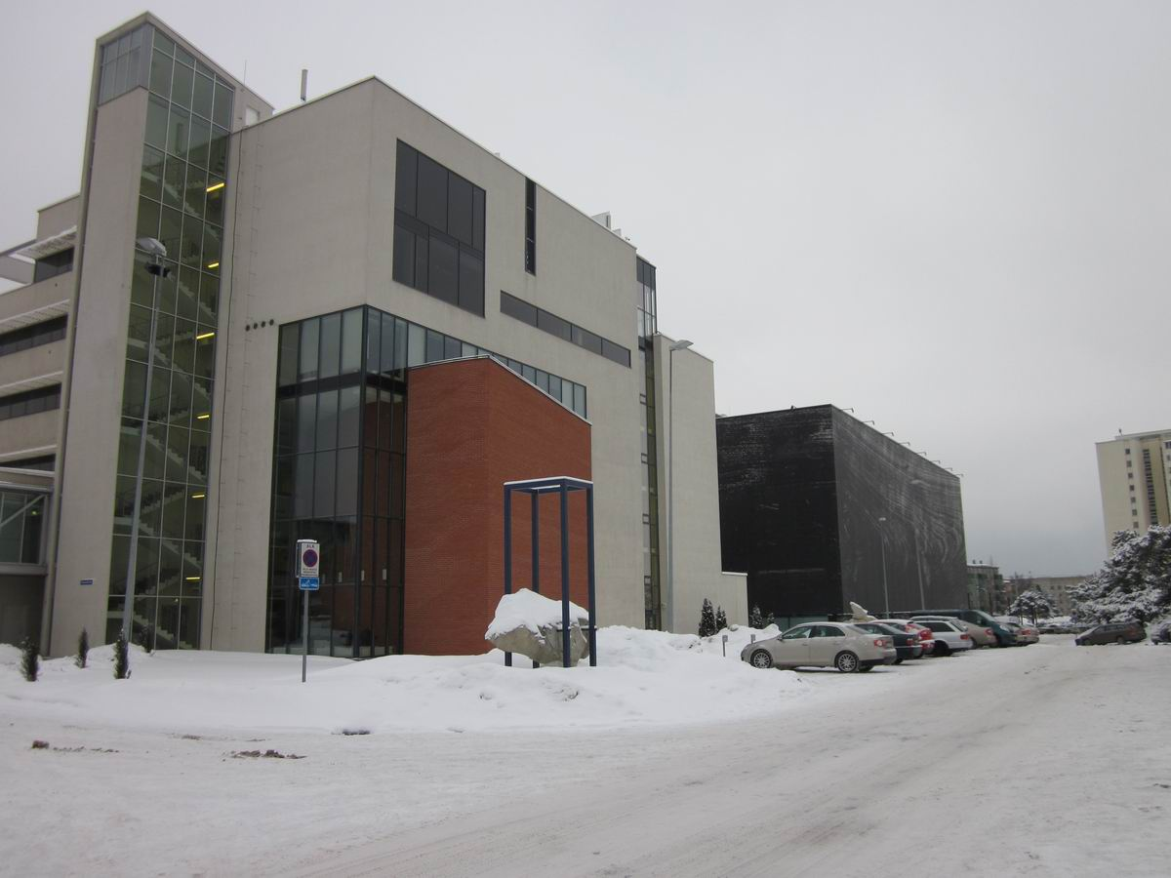

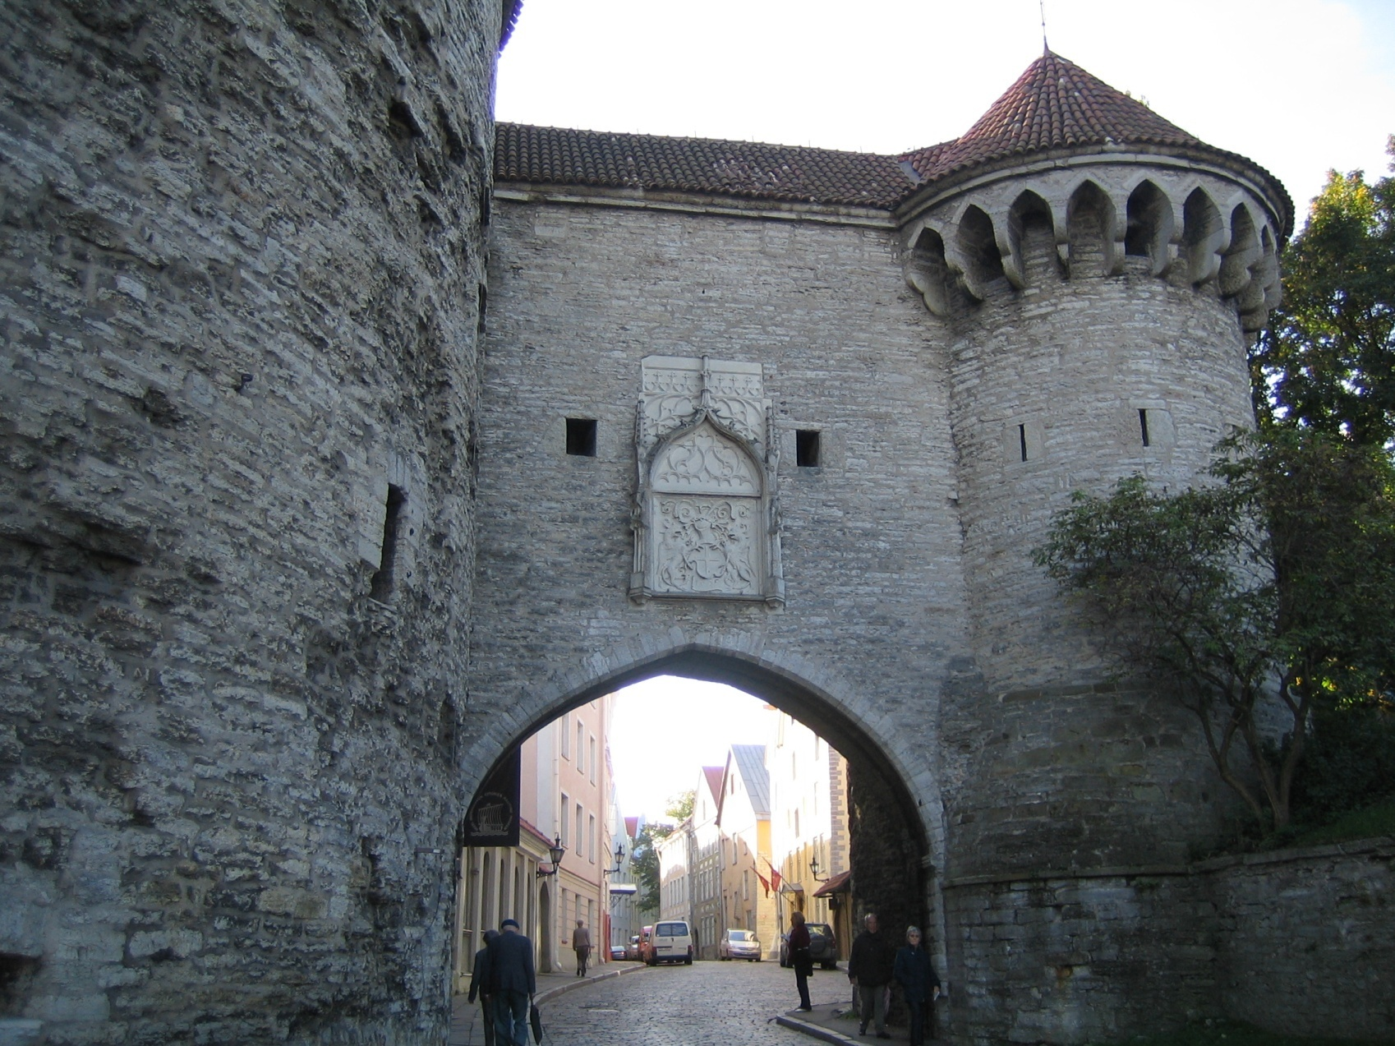
Thank you!
Peeter.Ross@taltech.ee

