Slide 2
30 June 2017
Demographic changes and migration in Europe
European Summer Academy for Leading Seniors
Vienna, Austria
Vít Novotný

Slide 3
Demographic panic in Europe
Demographic ageing
Immigration into Europe
Emigration from Southern and Eastern Europe

Slide 4
1. Demographic Ageing
Causes
Low fertility rates
Increase in living standards
Advances in medicine

Slide 5
1. Demographic Ageing
Long-term and world-wide phenomenon
Life expectancy in the Netherlands in the year 1800: 38
Life expectancy in Congo in 2000: 50

Slide 6
1. Demographic Ageing
Fertility:
Long term decline
1.6 live birth per woman
vs. replacement level of 2.1
Lowest in Southern and Eastern Europe
Life expectancy:
Constant increase: 3 years higher between 2003 (78) and 2013 (81)

Slide 7
1. Demographic Ageing
Socio-economic consequences
High social expenditure in general
Old-age dependency ratio (popul. aged 65 or over in relation to population aged 15-64) is increasing
19% in Slovakia 33% in Italy
Age-related expenditure to increase by 2 % of GDP by 2060 (if reforms and if GDP grows)

Slide 8
2. Immigration
2016: 35.1 million people born outside of the EU-28 living in the EU
6.8%
Cultural and socio-economic fears vs cultural and socio-economic benefits

Slide 9
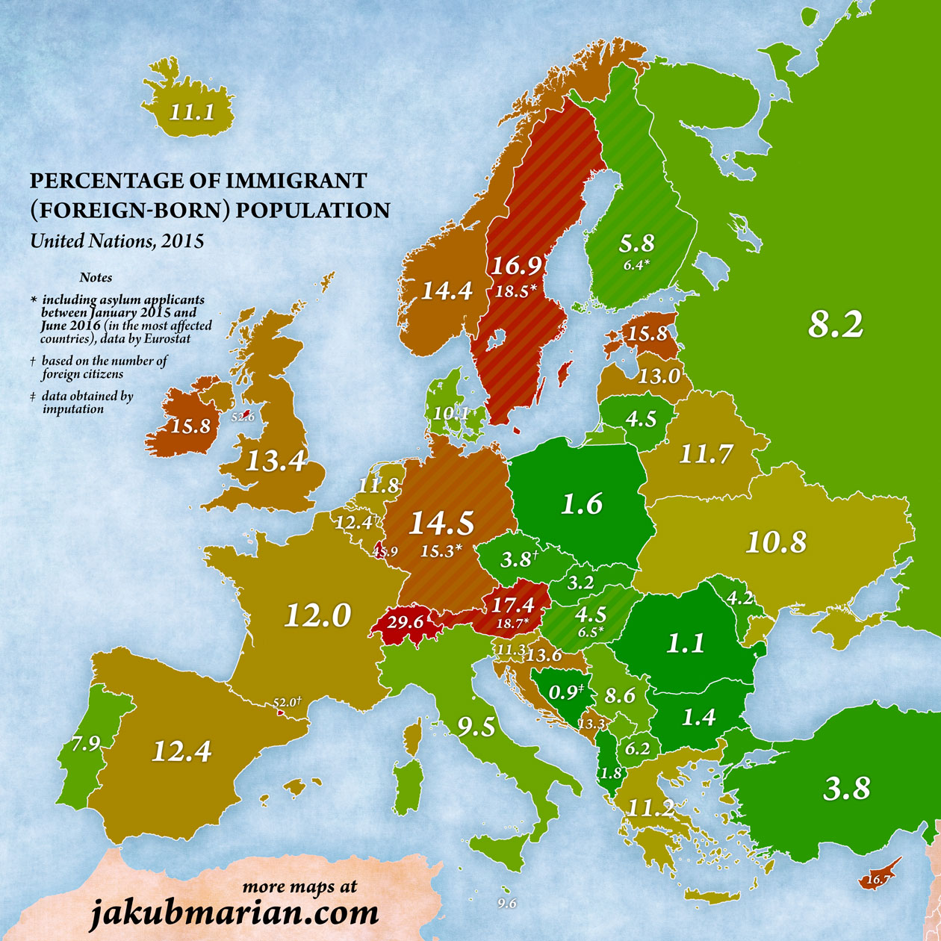
2. Immigration

Slide 10
2. Immigration
Population growth in EU28
1960 407 million
2014 510 million
Population growth mostly due to natural increase (births vs deaths). Recently, much more due to immigration:
In 2014
5% due to natural increase
95% due to immigration

Slide 11
3. Emigration
Despite population growth EU-wide, in 2014, 13 countries experienced a population decrease:
Spain, Portugal, Greece, Baltic states, Romania, Bulgaria
CEE population growth among the lowest in the world

Slide 12
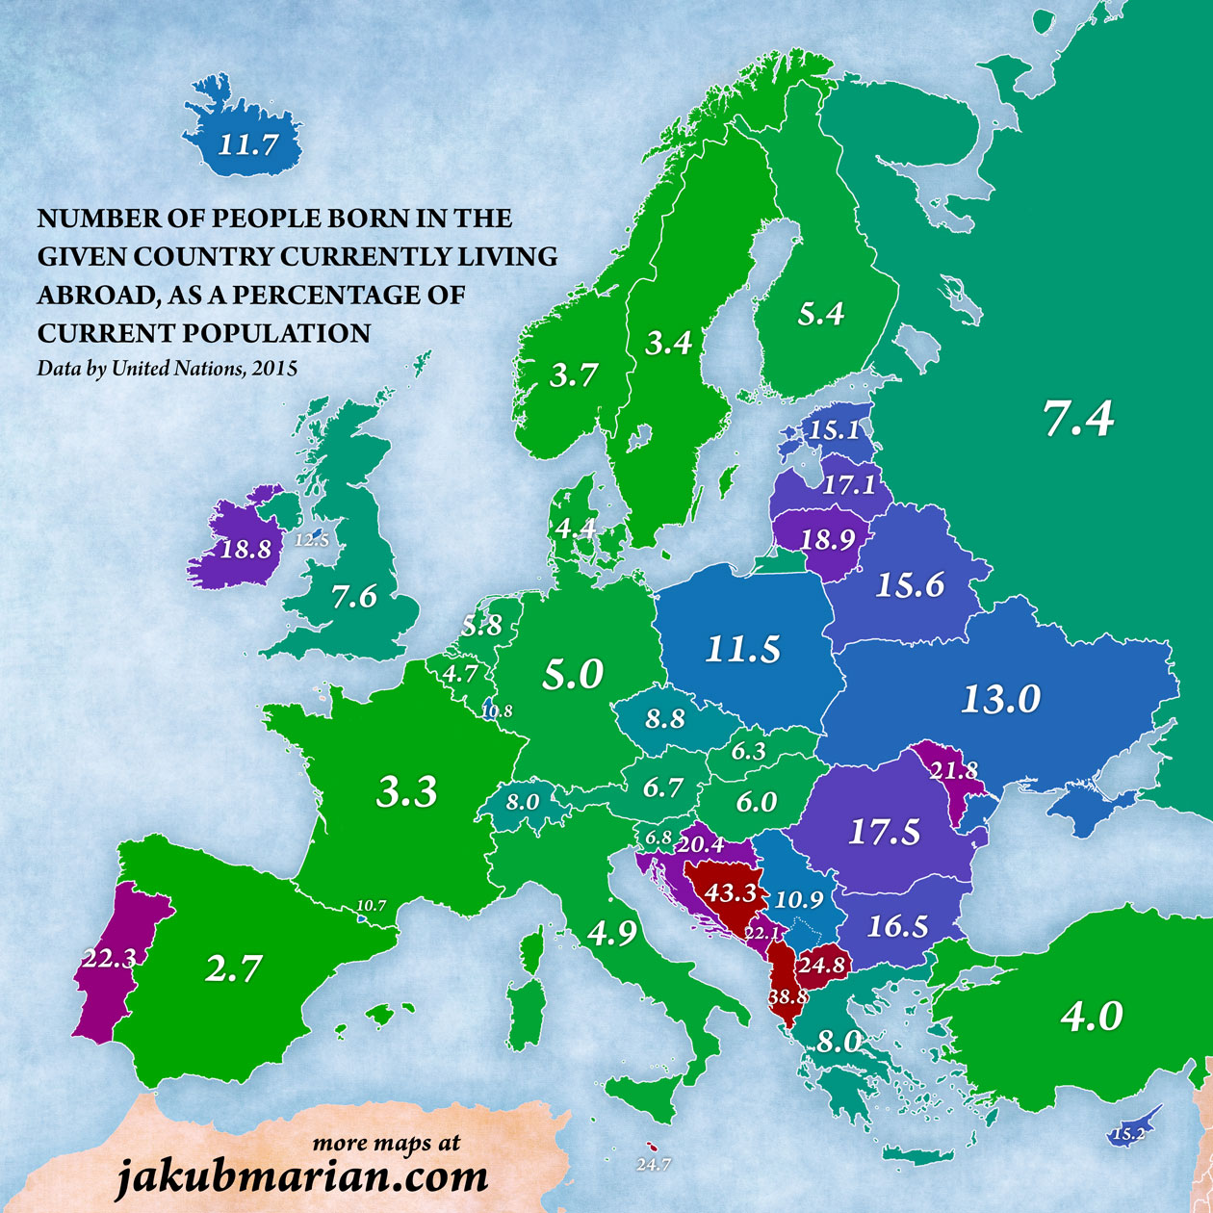
3. Emigration

Slide 13
Solutions: demographic ageing
Measures that are desirable anyway
Reforms
Productivity and GDP growth
Employment growth, including:
employment for older people (no mandatory retirement age)
raising state pension age
working parents
immigrant employment
Not: Government promotion of fertility

Slide 14
Solutions: immigration
Measures that are desirable anyway
Improve border management
Curbing illegal immigration and improving returns
Working with countries in North Africa and the Middle East
Selective legal immigration
Integration of immigrants
Including in the labour market

Slide 15
Solutions: emigration
Measures that are desirable anyway
Labour market reforms
Addressing clientelism and corruption
Welcoming policy for returnees

Slide 16
End of Presentation

