Slide 1
The Social Dimension of the EU ESU Summer Academy Vienna – 1 July 2017 Prof. Steven Van Hecke @VanHeckeSteven
Notes:
Unfinished business/incomplete contracts

Slide 2
1 July 1987 – Singe European Act

Slide 3
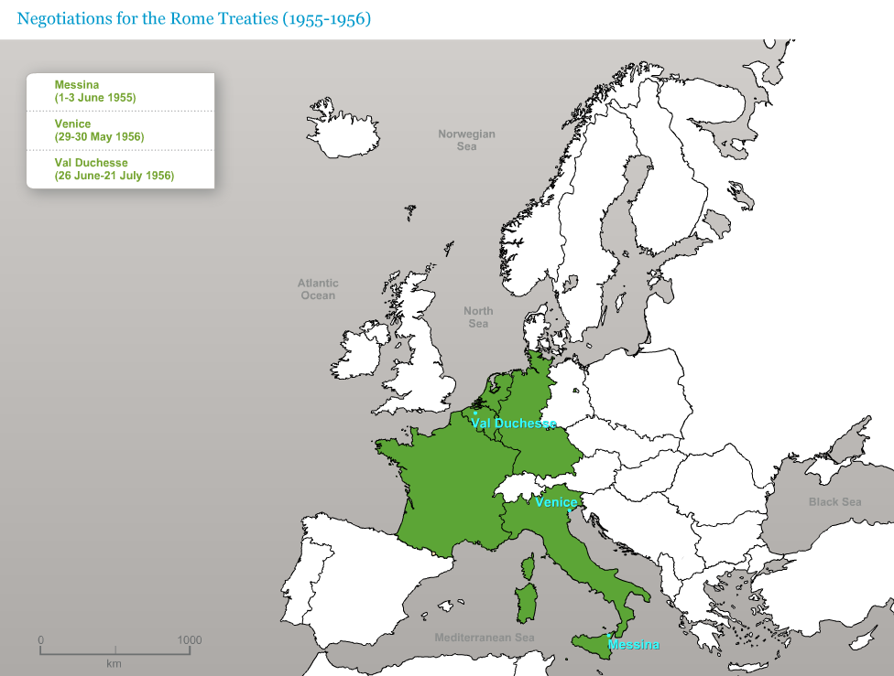
Notes:
http://www.cvce.eu/en/education/unit-content/-/unit/1c8aa583-8ec5-41c4-9ad8-73674ea7f4a7/3614cbc0-a81e-4d82-9d26-d8b600b6158a/Resources#b40ea816-b5d6-4599-a470-a9646e136e62_en&overlay

Slide 4
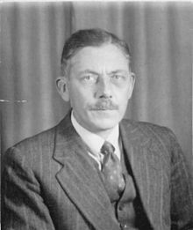
The British chose the exit …
“Gentlemen, you are trying to negotiate something you will never be able to negotiate. But if negotiated, it will not be ratified. And if ratified, it will not work.”
(Russell Bretherton, member of the Spaak Committee, 7 November 1955)
H. Young, The Blessed Plot. Britain and Europe from Churchill to Blair, London, 1999, p. 3. Cited in L. van Middelaar, The Passage to Europe. How a Continent became a Union, Yale University Press, 2013, p. 154.
Notes:
https://en.wikipedia.org/wiki/Russell_Frederick_Bretherton

Slide 5
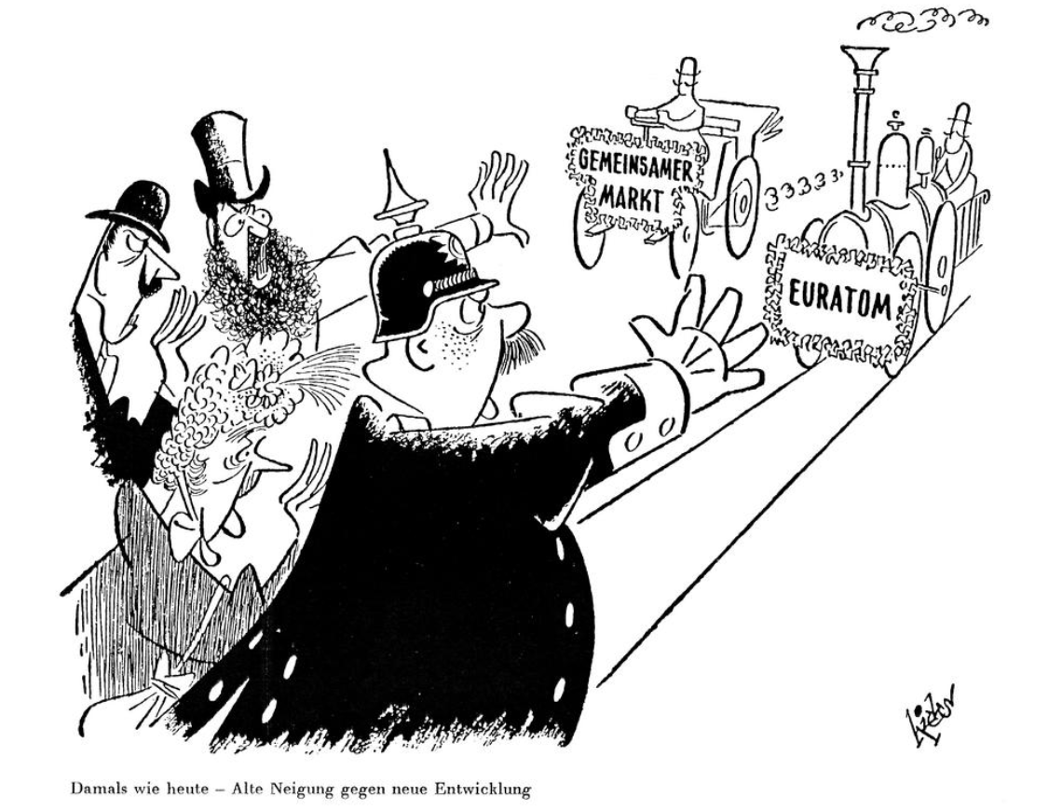
Notes:
‘Yesterday like today — old tendencies versus new developments.’ On 28 February 1957, the German cartoonist, Wolfgang Hicks, illustrates the resurgent fears in Europe in the light of the prospect of change prompted by the establishment of the European Economic Community (EEC) and the European Atomic Energy Community (EAEC or Euratom).
http://www.cvce.eu/en/obj/cartoon_by_hicks_on_the_fears_engendered_by_the_rome_treaties_in_europe_28_february_1957-en-3aaa324c-5b08-47f8-9a93-712ae6a708b9.html

Slide 6
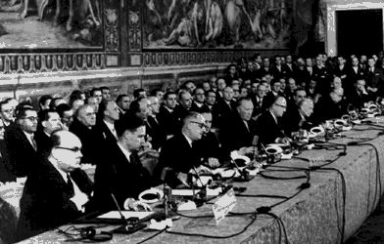
EEC Treaty
Notes:
To direct their efforts to the essential purpose of constantly improving the living and working conditions of their peoples
To promote improvement of the living and working conditions of labour so as to permit the equalisation of such conditions in an upward direction
To maintain the application of the principle of equal remuneration for equal work as between men and women workers
To strengthen the unity of their economies and to ensure their harmonious development by reducing the differences existing between the various regions and by mitigating the backwardness of the less favoured
A balanced trade and fair competition
Favour the harmonisation of social systems

Slide 7
Social chapter
very high ambitions (goals)
v. rather weak means:
“to promote close collaboration between Member States in the social field … For this purpose, the Commission shall act in close contact with Member States by means of studies, the issuing of opinions, and the organising of consultations”
Is that a problem? Not necessarily …
social and economic (and political) cohesion among the Six

Slide 8
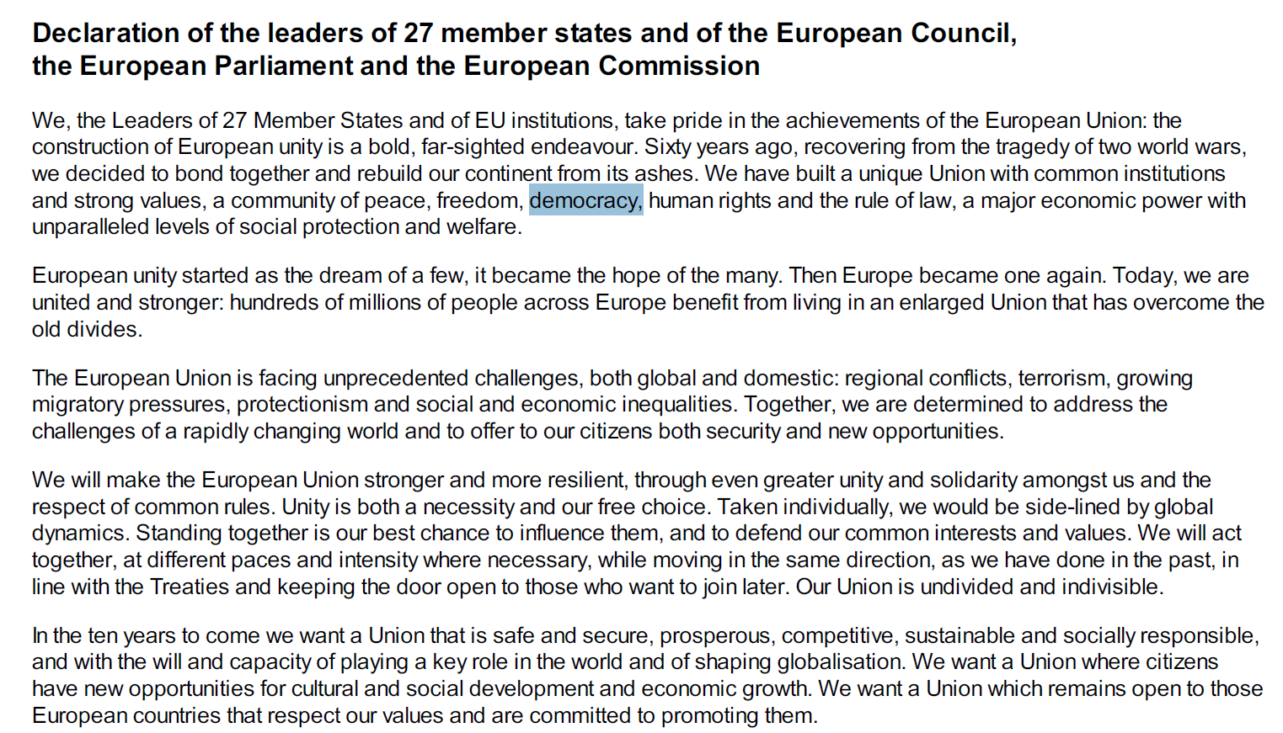
Rome, 25 March 2017
Notes:
Political-symbolic value

Slide 9
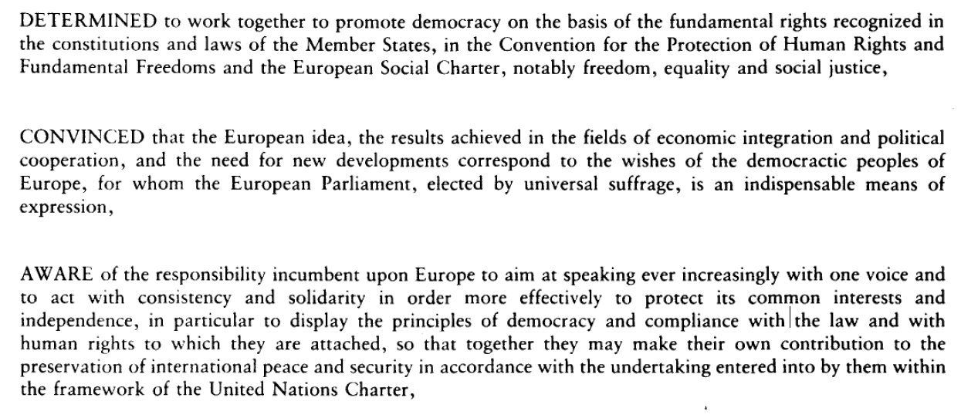
#EU60? No, not really …
Notes:
Single European Act (1985-1986-1987)

Slide 10
Single Market

Slide 11
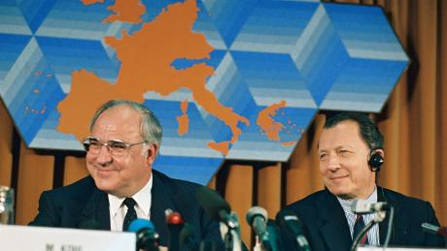
“You don’t fall in love with a common market, you need something else” (Jacques Delors)

Slide 12
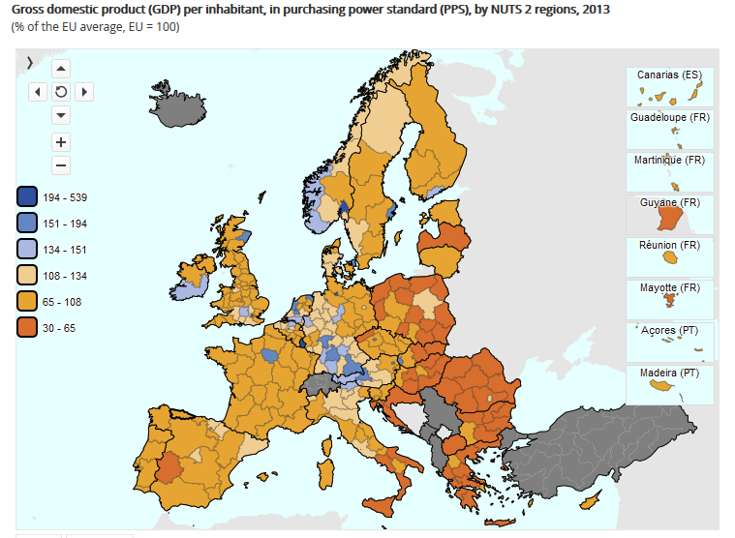
Notes:
http://ec.europa.eu/eurostat/web/cohesion-policy-indicators/statistics-illustrated

Slide 13
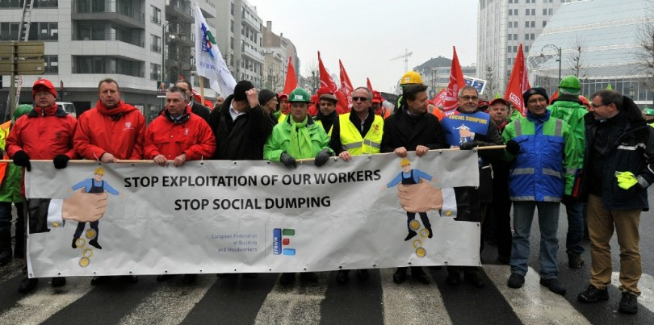

Slide 14
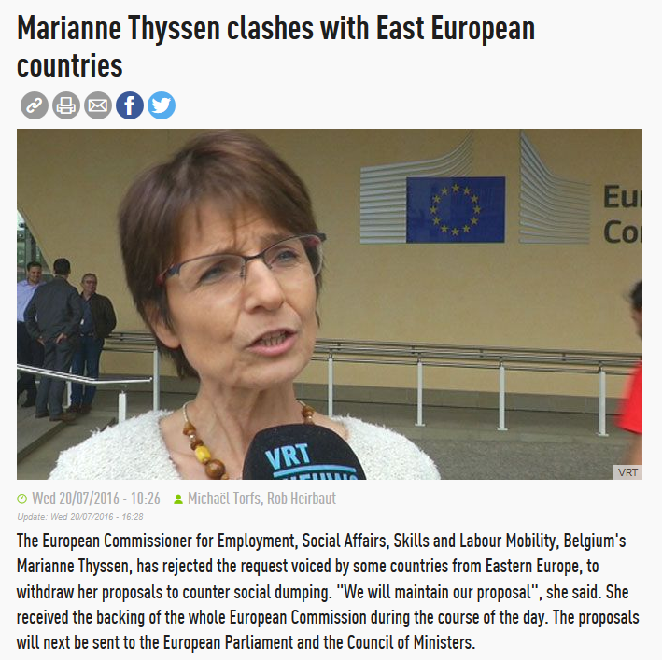

Slide 15
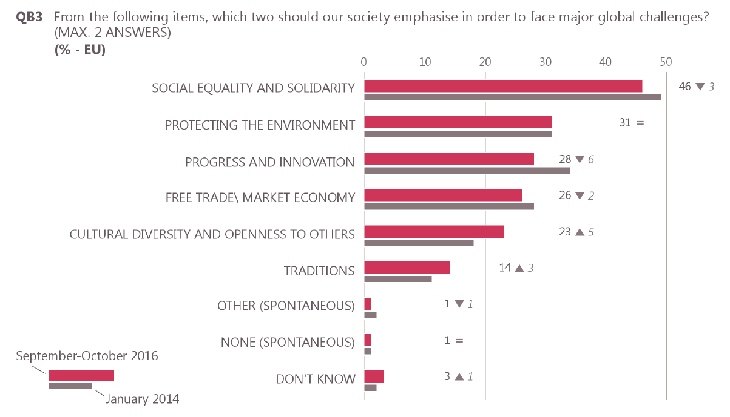
Eurobarometer 1/3 (October 2016)
Notes:
http://ec.europa.eu/COMMFrontOffice/publicopinion/index.cfm/Survey/getSurveyDetail/instruments/SPECIAL/surveyKy/2131

Slide 16
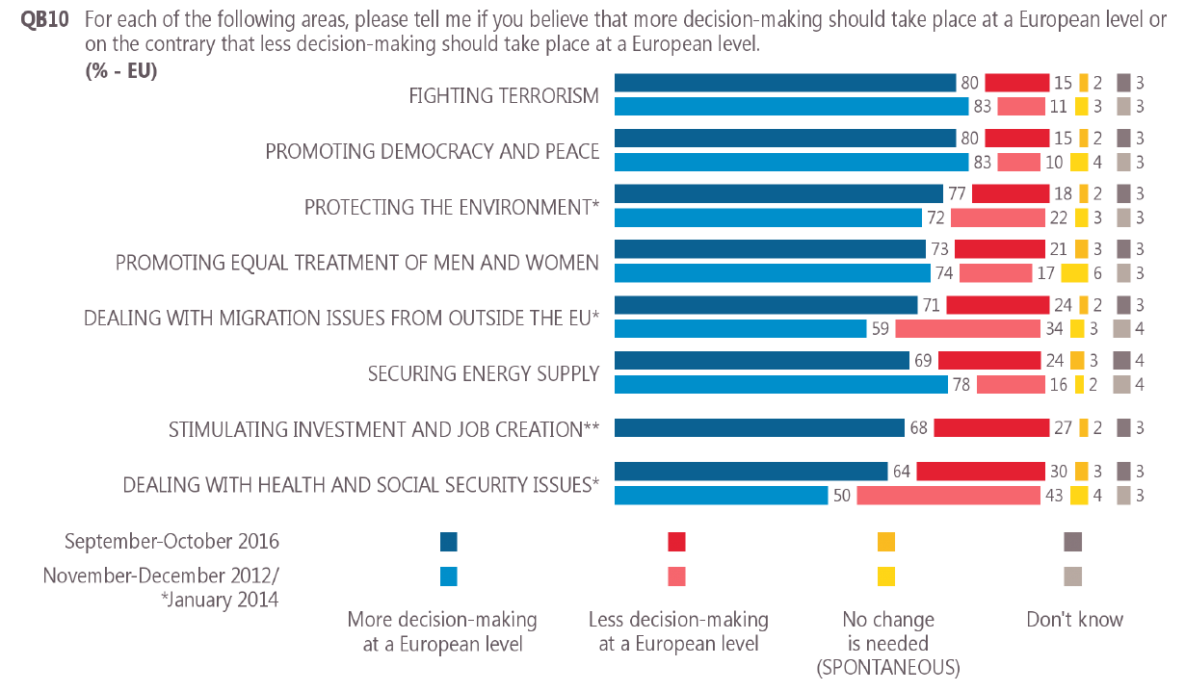
Eurobarometer 2/3 (October 2016)

Slide 17
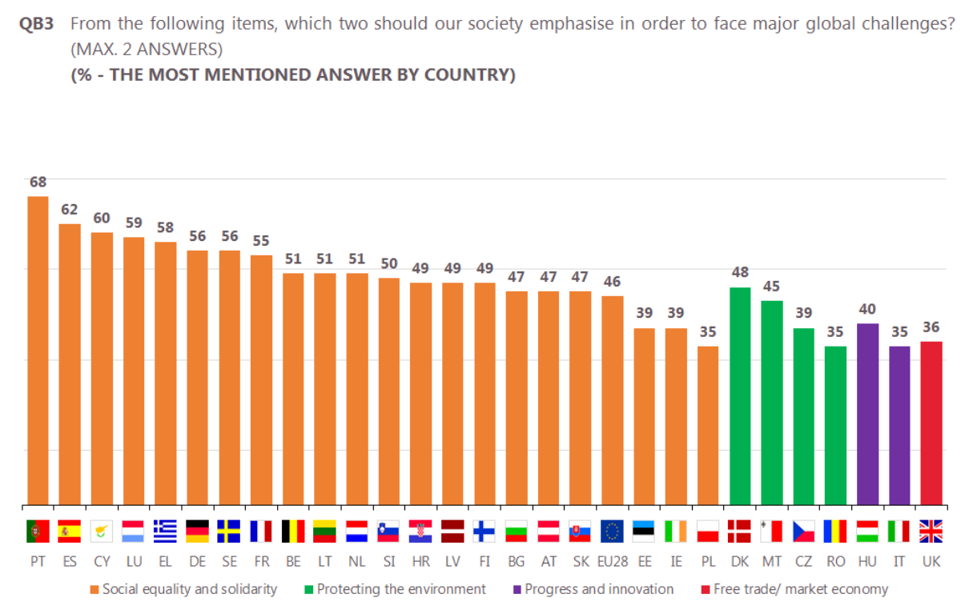
Eurobarometer 3/3 (October 2016)

Slide 18
Employment and Social Policy of the EU
Objectives
“The Union and the Member States … shall have as their objectives the promotion of employment, improved living and working conditions, so as to make possible their harmonisation, proper social protection, dialogue between management and labour, the development of human resources and the combating of exclusion.”
(art.151 TFEU)
Notes:
What?
(note: “harmonisation”) – in EU slang: “no exclusive competences” – in depth in couple of slides

Slide 19
Employment and Social Policy of the EU
Model
“The Union shall establish an internal market. It shall work for the sustainable development of Europe based on … a highly competitive social market economy, aiming at full employment and social progress...”
“It shall promote economic, social and territorial cohesion, and solidarity among Member States.”
(art. 3(2) TEU)
Notes:
Unique: economic and social model (internal market + social market economy) – in the Treaties since Lisbon
Social Market Economy
Solidarity among Member States

Slide 20
Employment and Social Policy of the EU
Tools
Shared Competences (set minimum requirements)
Coordinating Competences
(art. 153 TFEU)
Notes:
Shared Competences
OLP: working conditions, including health and safety at work; equality between men and women; information & consultation of workers
Unanimous: social protection, social dialogue
Coordinating Competences
(best practices, naming and shaming, guidelines, recommendations, …: e.g.: Social Security Coordination Regulation (see later); Pillar of Social Rights)
GENERAL: national prerogatives (EP EMPL “resolution committee”) – but: convicted of need for stronger social dimension (see further)
(1) past: conviction of Member States that the functioning of the Internal Market would lead to the development of better working and living conditions
(2) EFFECTS OF CRISIS - in IM, LABOUR MOBILITY is very LOW (lower than US) – automatic correction against asymmetric shocks did not work + labour costs (set nationally) become key source of competitiveness and competition – divergence – lack of trust

Slide 21
Tools – Strategies
Employment – Europe 2020 Strategy
75% employment
< 10% early leavers
-20 million in poverty
Notes:
EU 2020 Strategy
Includes former “EU Employment Strategy” (EES)
Implemented through European Semester (stronger focus on employment and social guidelines and social dialogue)

Slide 22
3.1. Minimum Requirements
Equality between men and women
Working Conditions
Terms of work
Ordinary Legislative Procedure
Notes:
Equality between men and women with regard to labour market opportunities and treatment at work (o.a. wage)
Working Conditions, including Health and Safety at Work (e.g. requirements at the workplace such as signs and personal protective equipment; Carcinogens and Mutagens Directive ! (2004) – up for revision; Driving and Resting Times in transport sector)
Terms of Work (right to information and consultation – e.g. European Works Council for European cross-border companies (before-after; main seat; transnational issues – e.g; Elia visit)
NOT: wage-setting ! = exclusive national competence

Slide 23
3.2. Funds
European Social Fund (ESF)
Fund for Aid to the Most Deprived (FEAD)
European Globalisation Adjustment Fund (EGF)
Support objectives of EU employment and social policy
Notes:
European Social Fund
Oldest structural fund
From adaptation with regard to economic integration -> supporting the objectives of employment and social policy ((1) high, qualitative employment, (2) high-quality education and training, (3) fighting poverty and exclusion)
74 billion euro – co-financing – additionality (no substition of national programmes)
Crisis: > 20% of public investment from EU structural funds (while 15% decline in general investment)
Greece: (1) frontloading + (2) 100% co-financing
Youth Unemployment: 20-50% - sub-fund Youth Employment Initiative - all young people under 25 a good, concrete offer within 4 months of leaving education or unemployment (PES)
Migration: call for increase in mid-term revision of MFF 2017
FEAD
“Safety net behind the safety net”
Combat poverty and social exclusion: vulnerable long-term unemployed: generational poverty, homeless, migrants, single mothers, …
Co-financing
EFG
Support in concrete cases where people lose job due to crisis – European Parliament: Ford Genk, Val St. Lambert, … - 160 applications so far

Slide 24
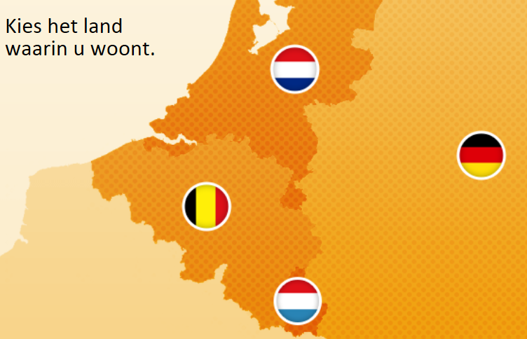
3.3. Social Security Coordination
Aim
Coordination in support of free movement of persons
General Rule
Country of employment/residence
Equal treatment
Aggregation
No overlap
Exportability
Exceptions?
Notes:
When 2 or more Member States are involved, under which country’s system are you insured? (cross-border workers? Moving mid-life for your job? Temporary?)
What? Sickness benefits, unemployment benefits, pension, child benefits, …
Equal treatment: with nationals of the Member State
Aggregation: taking into account previous employment in another Member State
No overlap
Exportability: e.g. child benefits
Exceptions?
General rule: in case of temporary employment (posting) (see further)
Exportability: Brexit discussion on child benefits
Exlusion of social protection after 3/6 months to discourage welfare tourism (EU Court of Justice)

Slide 25
3.4. Social Dialogue
Horizontal Social Clause
“In defining and implementing its policies and activities, the Union shall take into account requirements linked to the promotion of a high level of employment, the guarantee of adequate social protection, the fight against social exclusion, and a high level of education, training and protection of human health.” (art.9 TFEU)
Social Partner Autonomy
Social Dialogue Committee
Framework Agreements
No impact assessments
Notes:
≠ wage-setting mechanisms = national competence = national traditions (West: all levels, bi/tripartite / East / South: company-level / North: no universally applicable)
EU Treaties:
GENERAL: Horizontal Social Clause (art. 9 TFEU) – cf. social partner guarantee
SPECIFIC: Social Partner Autonomy
Right of association and collective bargaining in Treaties
(Sectoral) Social Dialogue Committee (bipartite, EU WG & WN associations, 4/year)
Negotiate Framework Agreements
EC mandatory consultation in field of social policy
Choose to negotiate themselves (max. 9 months)
Implementation through Council Directive – e.g.: Framework Agreement on Parental Leave; Part-Time Work Directive; Working Time Directives; … - dead? 2012 EC refused to submit Health and Safety of Hairdressers Agreement
Excluded from impact assessments (REFIT)

Slide 26
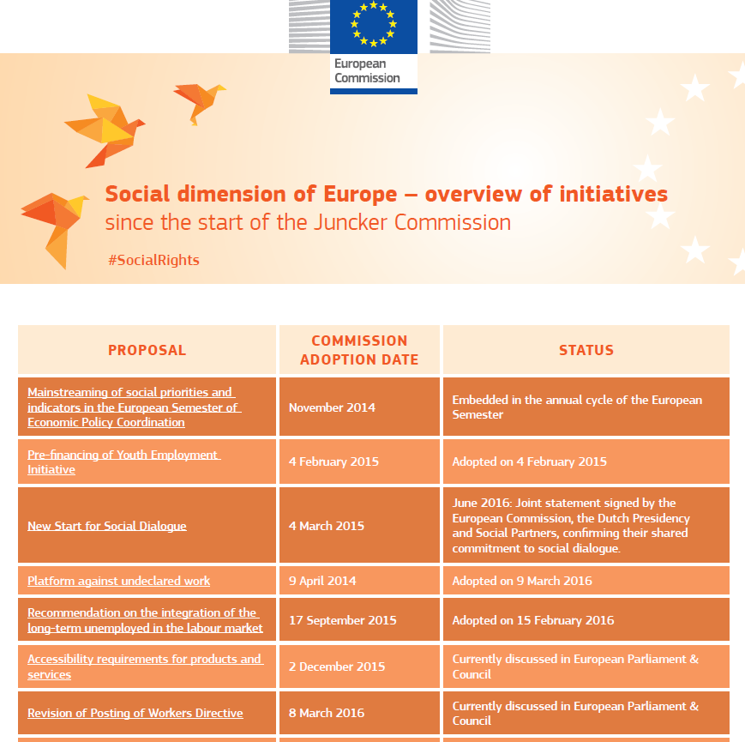
Notes:
https://ec.europa.eu/commission/sites/beta-political/files/social_dimension_of_europe_overview_of_initiatives.pdf

Slide 27
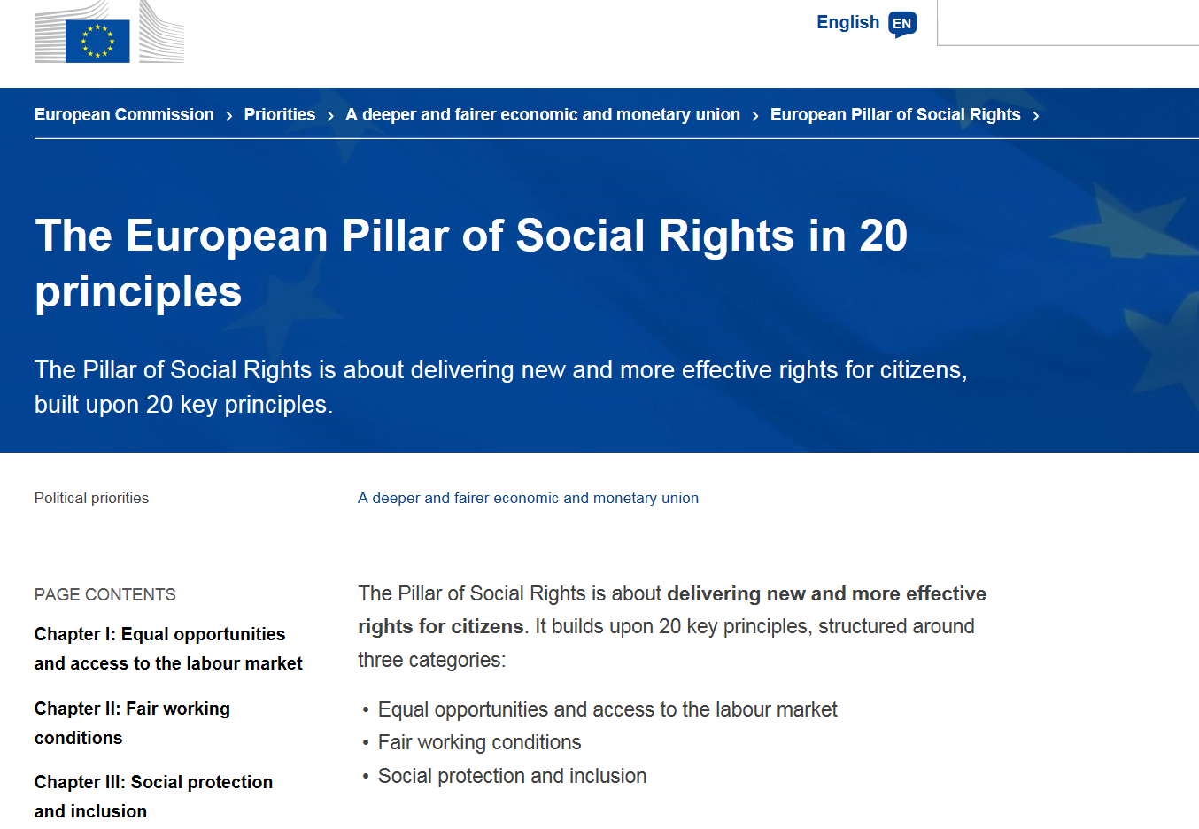

Slide 30
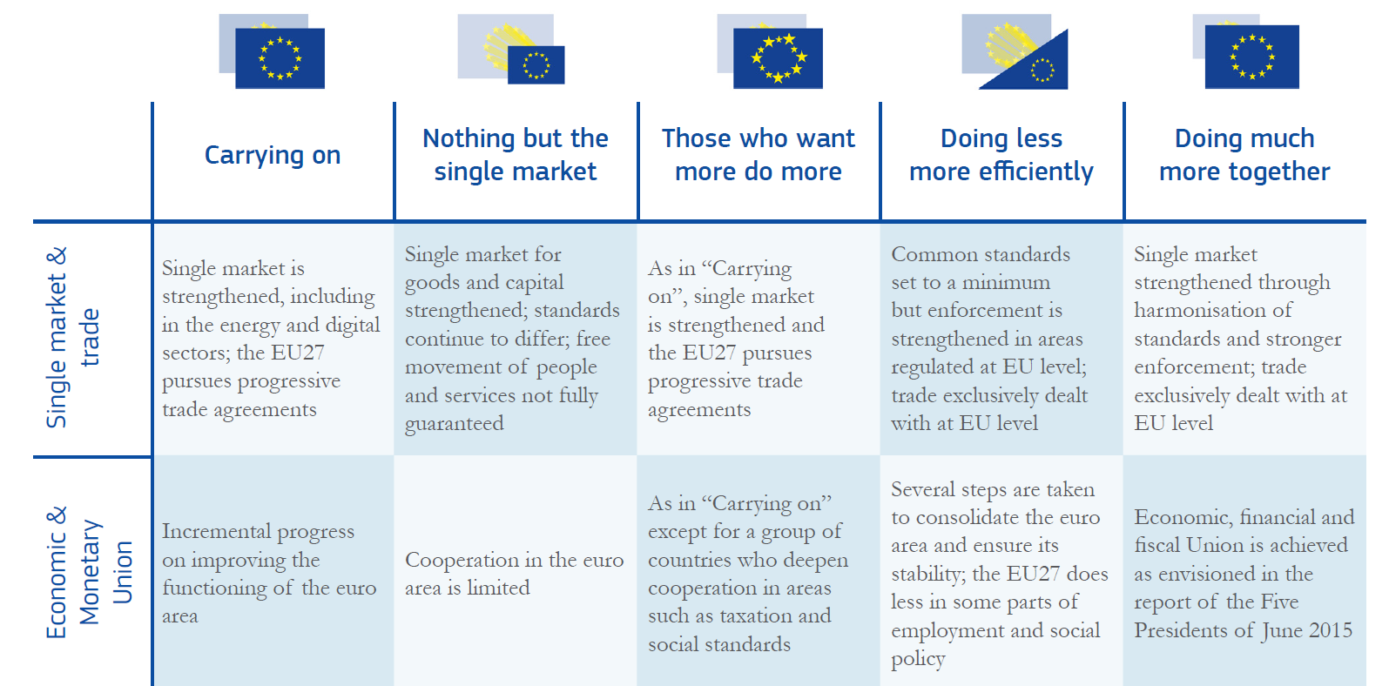
White Paper on the Future of Europe

Slide 31
Social Europe:
unfulfilled promise of the Rome Treaty
in high demand among citizens (Eurobarometer)
surprising support in the 2017 Rome Declaration
but one cannot have high ambitions and low means at the same time
[European Pillar of Social Rights]
so now up to national politicians to be courageous, just like in the fifties …

Slide 32
The Social Dimension of the EU ESU Summer Academy Vienna – 1 July 2017 Prof. Steven Van Hecke @VanHeckeSteven
Notes:
Unfinished business/incomplete contracts

