Slide 1
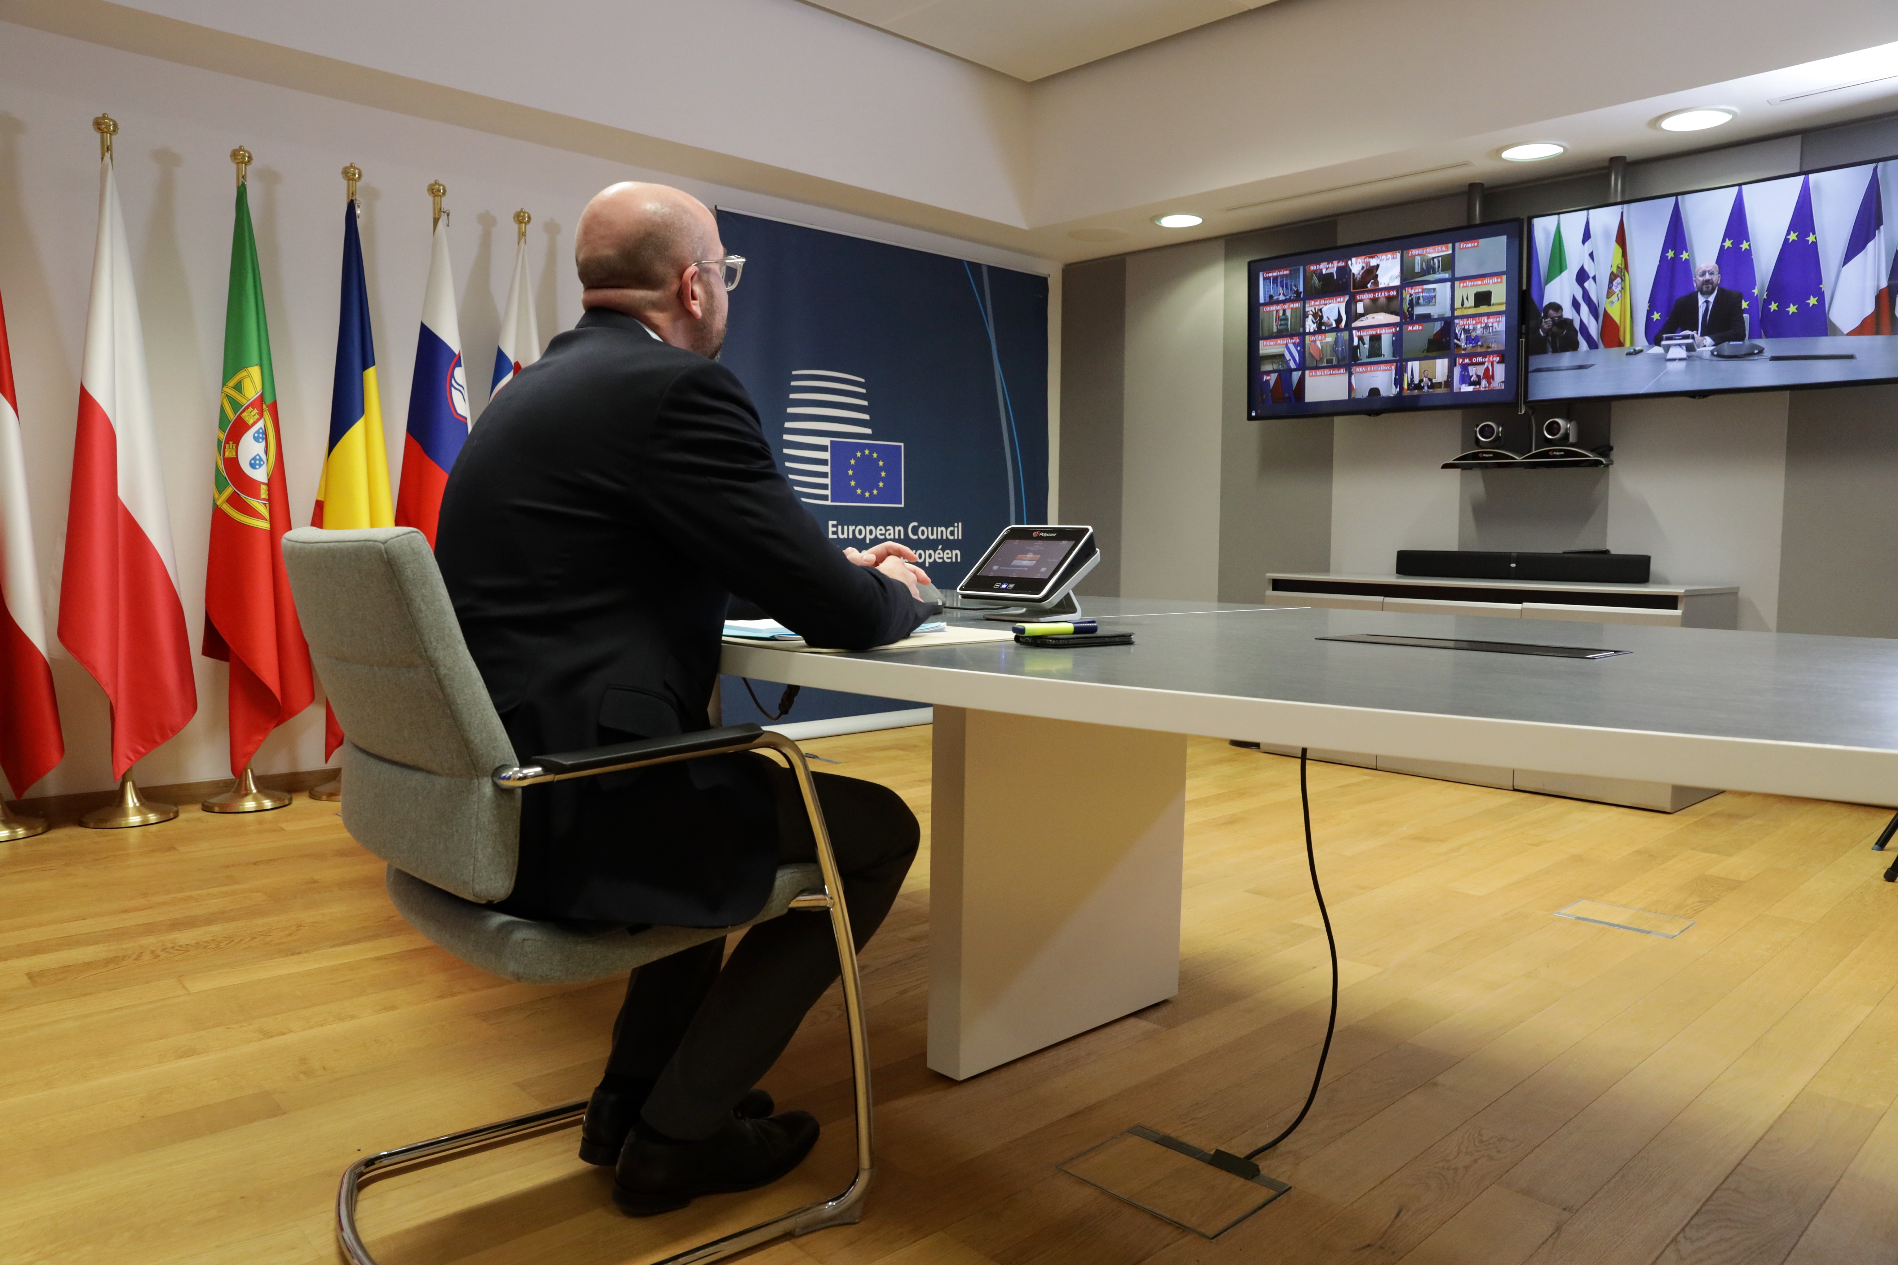
Europe & corona: never waste a good crisis? European Seniors’ Union 4 July 2020
Prof. dr. Steven Van Hecke @VanHeckeSteven
Notes:
Picture: https://newsroom.consilium.europa.eu/permalink/p102517

Slide 2
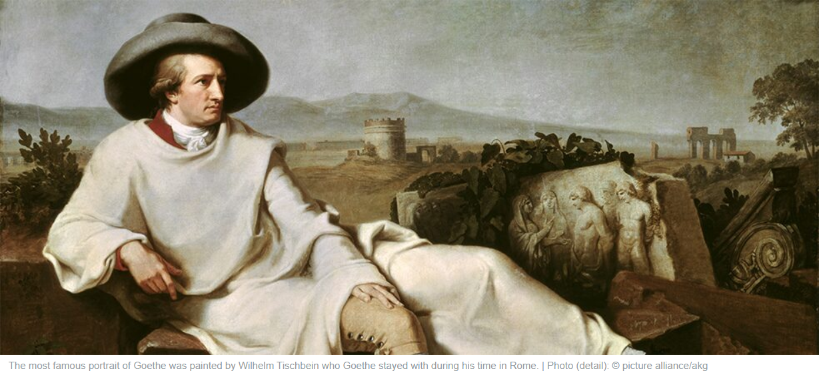
Challenge 1: Not exhaustive but representative
“In der Beschränkung zeigt sich erst der Meister” Johann Wolfgang von Goethe
Notes:
Picture: https://www.goethe.de/en/kul/lit/21348125.html?forceDesktop=1

Slide 3
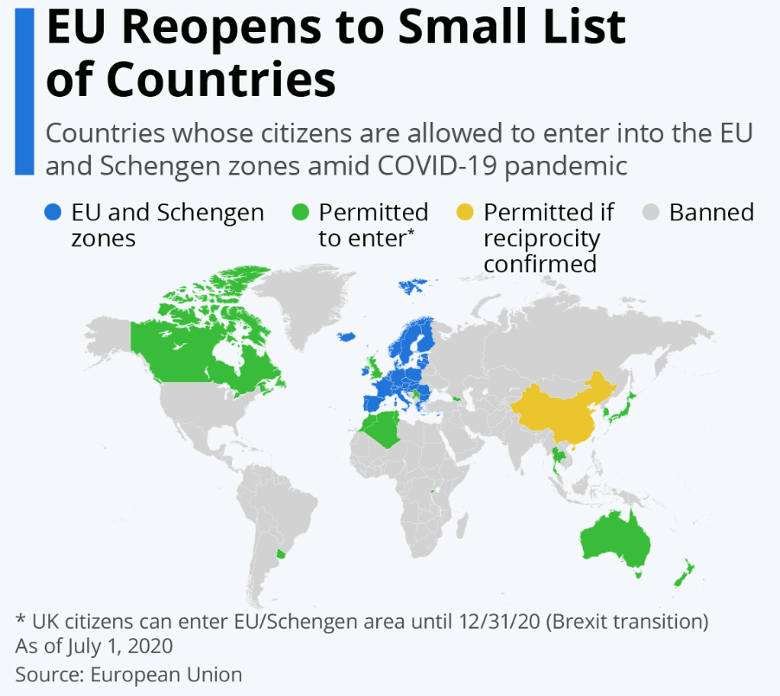
Challenge 2: What has not been said yet?
Notes:
http://mo8ushistory.weebly.com/the-columbian-exchange.html (cf. Black Lives Matter)
https://www.statista.com/chart/22165/countries-allowed-to-enter-eu-schengen/

Slide 4
5 lessons from 5 months Covid-19 in the EU
Just another crisis
Just another government
Never underestimate the Commission
The EU looks like … God
And let’s count on … Merkel

Slide 5
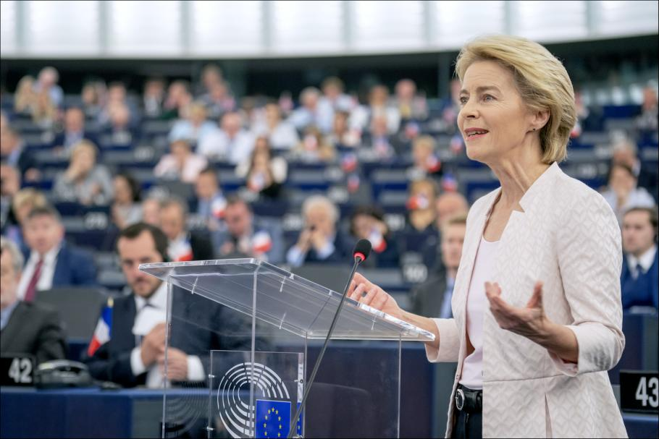
“We have moved out of the era of crisis management and can now look forward” (18 July 2019)
Notes:
https://ec.europa.eu/commission/sites/beta-political/files/political-guidelines-next-commission_en.pdf

Slide 6
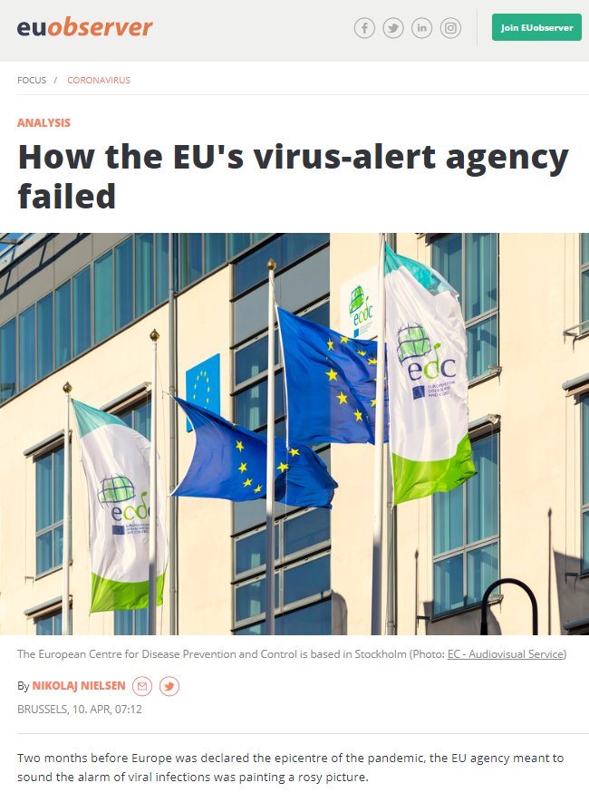
Notes:
https://www.ecdc.europa.eu/en
https://euobserver.com/coronavirus/148039

Slide 7
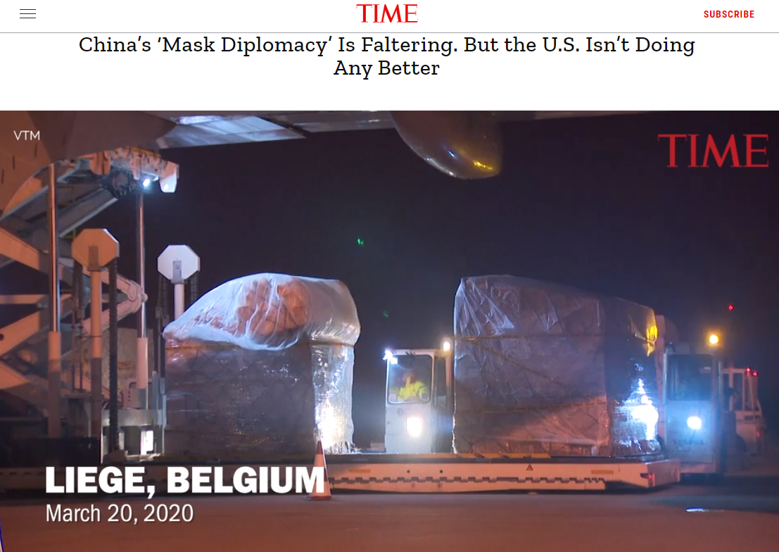
Notes:
https://time.com/5814940/china-mask-diplomacy-falters/

Slide 8
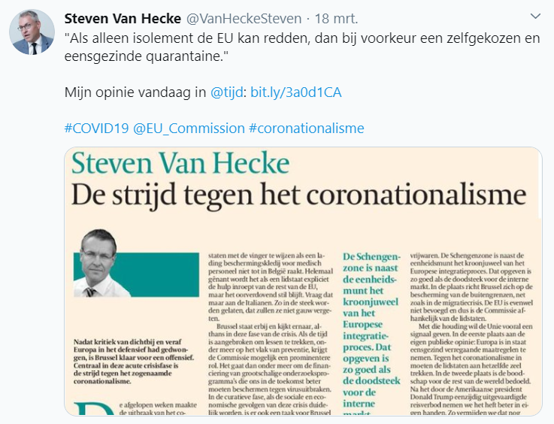
Notes:
https://www.tijd.be/opinie/algemeen/de-strijd-tegen-het-coronationalisme/10215152.html

Slide 10
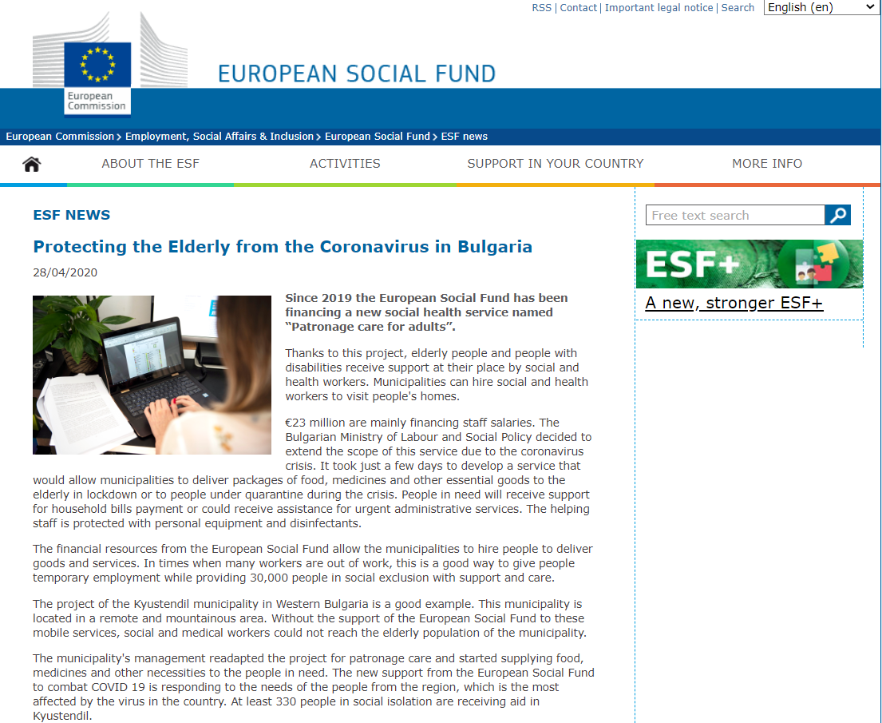
Notes:
https://ec.europa.eu/esf/main.jsp?catId=67&langId=en&newsId=9658

Slide 11
“twin transition of digitalisation and decarbonisation”
Notes:
https://www.euractiv.com/section/future-eu/interview/von-der-leyen-we-now-need-to-build-resilient-green-digital-europe/ (20 april 2020)
Bron afbeelding: https://youmatter.world/transitions/en/digital-transformation-and-ecological-transition-are-not-incompatible/

Slide 12
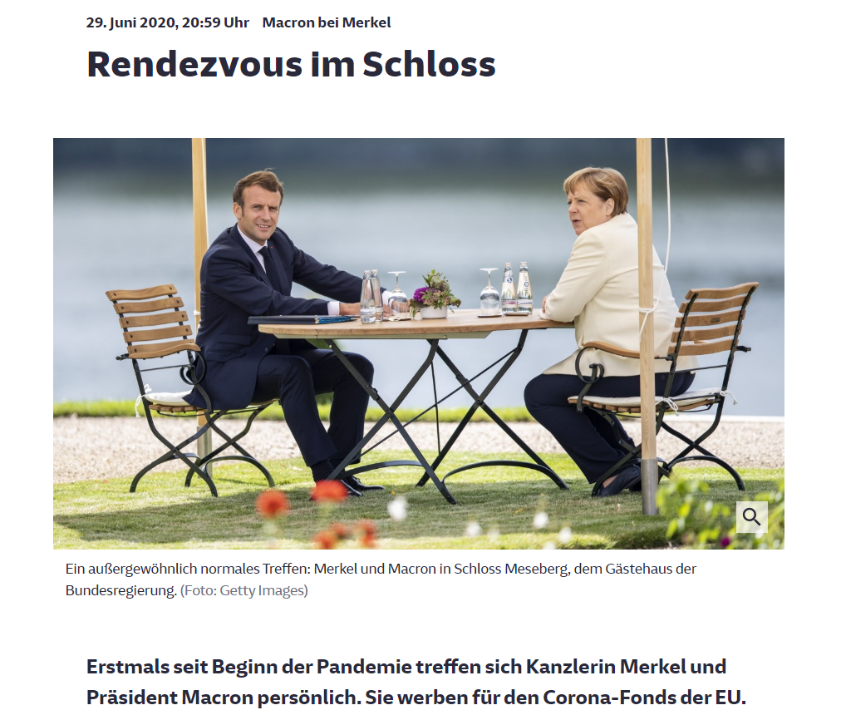
Notes:
https://www.sueddeutsche.de/politik/merkel-macron-eu-fonds-corona-1.4951747

Slide 13
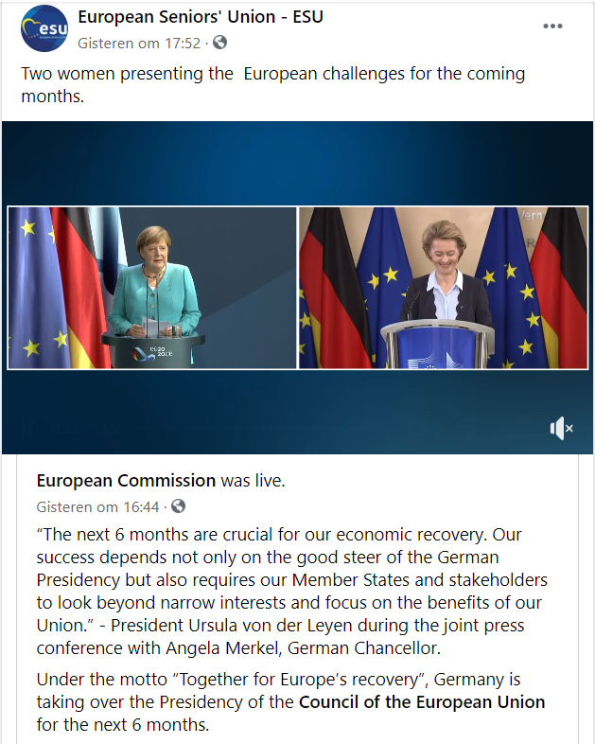
Notes:
https://www.facebook.com/EuropeanCommission/videos/1708533269298798/

Slide 14
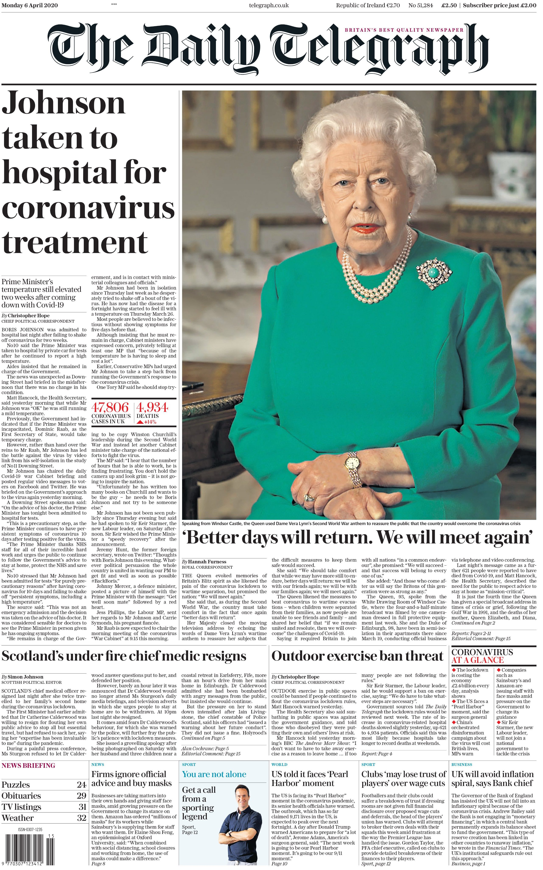
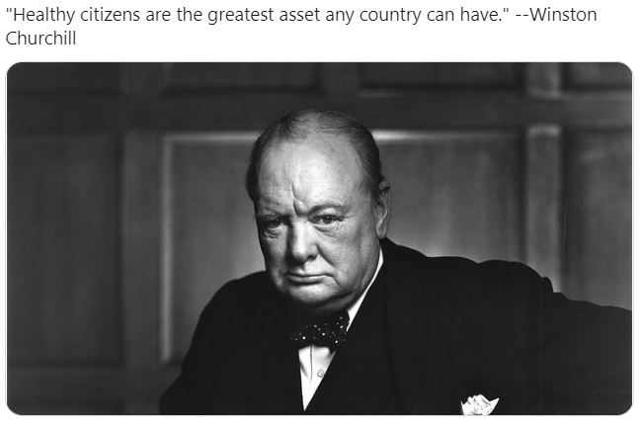
Notes:
“Never let a good crisis go to waste.”

Slide 15
Europe & corona: never waste a good crisis? European Seniors’ Union 4 July 2020
Prof. dr. Steven Van Hecke @VanHeckeSteven
Notes:
Picture: https://newsroom.consilium.europa.eu/permalink/p102517

