Slide 1


Slide 2

25 years ESU
Building the future TOGETHER
Construyamos el futuro JUNTOS
Madrid, 23-25 September 2021

Slide 3
25
24 September 2021
Introduction - An Hermans
‘Feeling grateful’
Looking ahead
A challenging future
ESU‘s look at EU policy priorities
Mainstreaming demographic change
Ensuring qualified health and care systems
People-centered ‘green deal’ and digital transformations
Together for resilient and sustainable societies
Stronger together
Rethinking age and ageing
Where no one is left behind
Let’s celebrate!

Slide 4
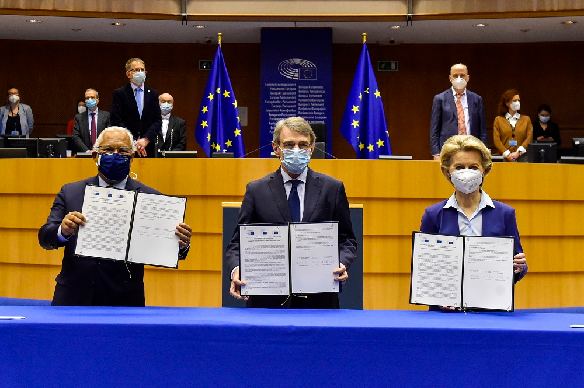
Source: © European Union 2021 – Eri Vidal/EP

Slide 5
The EU’s policy priorities (2019-2024):
1. A European Green Deal;
2. A Europe fit for the digital age;
3. An economy that works for people;
4. A stronger Europe in the world;
5. Promoting the European way of life;
6. A new push for European democracy;
7. Action to contain the coronavirus crisis and promote economic recovery from it.

Slide 6
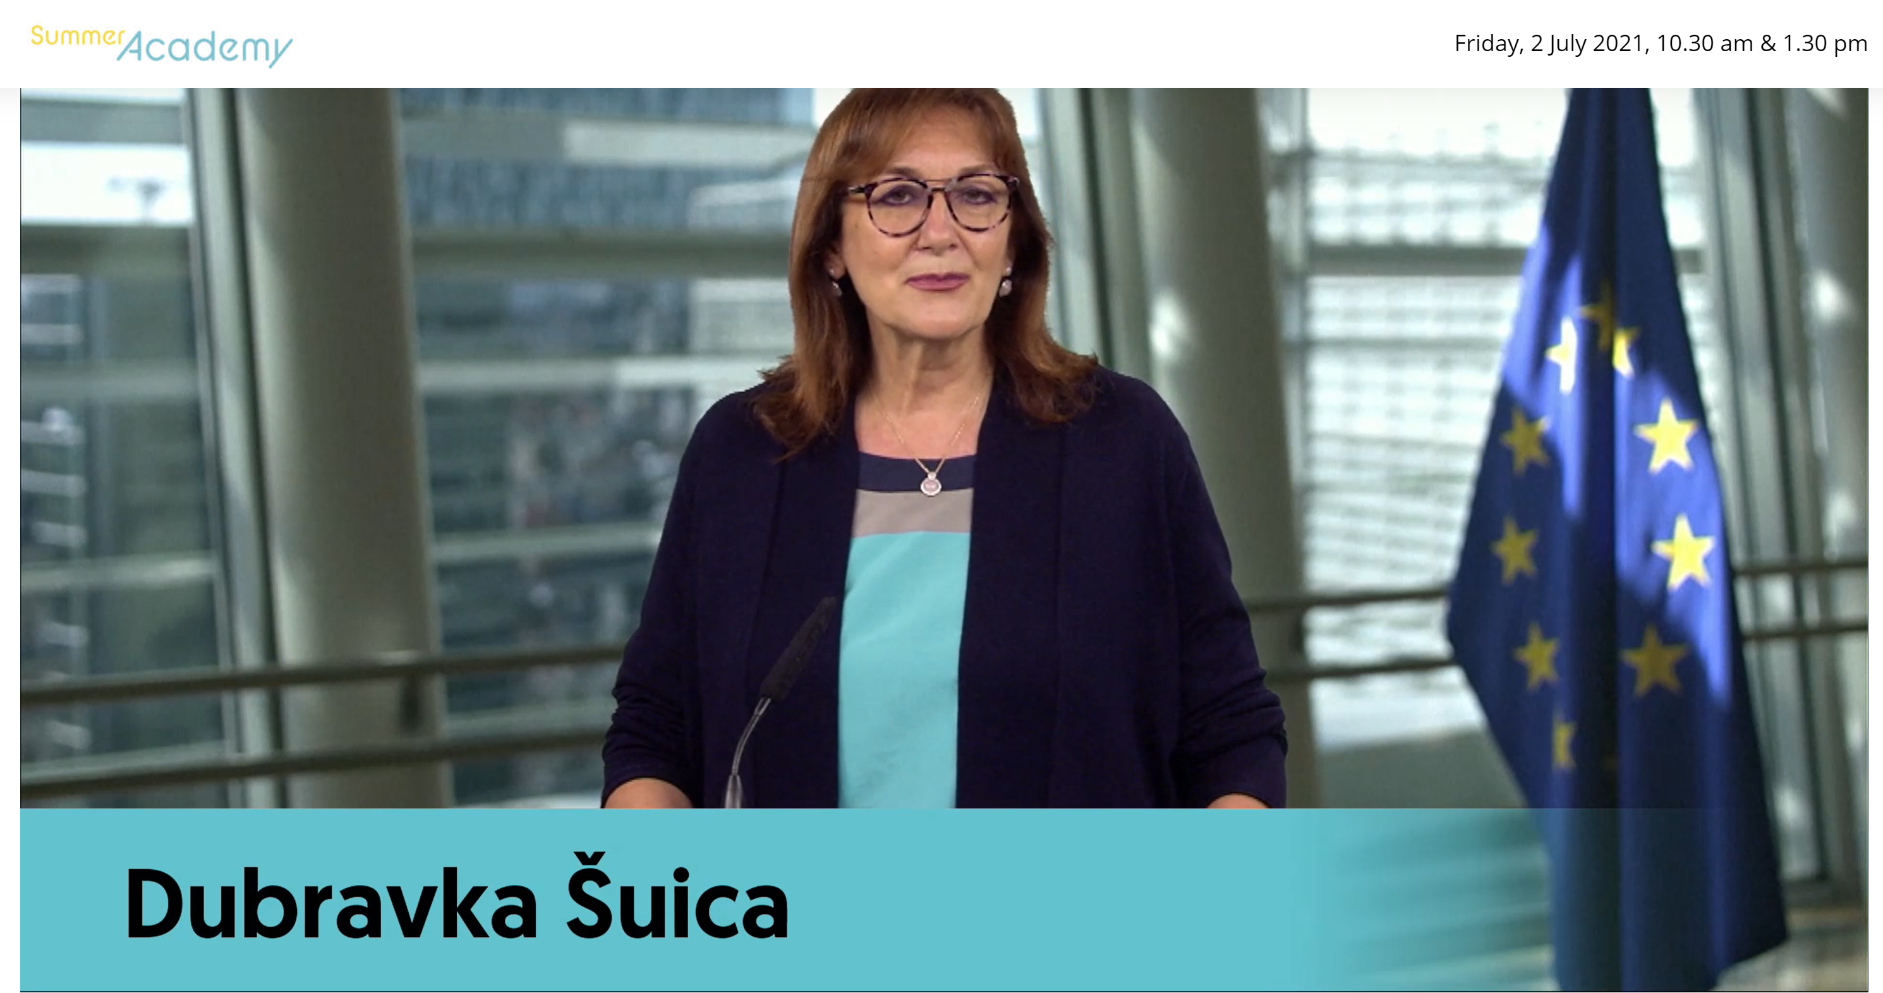
25
Mainstreaming demographic change
“Demographic Change: one of the ‘deepest-lying challenges’ for European societies” - Dubravka Šuica

Slide 7
25
Ensuring qualified health and long-term care systems
The new realities of the COVID-19 crisis have increased the focus on health policy at EU level.
How can we
  Implement the lessons we learnt from the pandemic?
  Give healthcare a higher priority in the recovery policy?
  Do better in addressing the health and care needs of older persons?
What is needed to improve the cooperation between, the EU, Member States and international institutions?

Slide 8


Slide 9
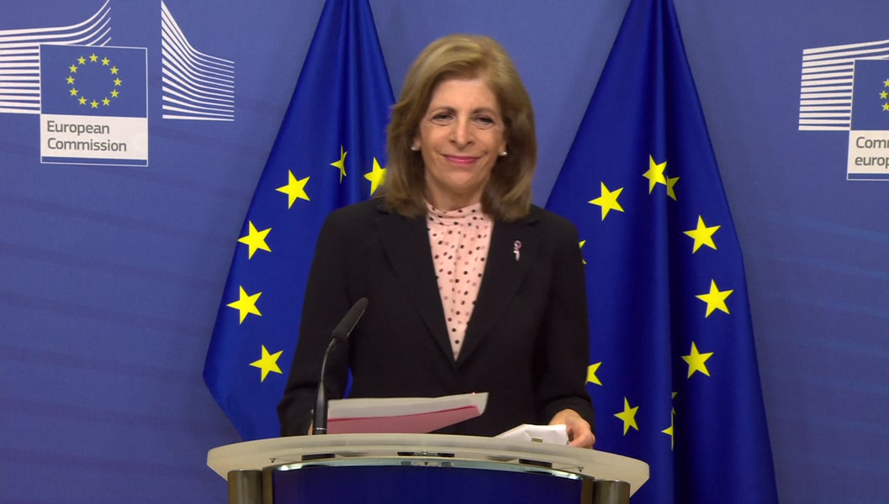
25
The EPP Group calls for more coordination and the extension of European action in the area of health policy within the existing Treaties.
EU Commissioner Kyriakides is taking the lead in this perspective.

Slide 10

25
People-centered ‘green deal’ and digital transformation.
To help achieve its climate goals, and reinforce digital transformation, the EU decided to strengthen both areas in the EU budget and the Recovery plans: at least 30% of new resources will go to fighting against climate change and 20% percent to digital.

Slide 11
25
The European ‘green deal’
The EU, together with its Member States, have set themselves binding targets of achieving climate neutrality by 2050. Step by step the EU is working on the revision and update of its climate, energy and transport-related legislation under the so-called ‘Fit for 55 package’. This ‘Fit for 55’ refers to the at least 55% emission reduction target which the EU has set for 2030. It is an intermediate step towards climate neutrality by 2050.

Slide 12
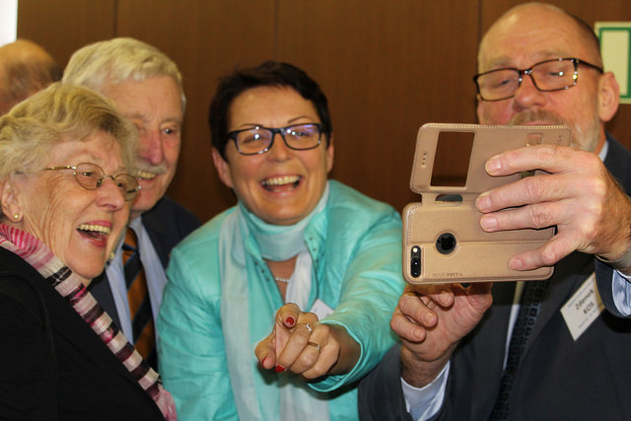

Slide 13
25
Society’s digital transformation
The ESU-attention towards digitalisation can be seen as one of the results of the recent COVID-19 pandemic.
More than ever, it is obvious that digital connectivity and frequent use of the internet is needed not only in a professional context, but that ‘all and everyone’ is supposed to be able to use the internet and to be integrated in the digital era.
Older persons have the right to participate in all areas of society. Digital integration is a crucial condition for connectivity and to participate and contribute to society.

Slide 14
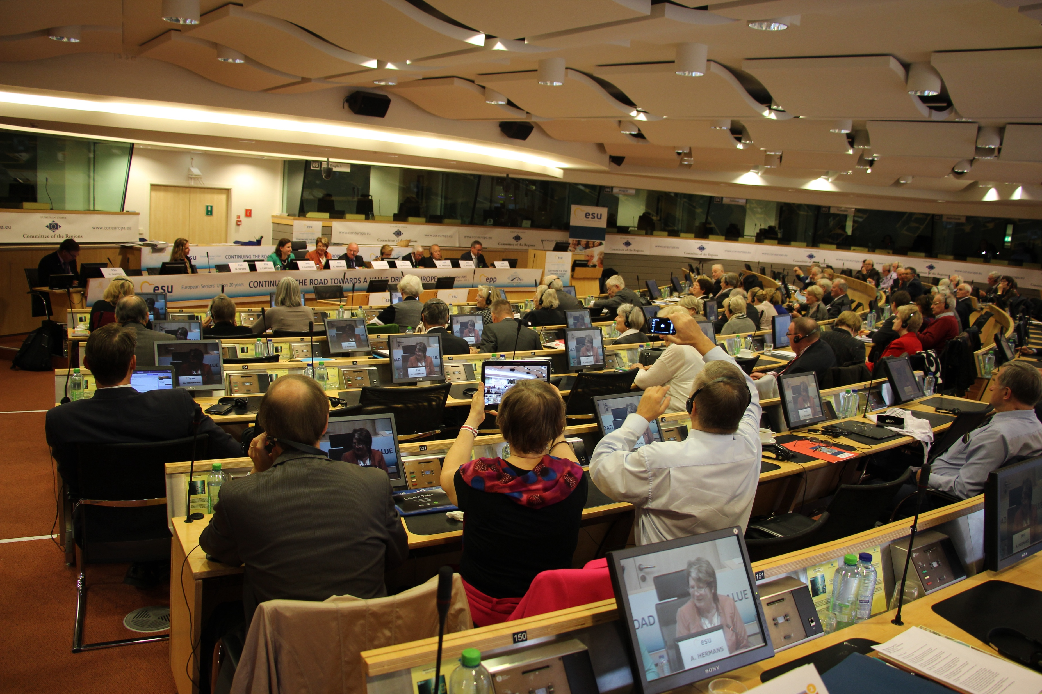

Slide 15
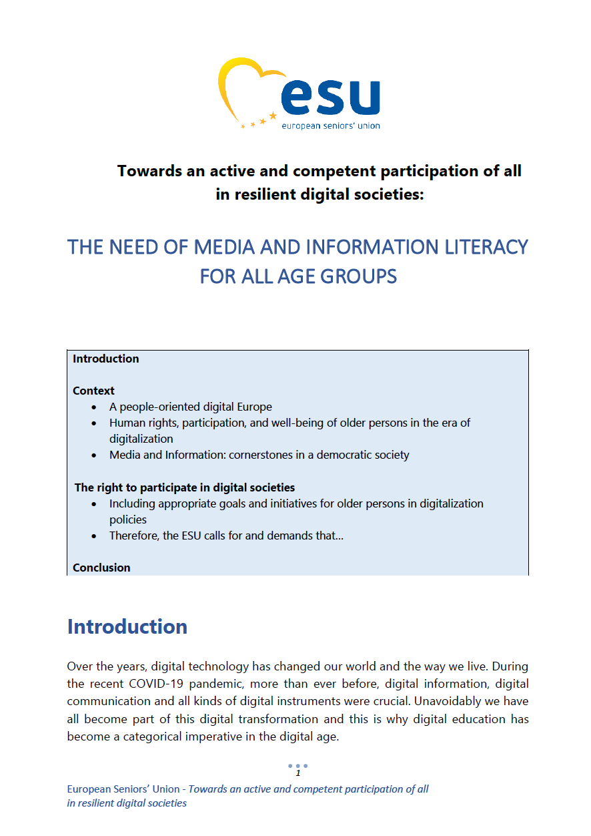
Media and Information Literacy are the first steps to participate in digital societies; are the building blocs to digital active citizenship. The ESU is urging governments, all stakeholders and civil society itself, to create a diversity of initiatives, not only to be developed for seniors and with seniors, but for all generations.
See: ESU Statement & ESU Resolution to be adopted by the EPP Congress:
“Towards an active and competent participation of all in resilient digital societies:
THE NEED OF MEDIA AND INFORMATION LITERACY FOR ALL AGE GROUPS”

Slide 16
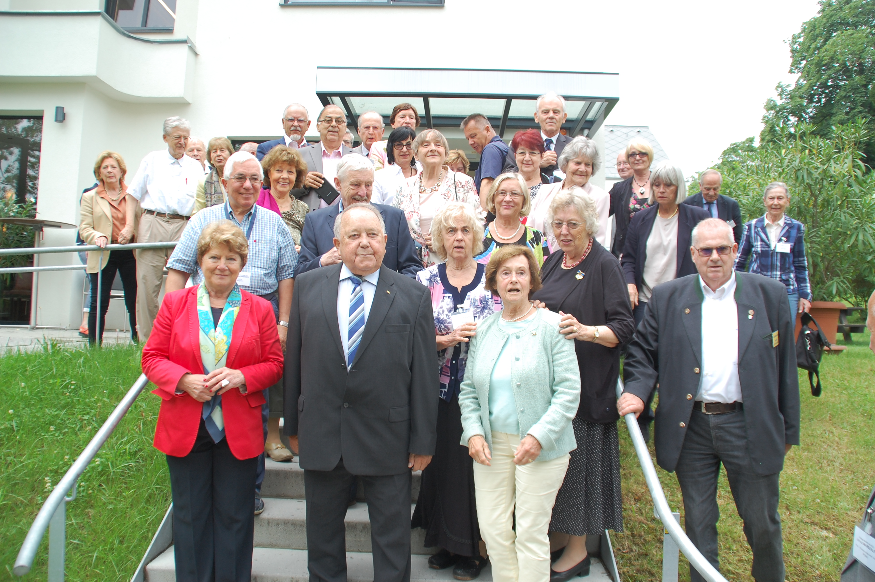
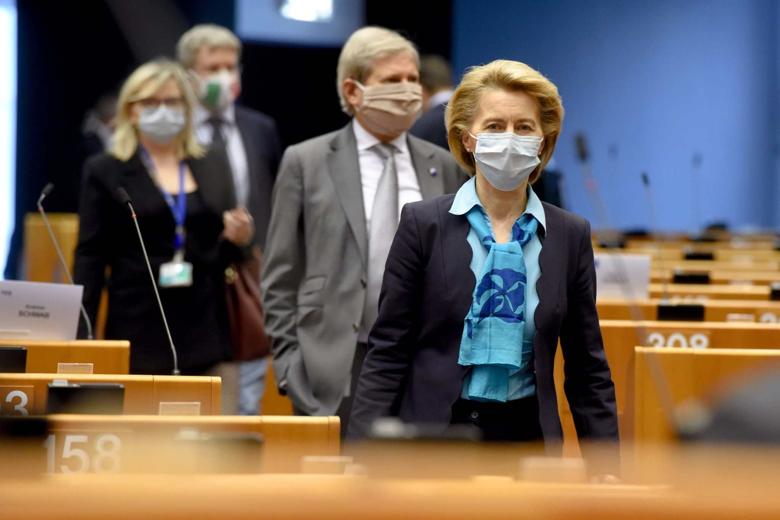
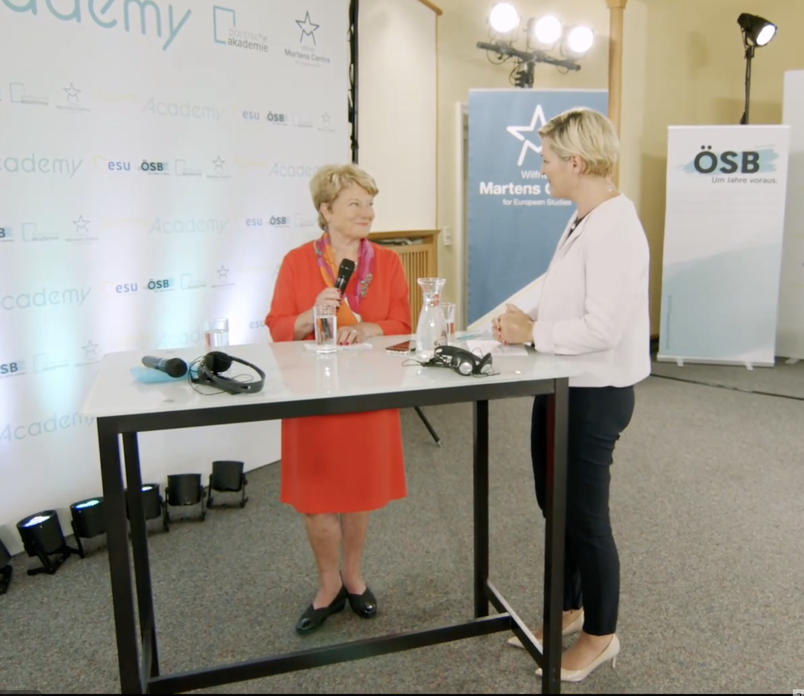
Together for resilient and sustainable societies
‘Europe can only recover together’
Rethinking age and ageing
Where no one is left behind

Slide 17
Let’s celebrate!

