Slide 1
The effects of COVID-19 on both the Finnish society and Kansallinen senioriliitto.
Leena Jääskeläinen
Chairwoman of the council of the National Senior’s Union.
ESU Regional Conference

Slide 2
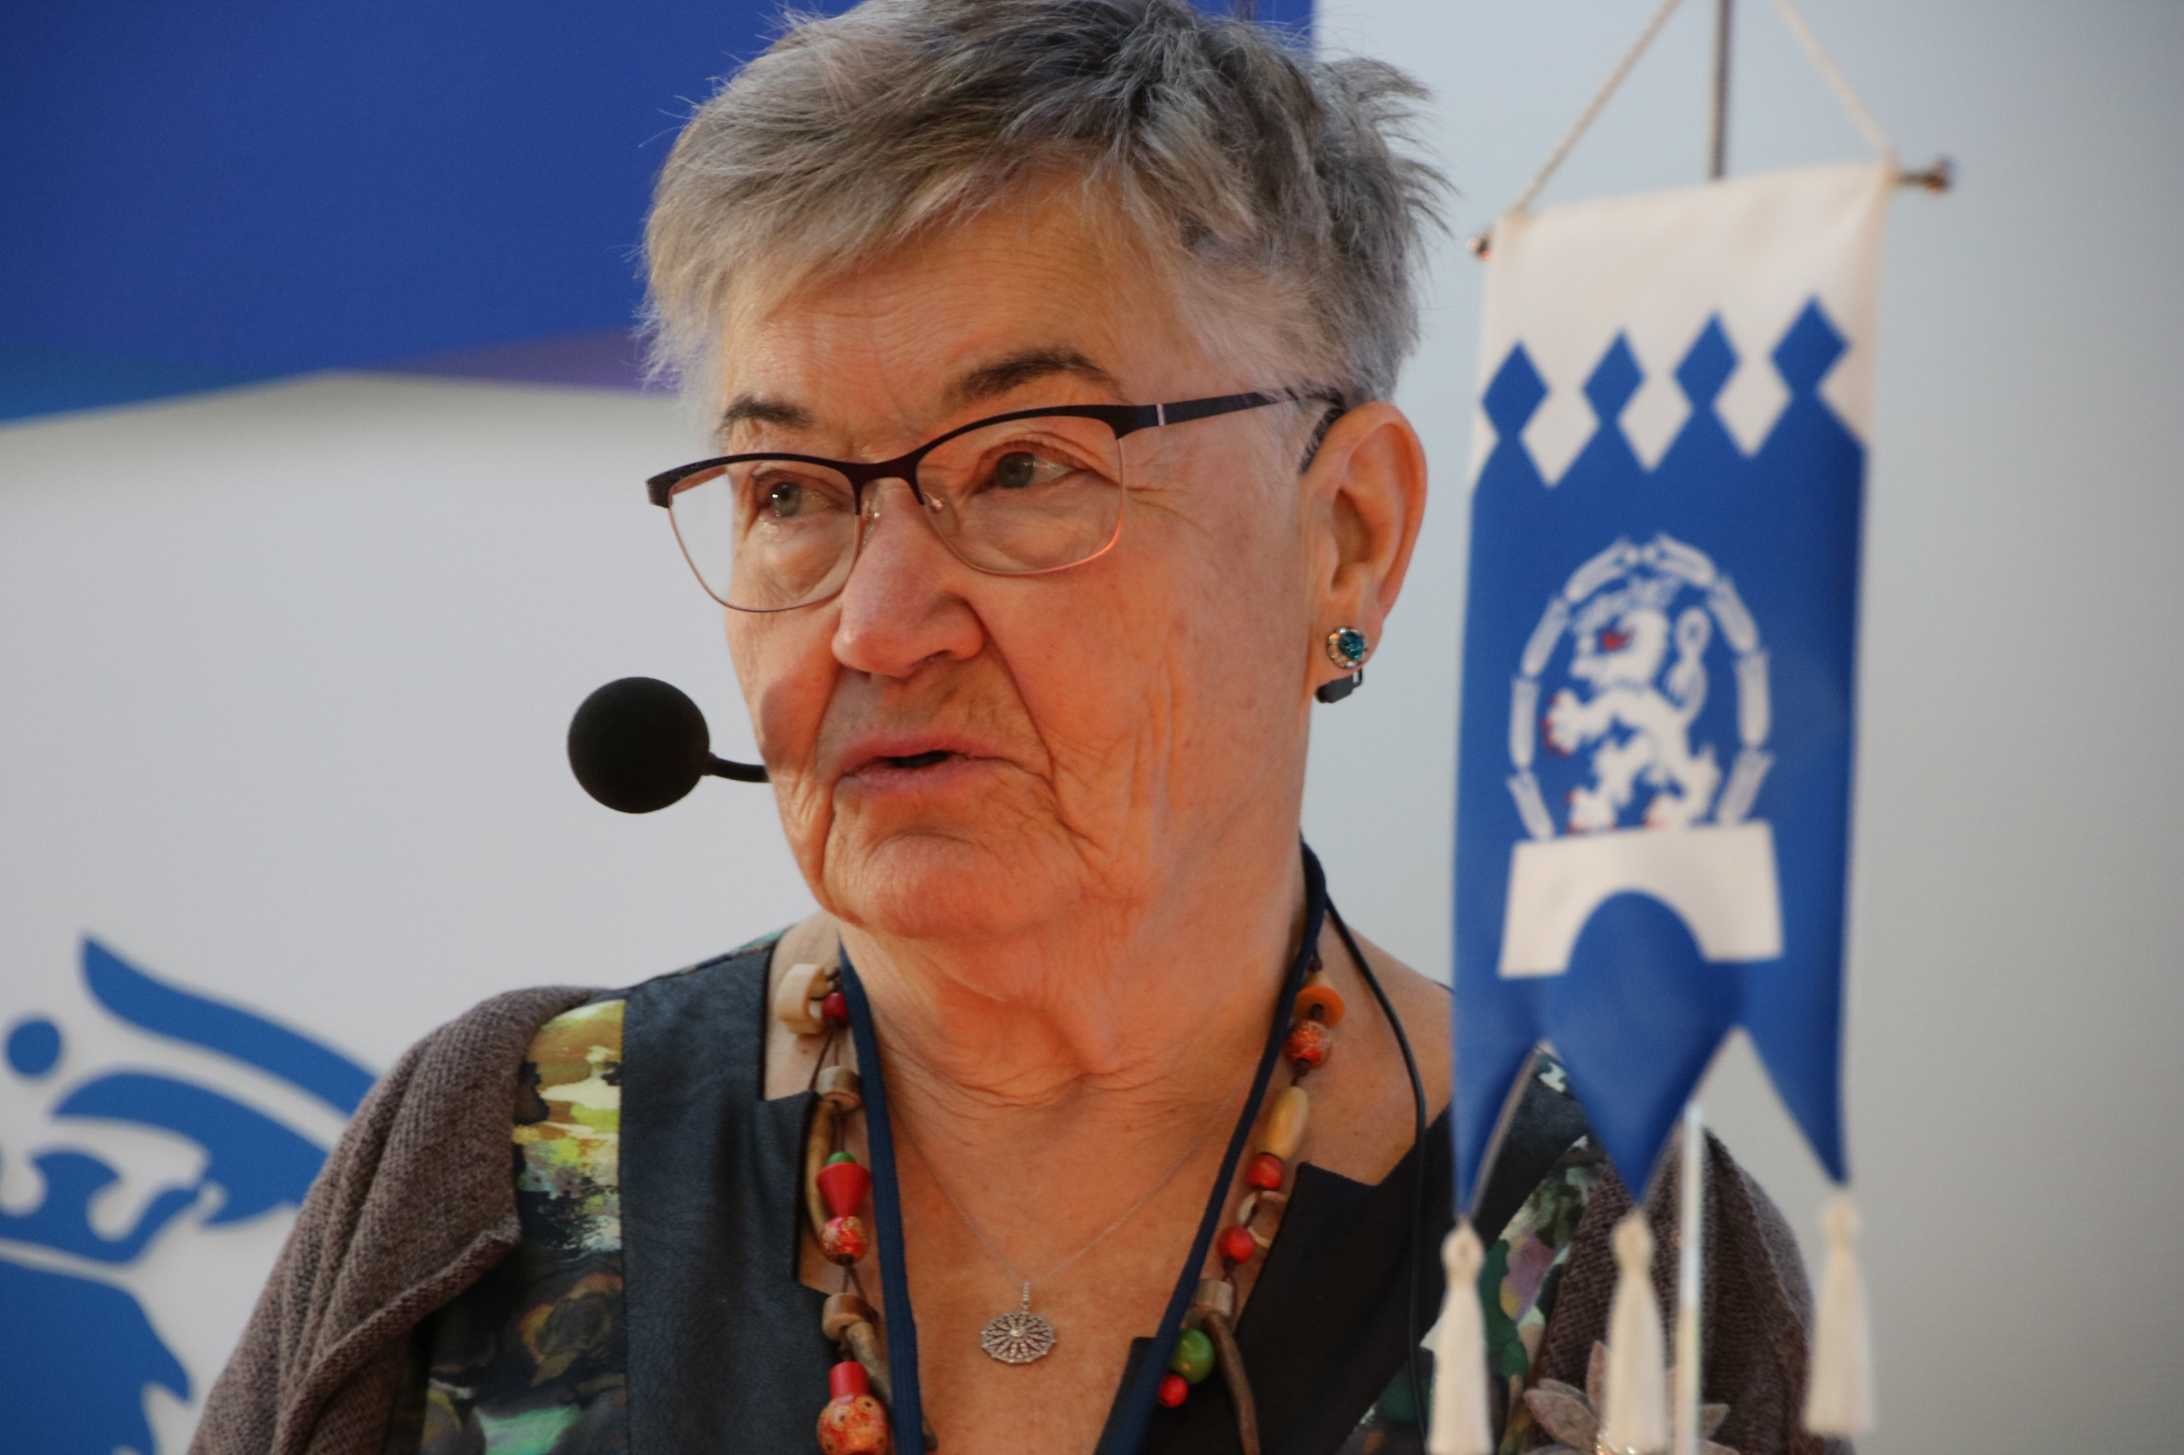
Leena Jääskeläinen
Current position:
Chairwoman of the council of Kansallinen senioriliitto
Career:
Senor supervisor on the health and physical Education in the National Board of General Education
Headmaster of Santasport institute in Rovaniemi
Educational background:
Master of science (Sport and Health ).
Vicepresident of ESU

Slide 3
Contents
1. Finland’s Covid-19 statistics and strategy.
2. The pandemic’s effects on the economy and on the wellbeing of elderly.
3. Examples of future prospects in Finland.
4. Kansallinen senioriliitto (the National Senior’s Union).
5. Pandemic related effects on Kansallinen senioriliitto.
6. Development of new ways of operating.

Slide 4
Finland’s Covid-19 statistics
Total population of Finland at approximately 5,5 million.
Between January 2020 and March 2022:
812,224 Covid-19 infections reported.
2,571 reported Covid-19 related deaths.
Average age of the deceased at 83 years.
Vaccination prevalence among the population:
62 % with three vaccination doses.
76 % with two vaccination doses.
80 % with a single vaccination dose.

Slide 5
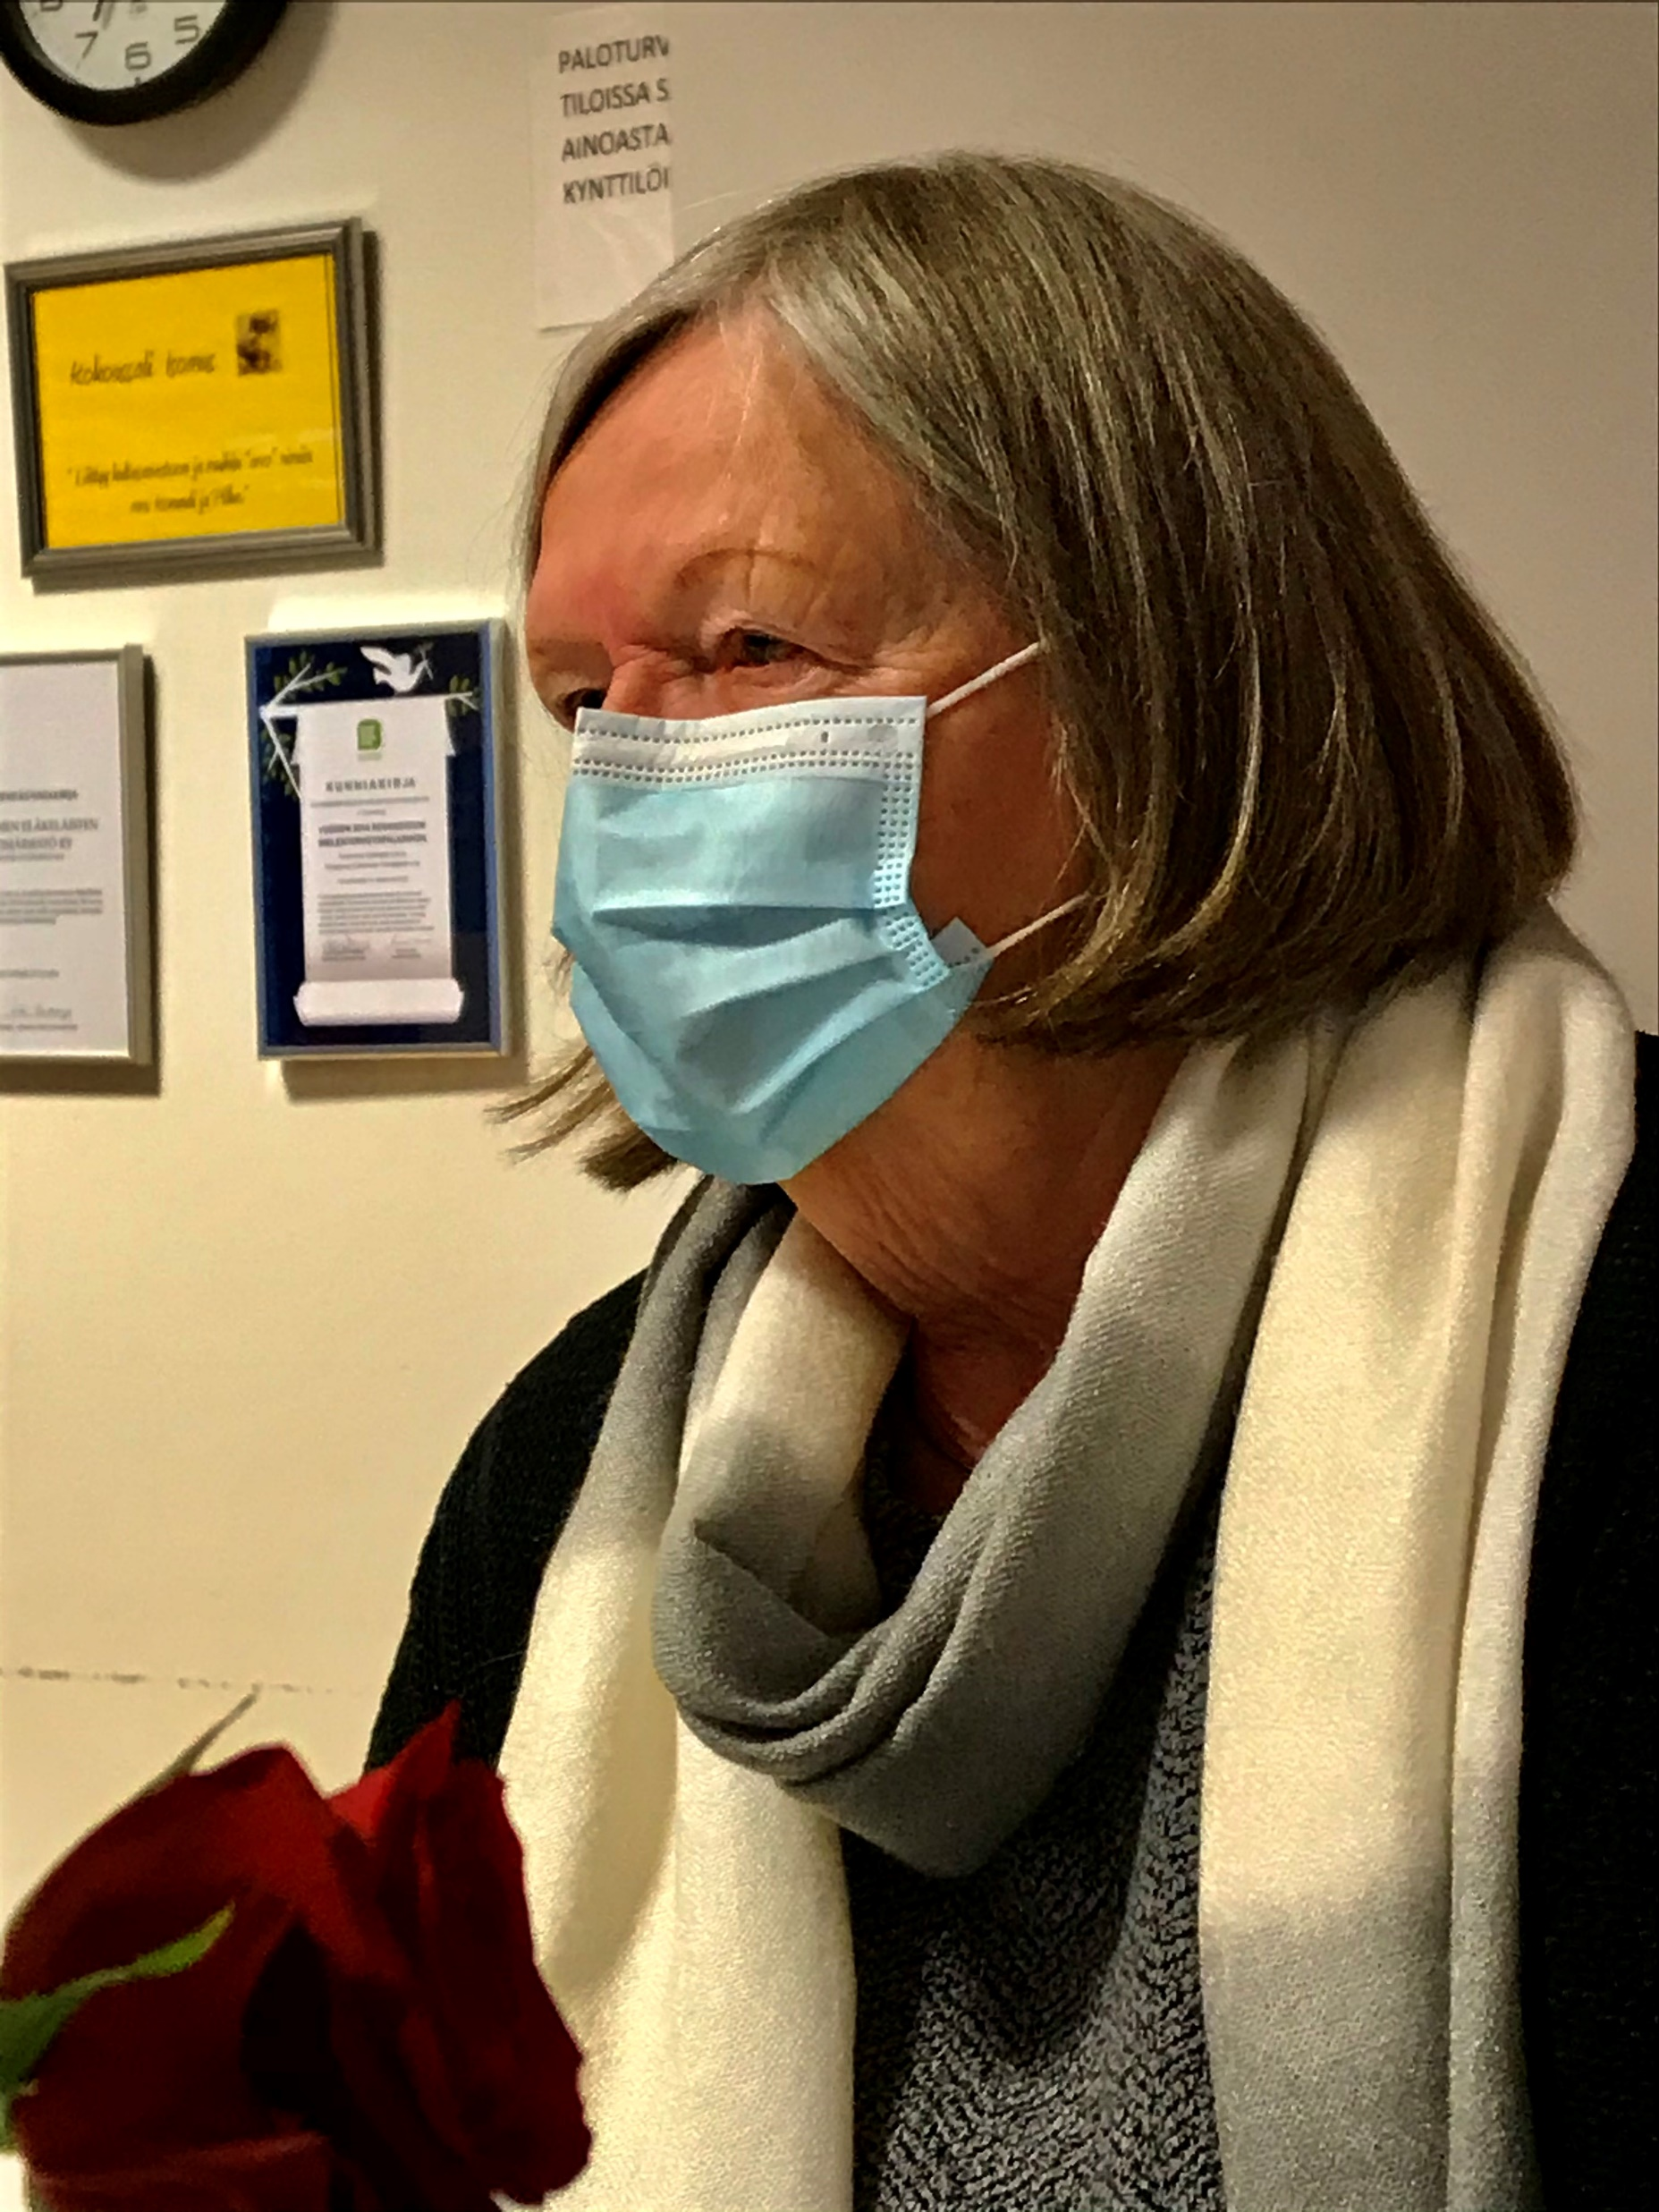
Finland’s Covid-19 strategy
Finland implemented a hybrid strategy. (set in May 2020 )
Encourage citizens to protect their own health.
Offer vaccines.
Impose necessary and limited restrictions.
Purpose
to guarantee the stability of the Finnish society and
to remain as open and possible
to support post-crisis management and reconstruction and prepare for an ongoing pandemic.

Slide 6
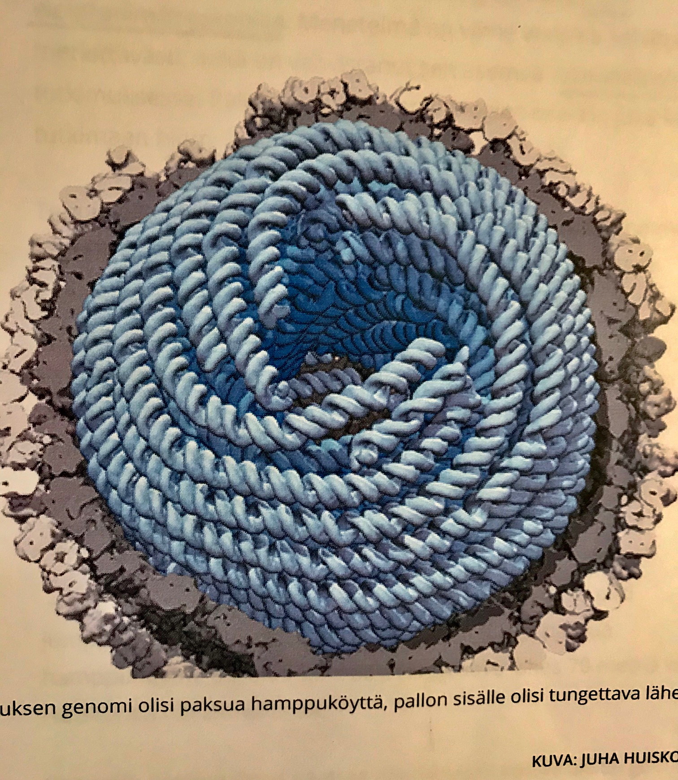
The pandemic’s effects on the economy
Growth of the GDP in 2021 but shows signs of slowing down.
Production of goods on the rise, consumption is lessening.
Company investments continued in 2021.
338 million euros paid as corporate subsidy.
Bankruptcy currently at a normal level.
Employment currently on the rise.
More job vacancies and salaries paid in 2021.
Inflation at 3,2 % in October 2022.

Slide 7
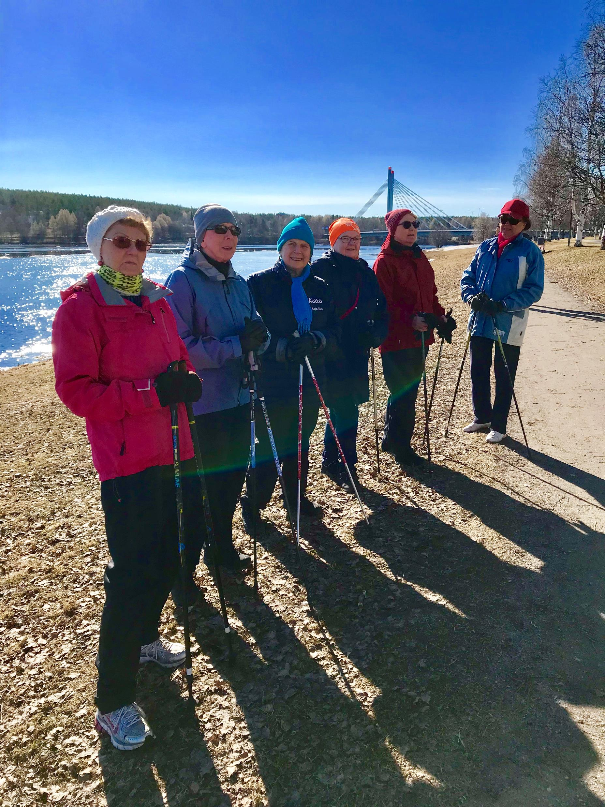
The pandemic’s effects on the wellbeing of elderly
The elderly feeling lonelier due to the pandemic.
Difficult to facilitate the upkeep of physical health and the possibility to go outside.
Ability to perform decreased among the elderly.
Increased lack of services for the elderly.
Due to a lack of resources services becoming more institutionalized instead of customer centered,
Increased use of digital services regarding the elderly.
Support and guidance needed for the use of digital platforms.

Slide 8
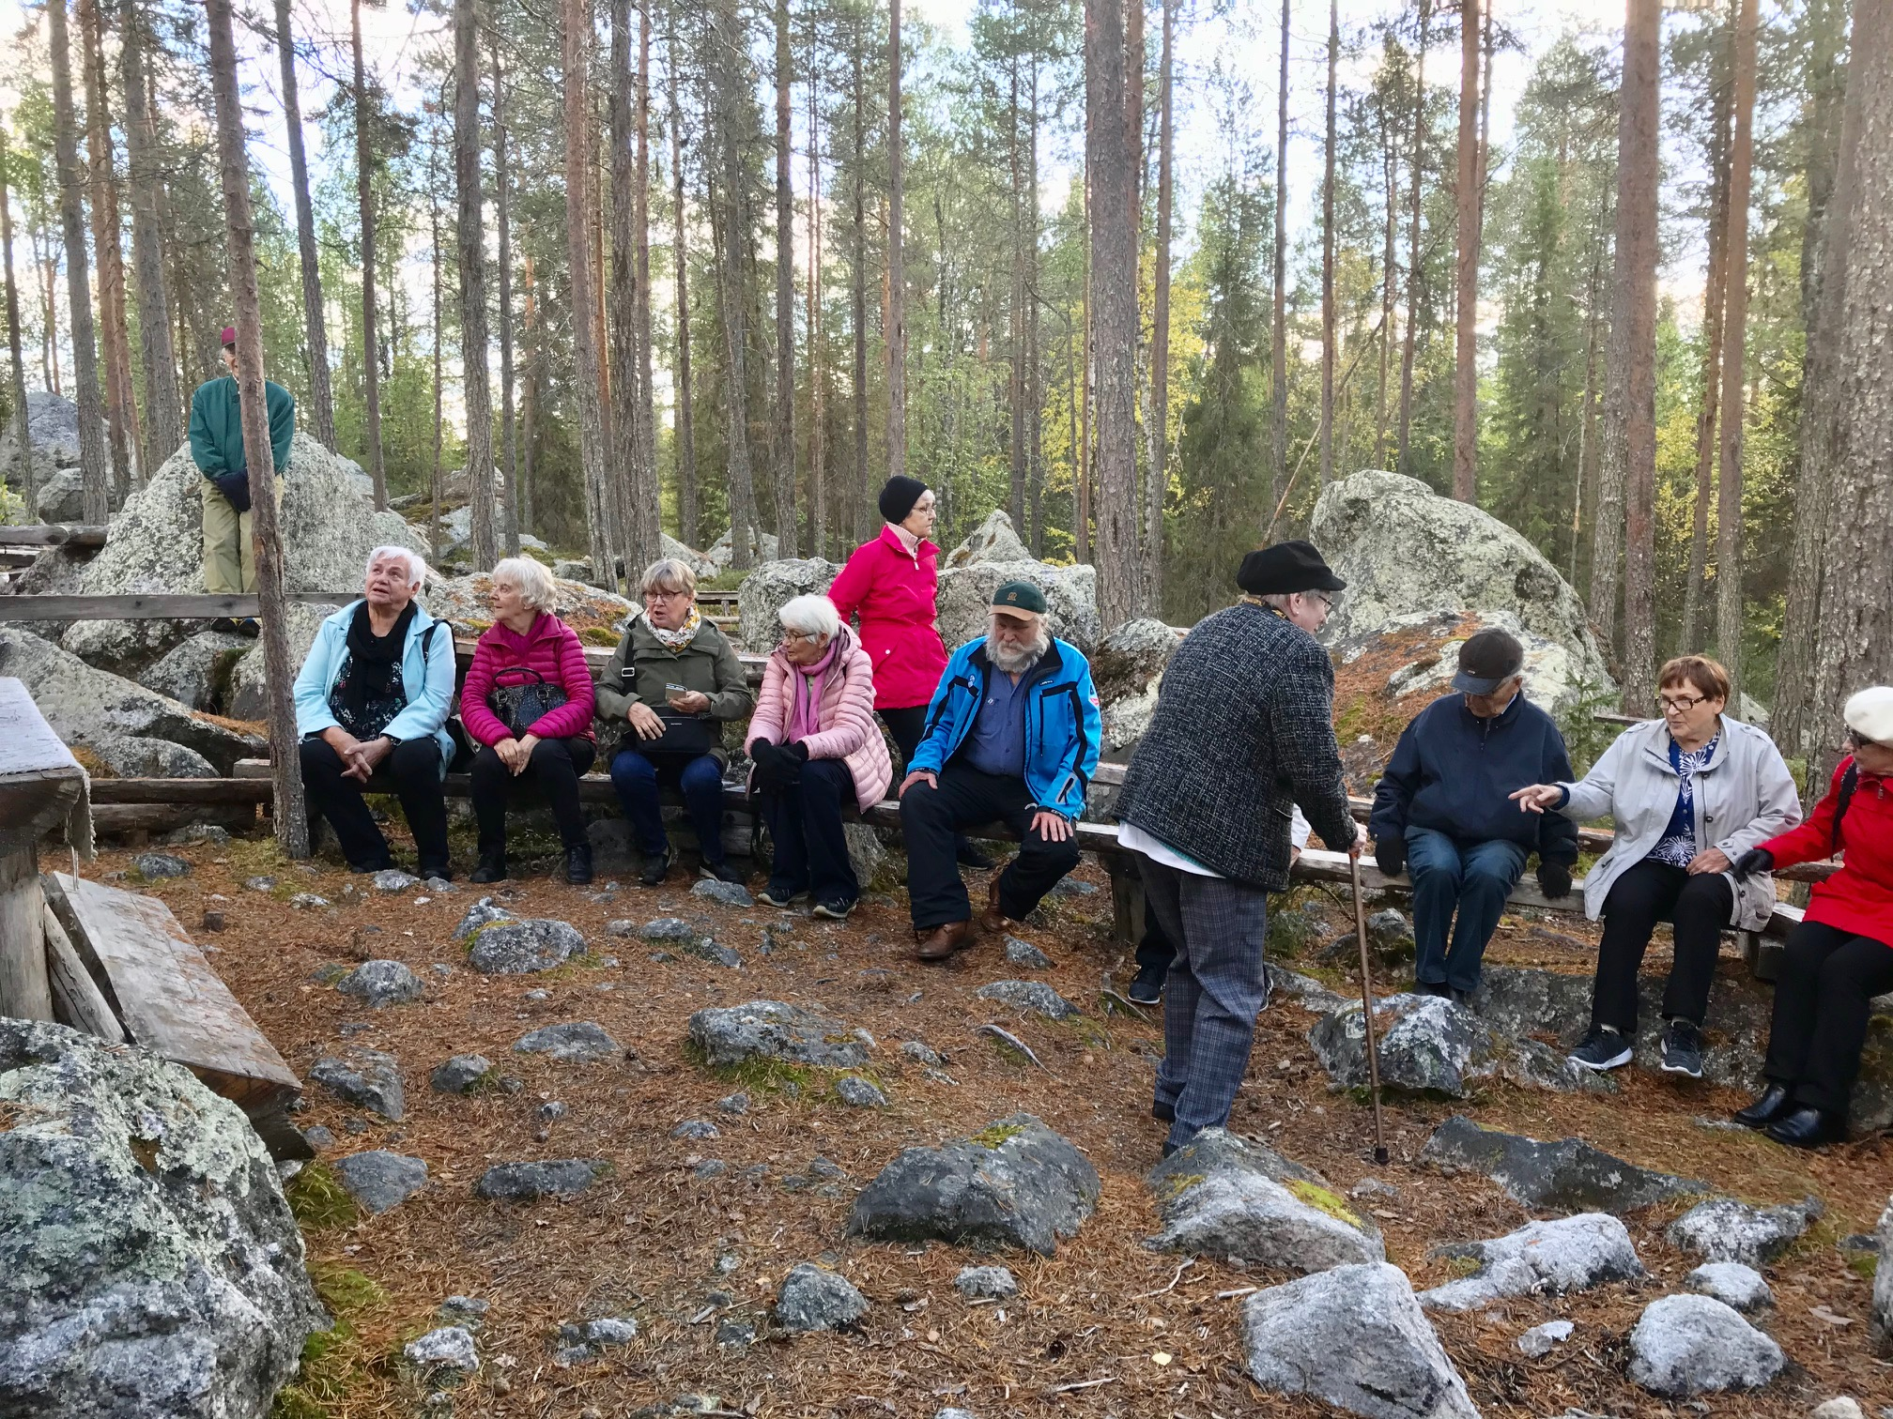
Examples of future prospects in Finland
The optimization of COVID-19 guidelines, to ensure the least amount of interference in everyday operations
.
A space for innovative thinking, allowing larger structural changes in society.
Solidify resources for research and education to safeguard innovation concerning future challenges.
Implementation of a resilience plan.
Security of supply to be improved to ensure self-sufficiency.
Cultivate international co-operation and learning.

Slide 9
Examples of future prospects in Finland (2)
Maintaining support for developing countries benefits Finland in the long run.
Encouragement for volunteer work and peer-support activities.
Efforts to decrease unemployment to reduce the detrimental affects of a pandemic.
Distance work and studies provide new ways to combine family and professional life.
The pandemic provides an opportunity to advance environmental goals and reinforce the Finnish economy.

Slide 10
Kansallinen senioriliitto
Founded in 10.10.1971.
Purpose to ensure social safety and wellbeing of the elderly and monitor and uphold their rights.
Politically unaffiliated.
14 reginal districts with 158 regional associations.
Approximately 24 000 members.
Educates its members, promotes its operations, organizes events, supports volunteer-based activities, endorses recreational and rehabilitative work.
Financed through membership fees, donations and grants.

Slide 11
Pandemic related effects on Kansallinen senioriliitto
During the year 2020:
Operations of the National Senior’s Union greatly affected.
60 % of associations had a lower than 50% attendance rate for activities.
Pandemic related restrictions forced associations to cancel numerous activities.
Percentage of members of the union reported:
20 % of increased feelings of loneliness.
16 % increased feelings of anxiety and depression.
71 % reported diminished social interactions.
Average age among the members of the unions was lowered with one year in addition to the union losing members due to inactivity caused by the Covid-19 restrictions.

Slide 12
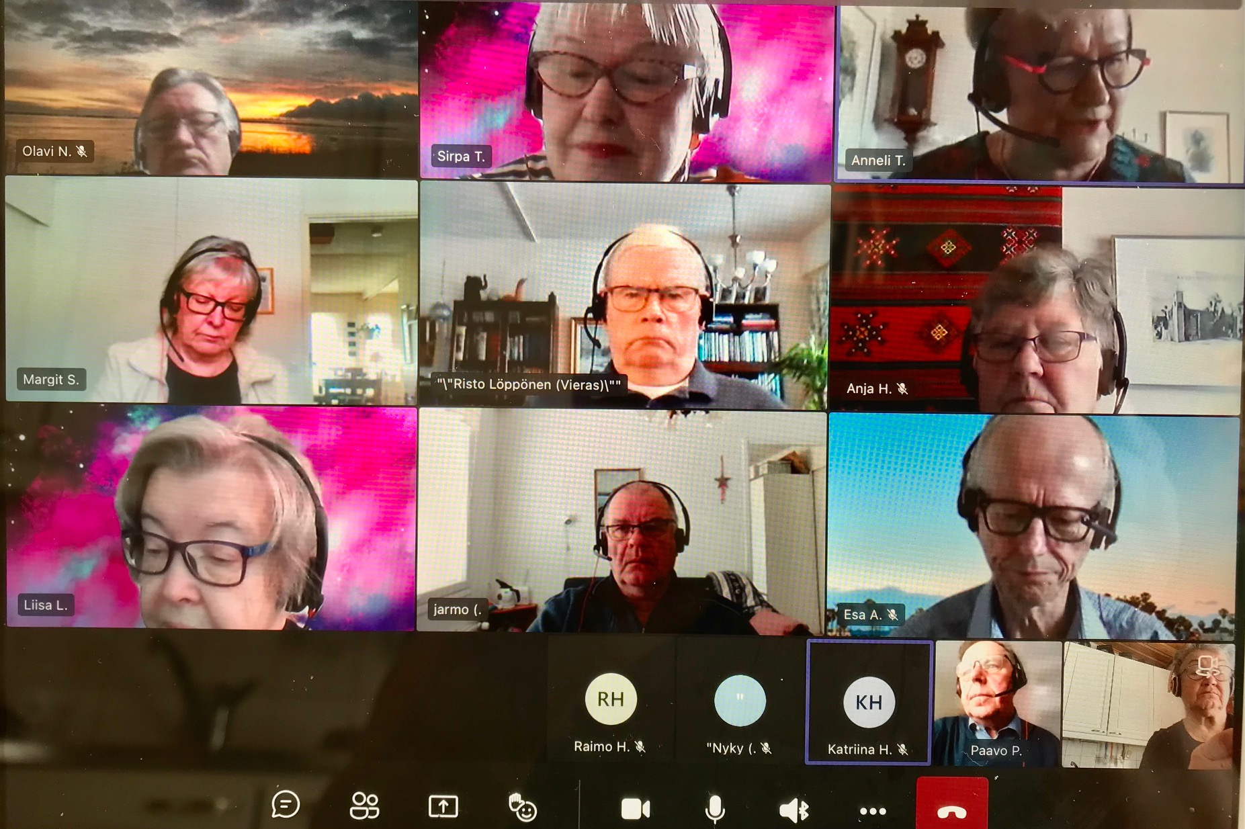
Development of new ways of operating
The roll-out of new ways of operating included education related to different digital platforms and further development of online activities.
Newly developed ways of operating partly adopted into regular operations:
Online conferencing (Teams).
Podcasts.
Online video platforms and social media (Youtube, Facebook).

Slide 13
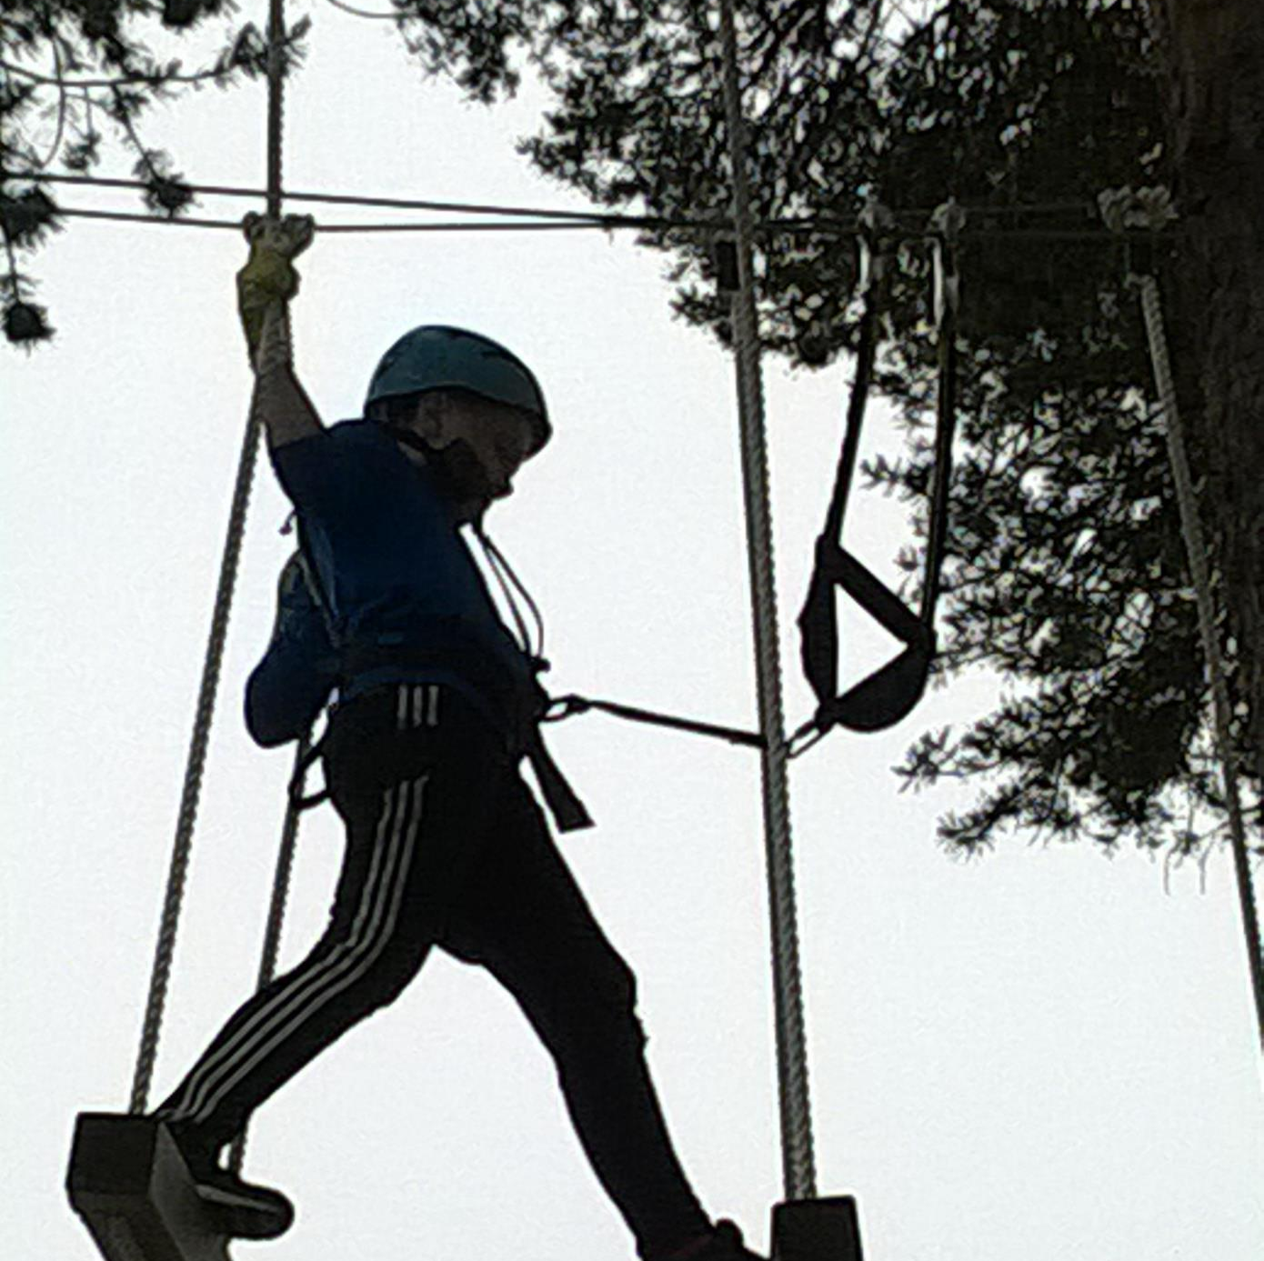
Guidelines for the future
To observe the development of the new healthcare and social welfare districts and draw attention grievances.
To increase the number of position papers on topics relating to the elderly.
To focus on the recruitment of new members.
To solve issues related to daily life of the elderly in co-operation with members from districts and associations.

Slide 14
Guidelines for the future (2)
To provide training for both district and association members.
To organize first aid training and education on digital matters if possible.
To offer districts and associations free and limited Microsoft office licenses.

Slide 15
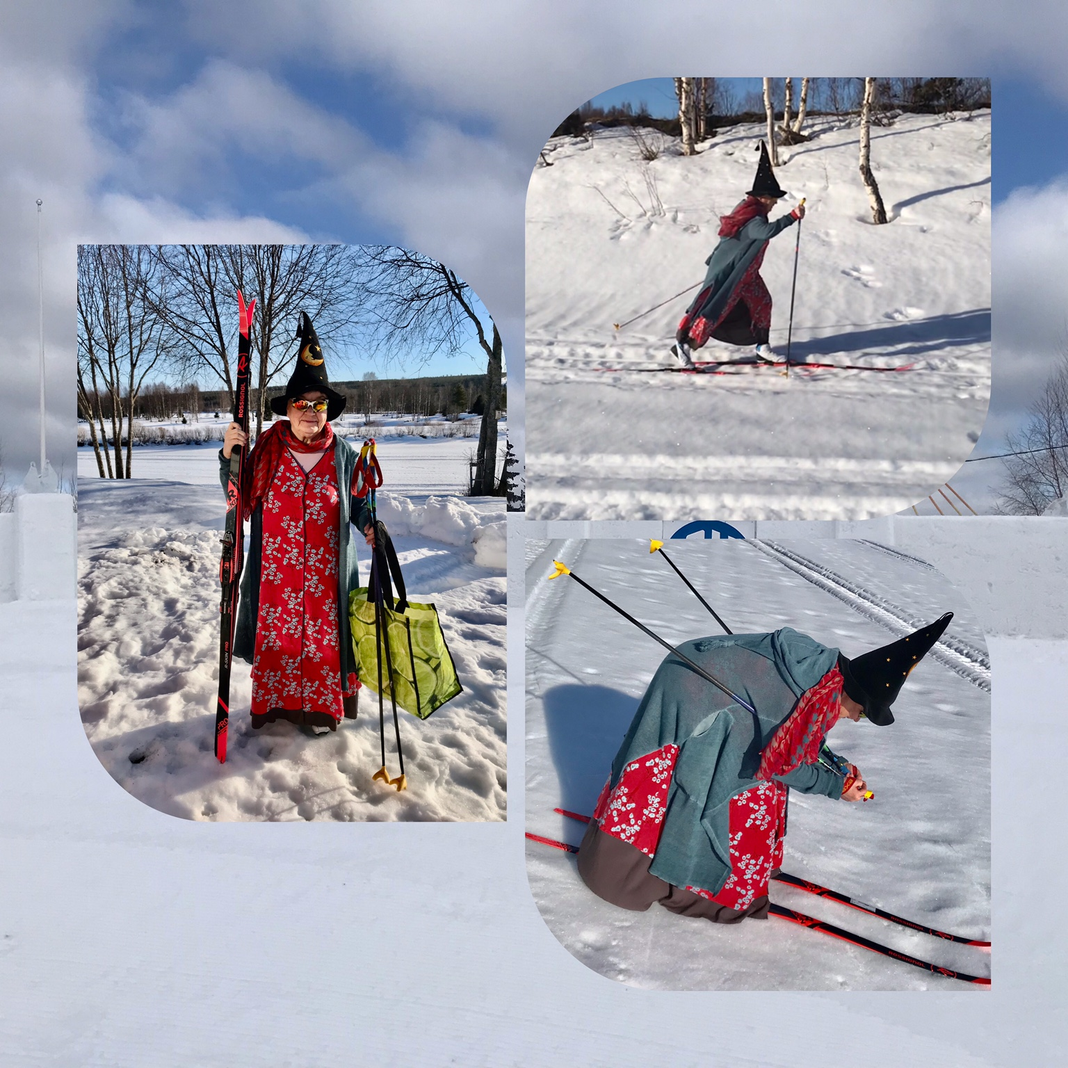
BOLDLY INTO THE FUTURE!

Slide 16
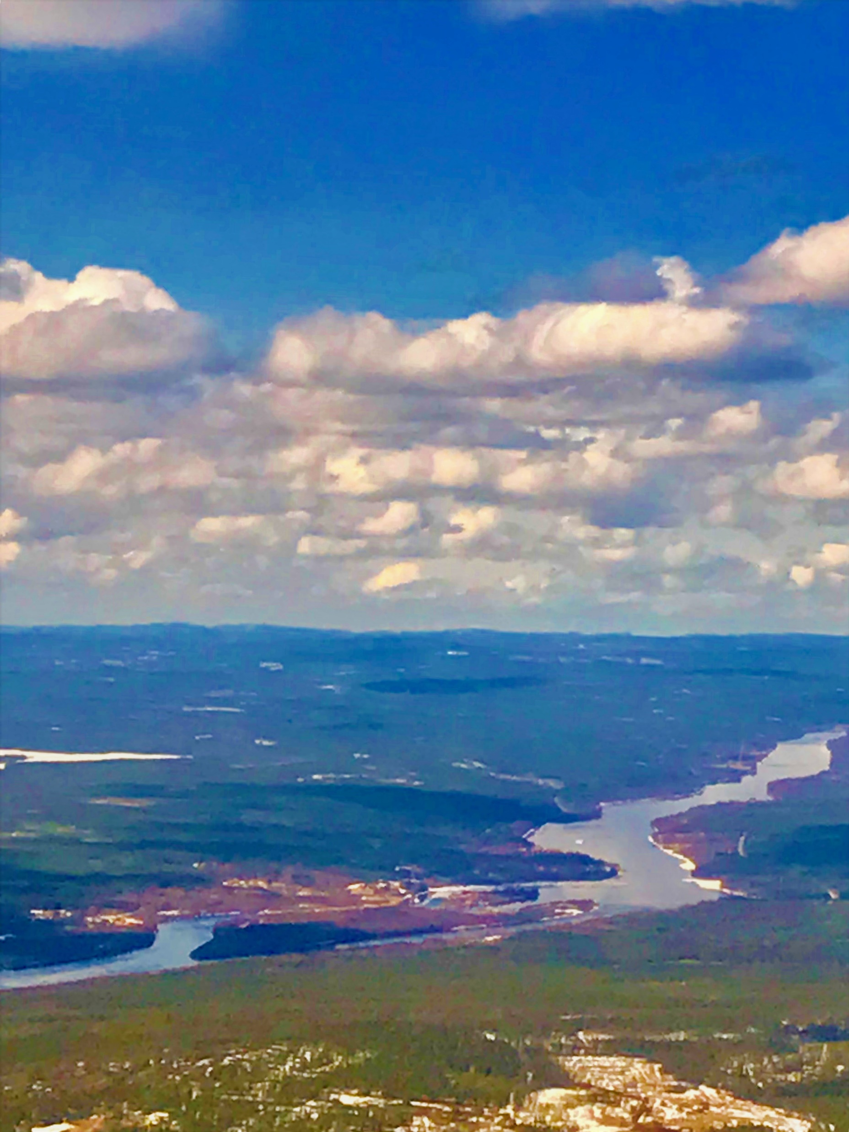
More info
https://www.eduskunta.fi/FI/naineduskuntatoimii/julkaisut/Documents/tuvj_1+2020.pdf
https://www.stat.fi/ajk/koronavirus/koronavirus-ajankohtaista-tilastotietoa/miten-vaikutukset-nakyvat-tilastoissa/talouden-tilannekuva
https://valtioneuvosto.fi/en/information-on-coronavirus/hybrid-strategy-to-manage-the-covid-19-epidemic
https://thl.fi/fi/web/hyvinvoinnin-ja-terveyden-edistamisen-johtaminen/ajankohtaista/koronan-vaikutukset-yhteiskuntaan-ja-palveluihin
https://www.julkari.fi/bitstream/handle/10024/142536/THL_Rap3_2021-Covid-seuranta%20kev%c3%a4t%202021_f_web.pdf?sequence=4&isAllowed=y
https://www.eduskunta.fi/FI/naineduskuntatoimii/julkaisut/Documents/tuvj_1+2020.pdf

