Slide 1
The European Seniors’ Union
ESU ACTIVITIES DURING THE PANDEMIC AND FUTURE PROSPECTS

Slide 2
How to cope with the pandemic-situation
Last live meeting of 2020 with ESU: 5-7 March Prague…
Shortly afterwards, we realised that COVID-19 would also have a major impact on our activities.
How to cope with the pandemic-situation?
How could the ESU continue to operate during COVID-19?

Slide 3
We had to select new priorities
Keeping Contact
Why?
How?
What?

Slide 4
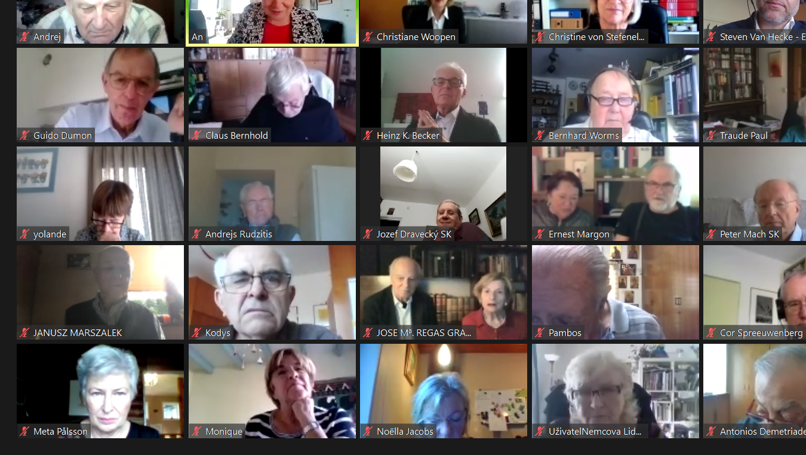
Keeping Contact
WHY?
Empower people
Exchange experiences
Create common goals

Slide 5
Keeping Contact - How?
To keep in touch we relied on a variety of media:
Our ESU Facebook page (2500 likes) is almost daily updated. And besides our own page, we could also follow the activities of our associations, several senior associations have their own Facebook account which enables us to follow the initiatives.
Follow us!

Slide 6
Keeping Contact - How?
The ESU Newsletter
Our most comprehensive communication tool during the pandemic;
We started in April and wrote two newsletters about the challenges the COVID-19 pandemic brought to the older generation;
The focus was on Respect for older persons’ rights;
We are proud to say that our newsletter became ‘an interactive communication tool’.

Slide 7
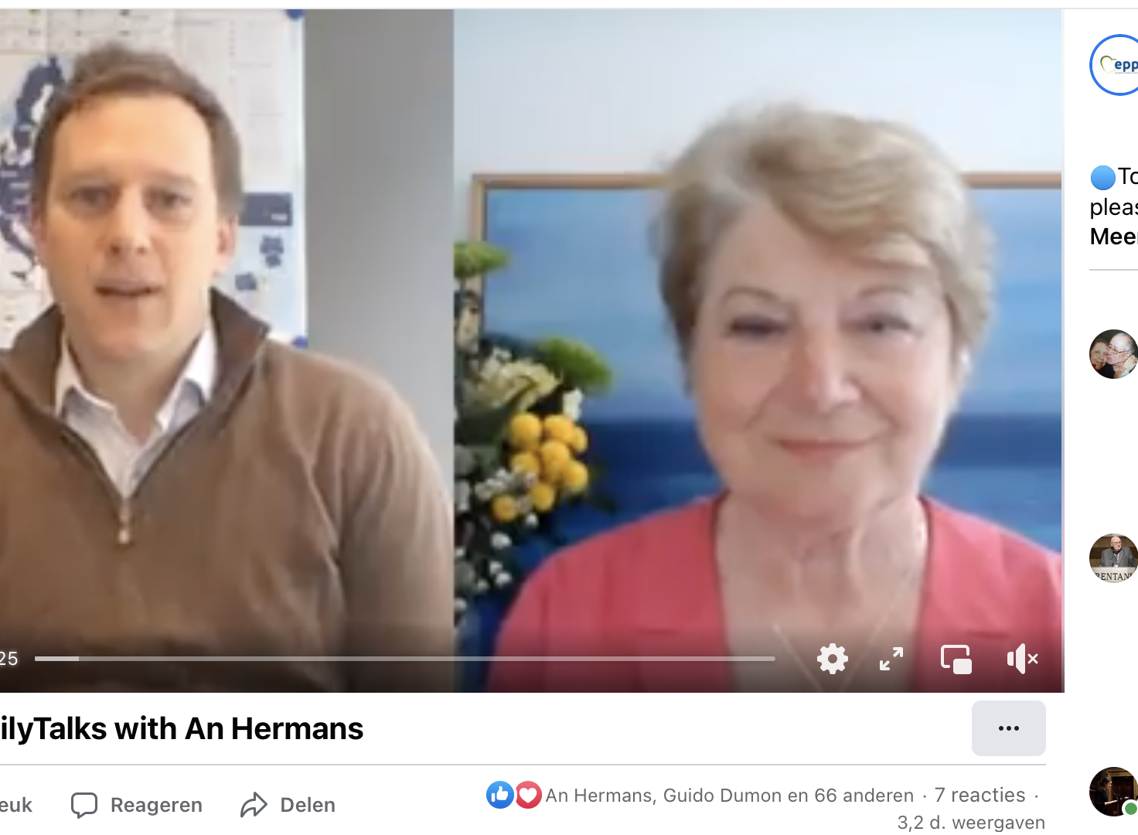
Keeping Contact - How?
‘EPP family interviews’
The EPP also took initiatives to give the ESU a voice through online communication
ESU president An Hermans had a Skype meeting with EPP policy advisor Nathan Shepura on the 29th of April 2020.
This meeting has been viewed and shared many times.

Slide 8
Keeping Contact - How?
Video conferences
New concept → New challenges
Composing the programme;
Selecting a relevant theme;
Host/ Moderation;
Keynote speaker;
Technical support - credits to Secretary General Guido Dumon.
New concept → New opportunities
Chances for new people to follow our meetings;
The oldest participant was 94 years old, also the seniors (had to) learn to meet online (sometimes help from grandchildren);
This was sometimes an advantage for the speakers as well, as they did not have to make long transfers.
THE NEED FOR LIVE MEETINGS REMAINED!!

Slide 9
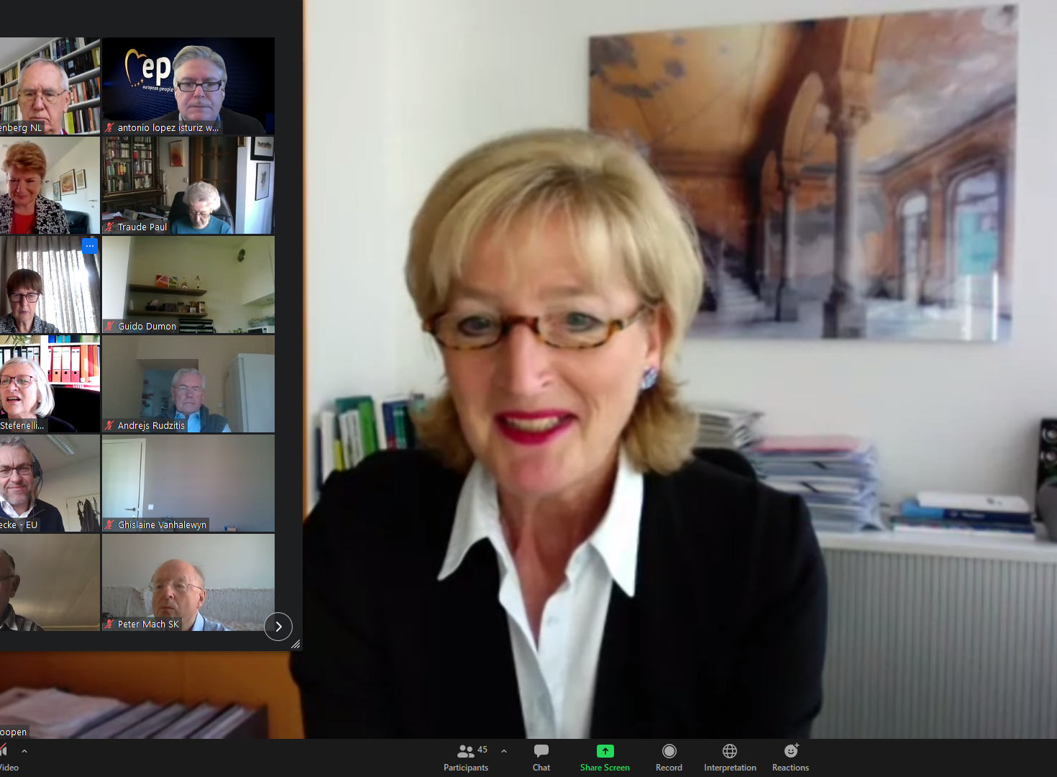
Keeping Contact - How?
Video conferences, some examples:
‘Let’s be guardians of an ethical dimension of politics’ 06.11.2020
Lecture by Prof Dr. Christiane Woopen (chair of the European Group on Ethics in Science and New Technologies, EGE): Lessons to be learned about older persons rights in emergency times

Slide 10
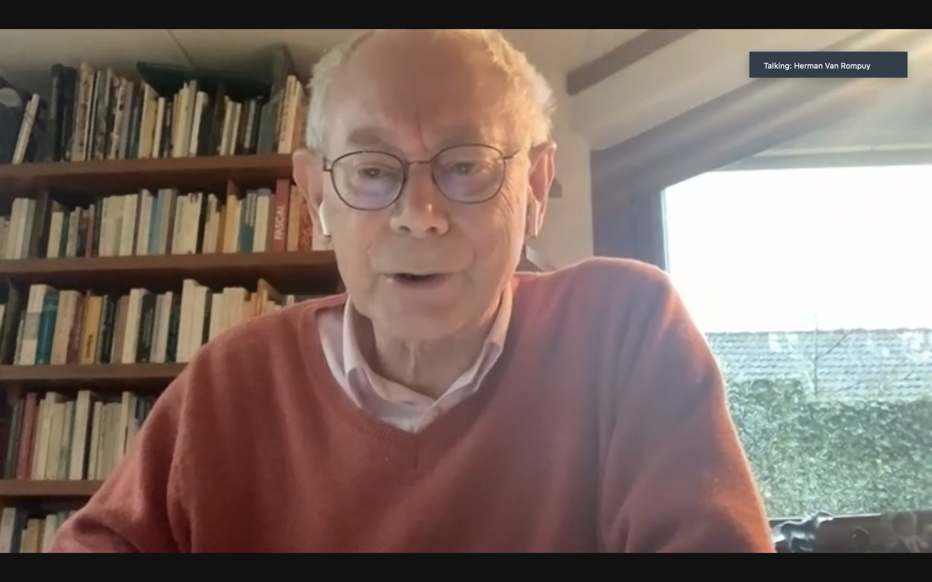
Keeping Contact - How?
Video conferences, some examples:
Drawing lessons from the COVID-19 pandemic, to cope with future challenges for people and for the EU 19.01.2021
Herman Van Rompuy gave an analysis of the current problem areas ahead of us: clear, concrete and based on factual data, in line with his years of experience as an economist and politician and his firm belief in the necessity of European integration.

Slide 11
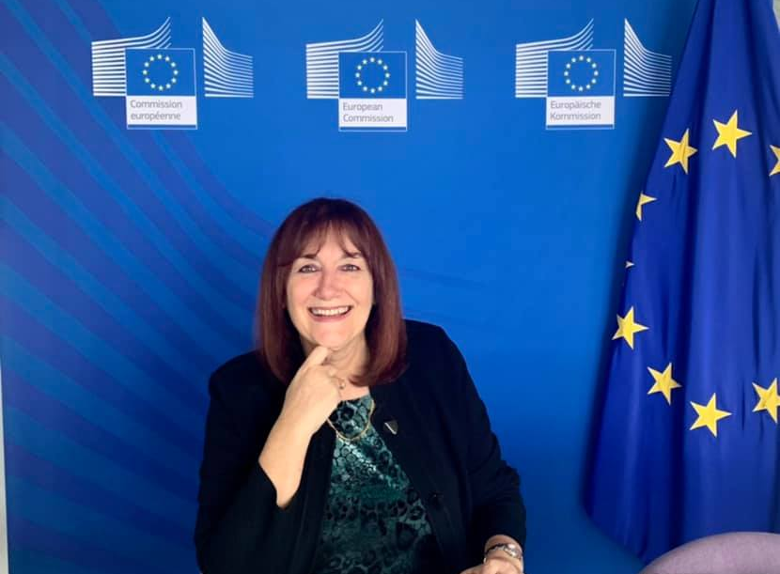
Keeping Contact - How?
Video conferences, some examples:
Europe’s future: demographic challenges and opportunities for a strong recovery 16.02.2021
Mrs. Dubravka Šuica, Vice-President of the European Commission in charge of Democracy and Demography
“The launch of the Green Paper is a decisive step in a policy process focusing on the EU response to demographic change.”

Slide 12
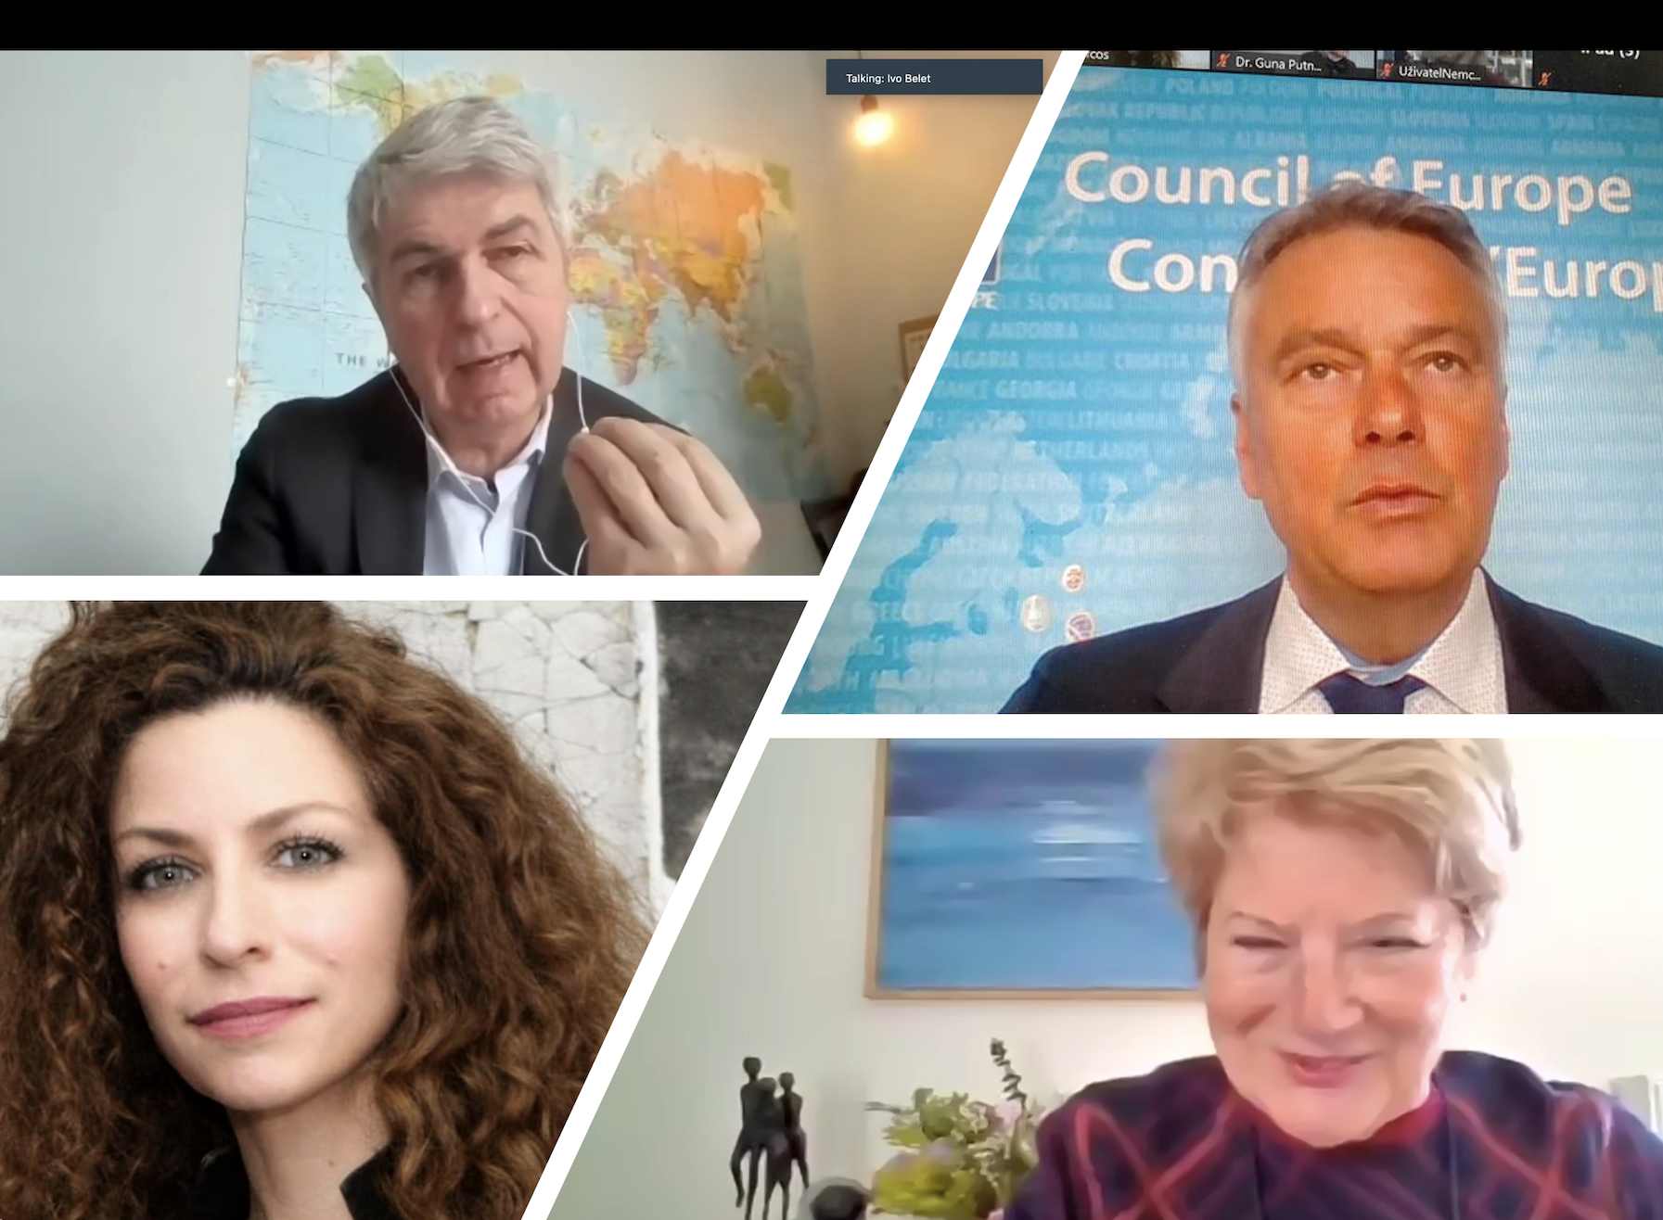
Keeping Contact - How?
Video conferences, some examples:
The era of digitalization: from communication highways to disinformation and infodemic. Opportunities and potential risks 23.03.2021
How to participate in today’s digital society? Which are the opportunities for older persons? Is the ‘digital society’ taking into account the ‘competences and skills’ of older persons and their rights to participate in society? How to create ‘room for all generations’ in this information society?

Slide 13
Keeping Contact - What did we learn? The EU’s policy priorities (2019-2024):
1. A European Green Deal;
2. A Europe fit for the digital age;
3. An economy that works for people;
4. A stronger Europe in the world;
5. Promoting the European way of life;
6. A new push for European democracy;
* 7. Action to contain the coronavirus crisis and promote economic recovery from it.
EU solidarity with Ukraine:
To stop the aggression of Russia by imposing far-reaching sanctions and measures;
To support the Ukrainian people by providing financial, military and humanitarian assistance;
To stand together for peace and sovereignty, democracy and prosperity.

Slide 14
Keeping Contact - What did we learn?
New subjects emerged:
Health and healthcare systems at different levels
Digitalisation, also for the older generation (MIL)
Mainstreaming demographic change

Slide 15
Ensuring qualified health and long-term care systems
The new realities of the COVID-19 crisis have increased the focus on health policy at EU level.
How can we:
Implement the lessons we learnt from the pandemic?
Give healthcare a higher priority in the recovery policy?
Do better in addressing the health and care needs of older persons?
What is needed to improve the cooperation between, the EU, Member States and international institutions?

Slide 16
Media and Information Literacy (MIL)
MIL are the first steps to participate in digital societies; are the building blocs to digital active citizenship. The ESU is urging governments, all stakeholders and civil society itself, to create a diversity of initiatives, not only to be developed for seniors and with seniors, but for all generations.
See: ESU Statement & ESU Resolution to be adopted by the EPP Congress:
“Towards an active and competent participation of all in resilient digital societies:
THE NEED OF MEDIA AND INFORMATION LITERACY FOR ALL AGE GROUPS”

Slide 17
Media and Information Literacy

Slide 18
Mainstreaming demographic change
“Demographic Change: one of the ‘deepest-lying challenges’ for European societies” - Dubravka Šuica

Slide 19
Looking ahead
We need more coordination at European level: a better coordinated health policy that has an impact in the Member States;
We have to embrace the new opportunities: such as digitalisation, e-health; digital justice for all, ...
We have to respond to the need for solidarity.

Slide 20
Thank you for Your attention!

