Slide 1
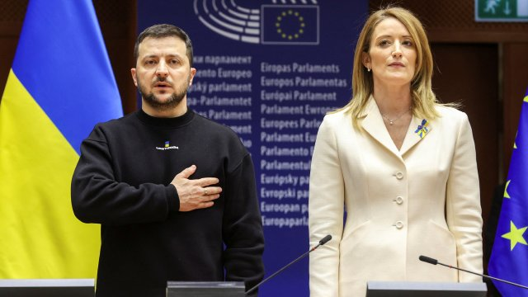
The current challenges of the EU European Seniors’ Union Leuven | 25 March 2022
Prof. dr. Steven Van Hecke
@VanHeckeSteven
Notes:
Picture: https://www.tijd.be/dossiers/oorlog-in-oekraine/zelensky-in-europarlement-als-oekraine-valt-verdwijnt-ook-de-europese-levensstijl/10446180.html

Slide 2
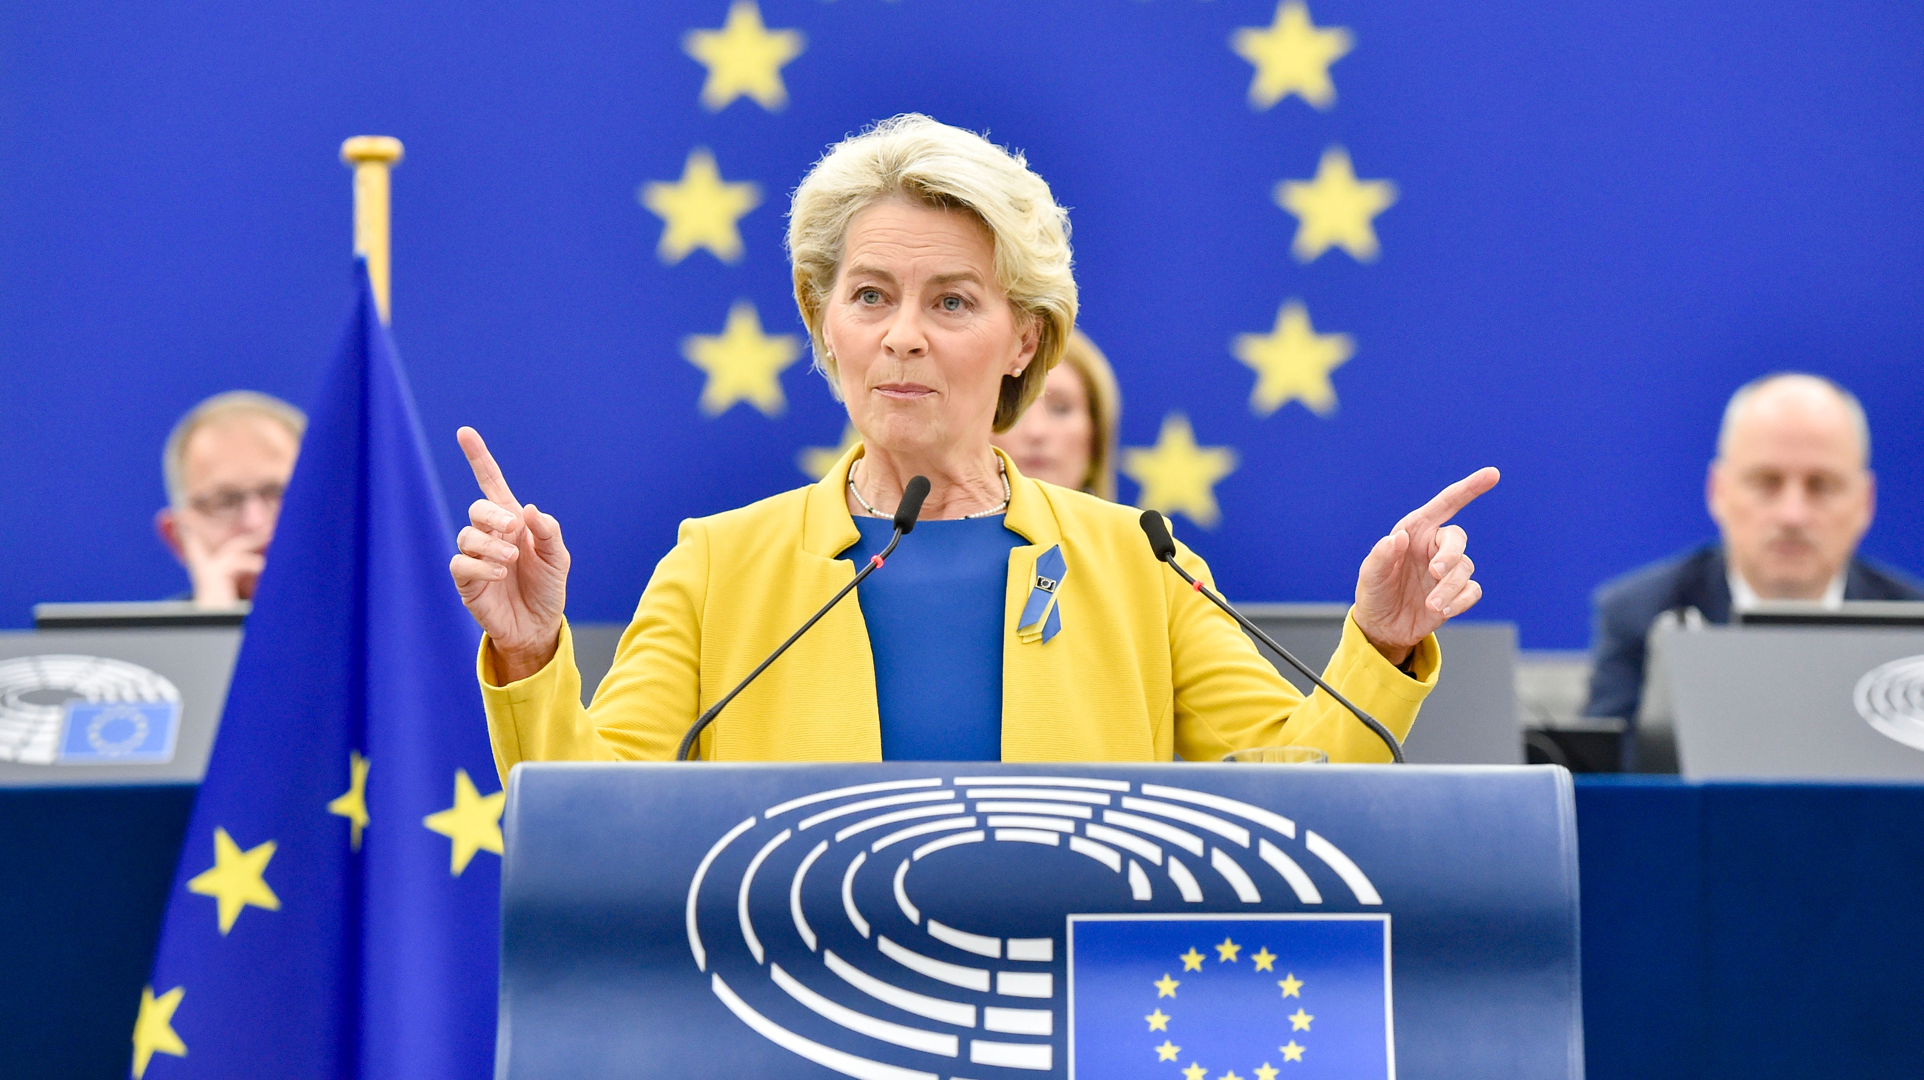
SOTEU - 14 September 2022
Notes:
Picture: SOTEU 2022 (https://www.euractiv.com/section/energy/news/eus-von-der-leyen-rows-back-on-plans-to-cap-fossil-gas-prices/)

Slide 3
SOTEU 2022
‘This is a war on our energy, a war on our economy, a war on our values and a war on our future.’

Slide 4
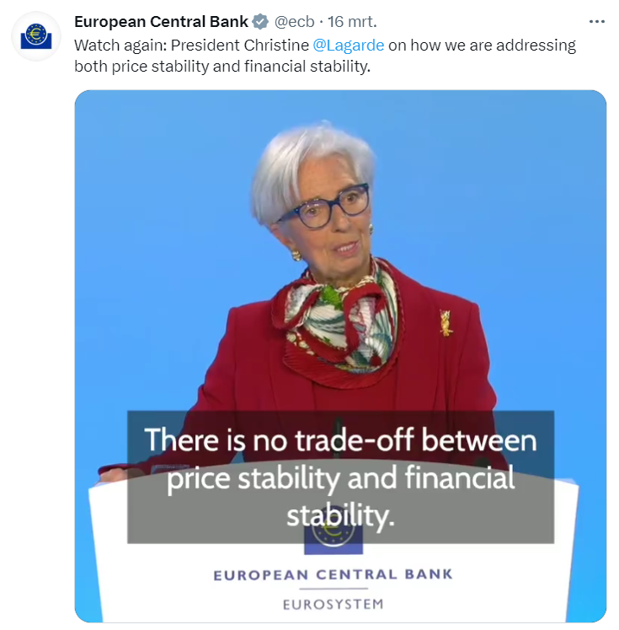
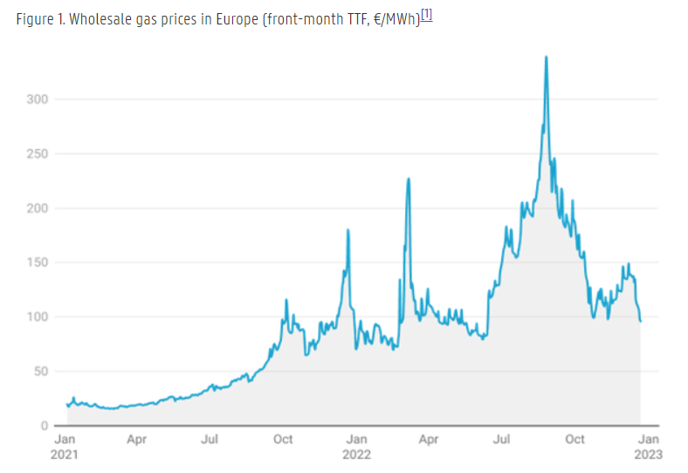
Energy (and inflation)
Notes:
https://www.ugent.be/ps/politiekewetenschappen/gies/en/research/publications/gies_papers/2023-global-energy-crisis/europes-energy-crunch-no-time-for-complacency

Slide 5
SOTEU 2022
‘This is a war on our energy, a war on our economy, a war on our values and a war on our future.’

Slide 6
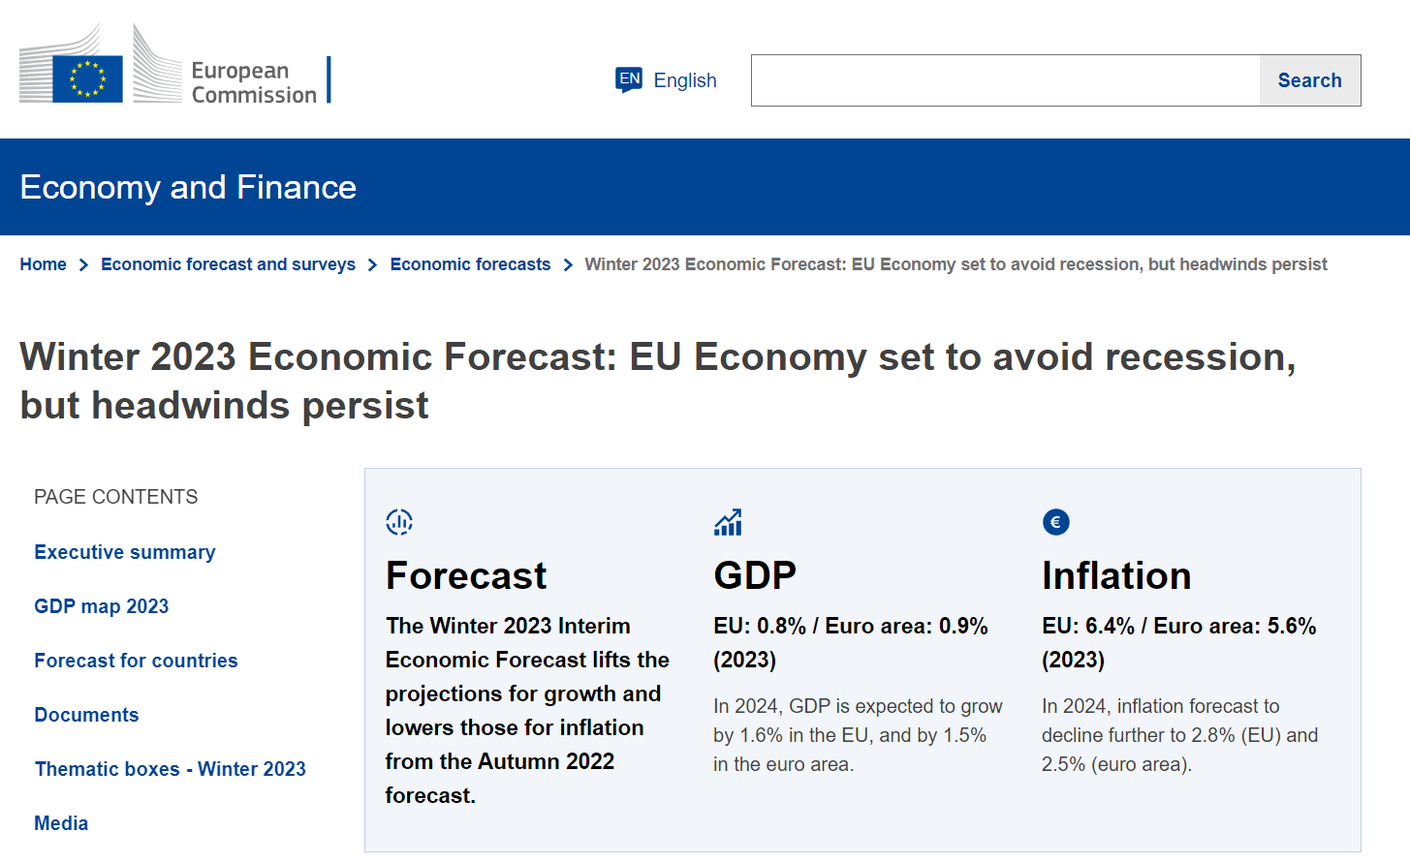
Notes:
https://economy-finance.ec.europa.eu/economic-forecast-and-surveys/economic-forecasts/winter-2023-economic-forecast-eu-economy-set-avoid-recession-headwinds-persist_en#:~:text=Growth%20for%202022%20is%20now,in%202024%20in%20the%20EU.

Slide 7
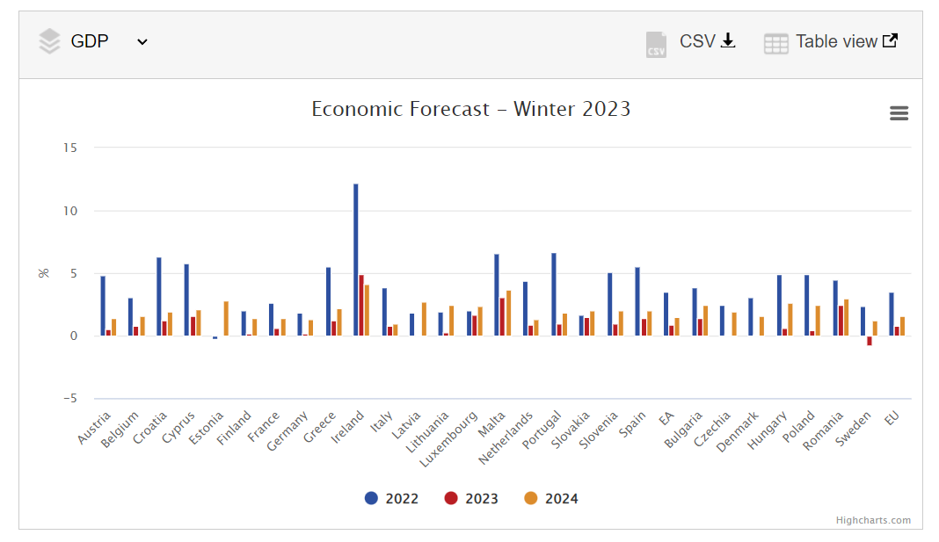

Slide 8
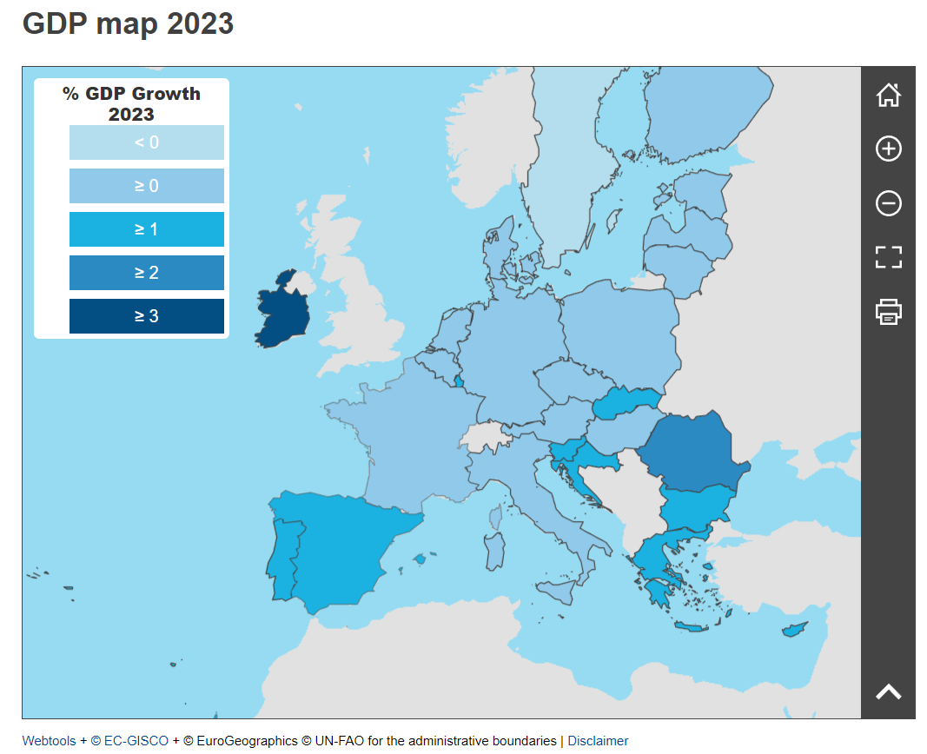

Slide 9
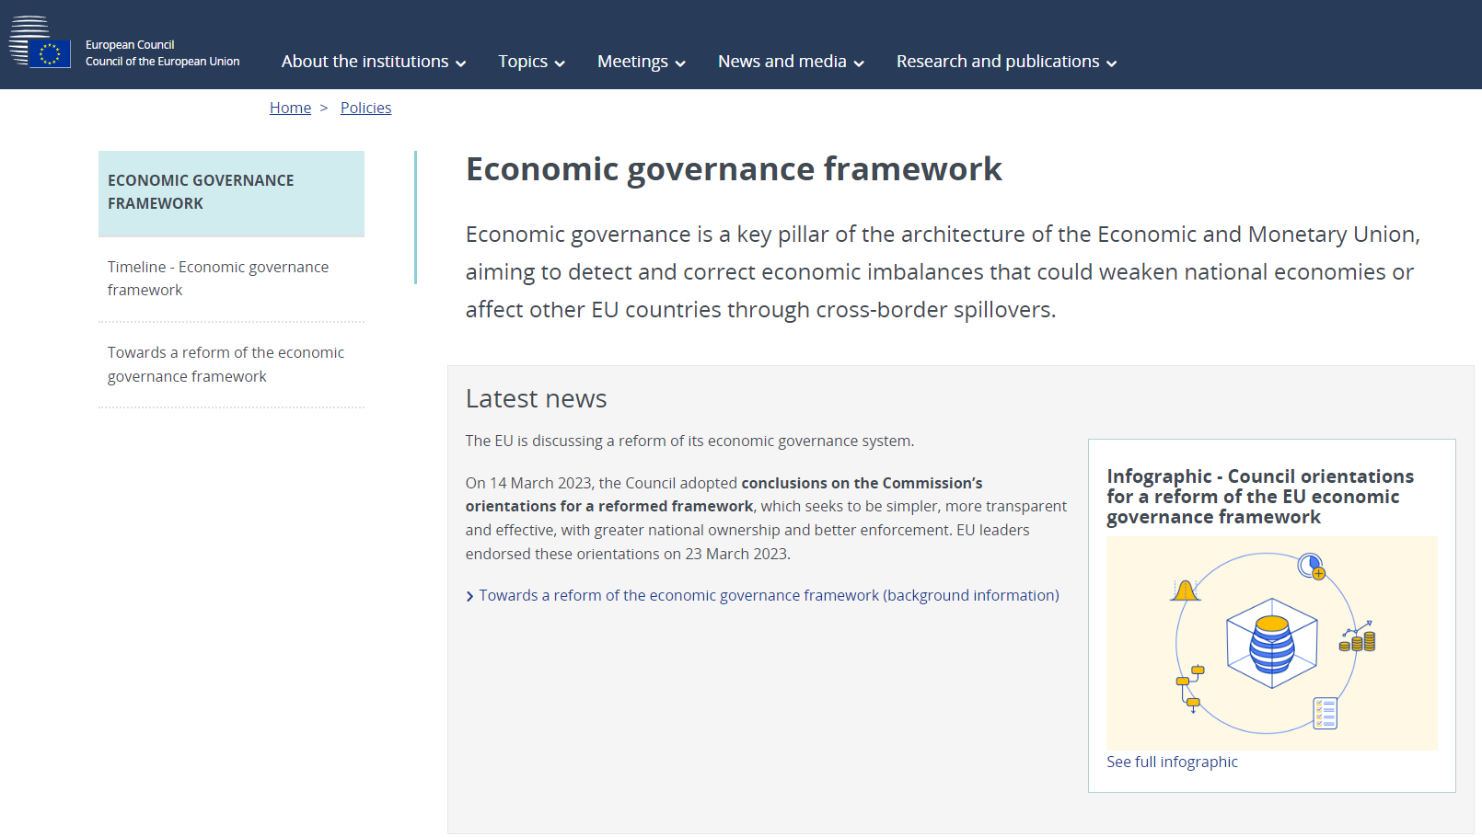
Economy (and finance)
Notes:
https://www.consilium.europa.eu/en/policies/economic-governance-framework/

Slide 10
SOTEU 2022
‘This is a war on our energy, a war on our economy, a war on our values and a war on our future.’

Slide 11
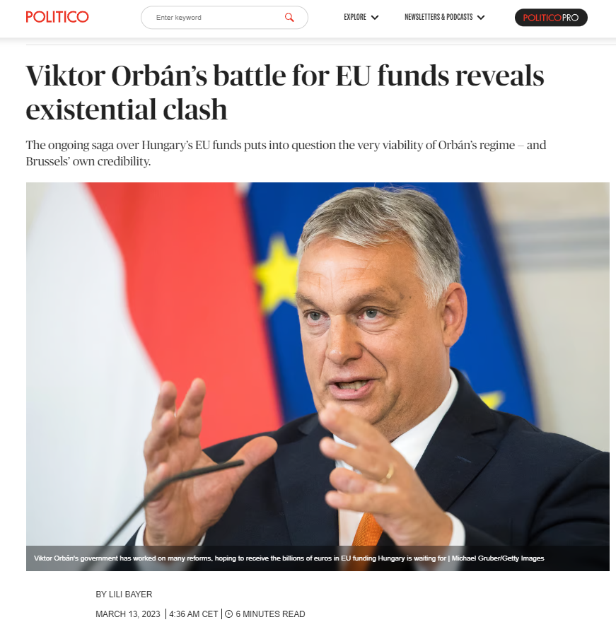
Our Values
Notes:
https://www.politico.eu/article/viktor-orban-battle-eu-funds-reveal-existential-clash/

Slide 12
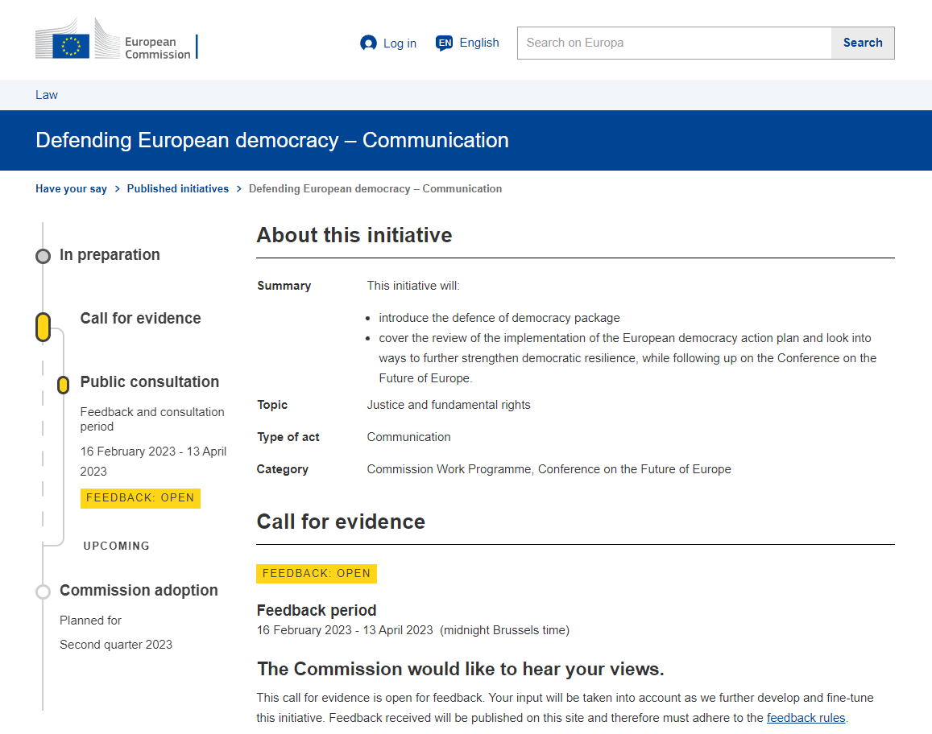
Notes:
https://ec.europa.eu/info/law/better-regulation/have-your-say/initiatives/13730-Defending-European-democracy-Communication_en

Slide 13
SOTEU 2022
‘This is a war on our energy, a war on our economy, a war on our values and a war on our future.’

Slide 14
Our Future
Short term: War in Ukraine
Mid term: Strategic Autonomy (Energy, Technology and Defence)
Long term: Fight against Climate Change
Fit for 55 (outphasing sale combustion engines by 2035)
Critical Raw Materials Act
Net Zero Industry Act

Slide 15
Sweden and Finland joining NATO

Slide 16
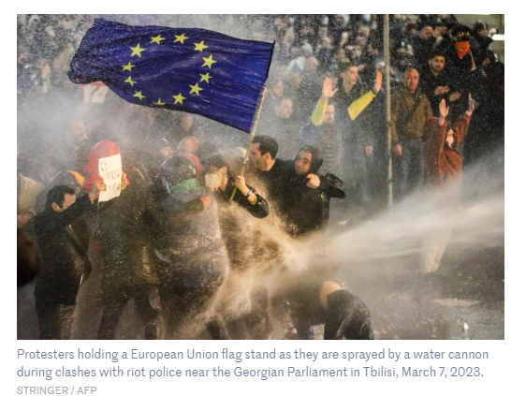
Notes:
https://www.lemonde.fr/en/international/article/2023/03/18/georgia-protester-holding-european-flag-hailed-as-heroine_6019830_4.html

Slide 17
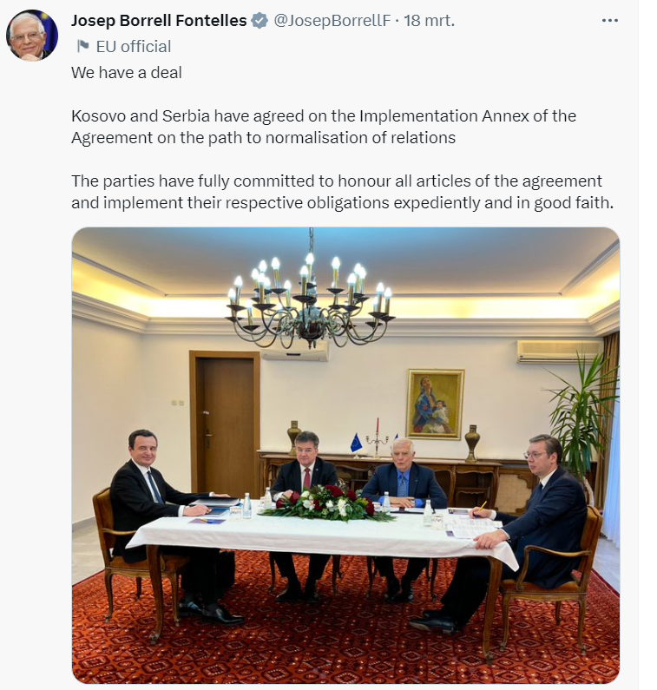

Slide 18
The current challenges of the EU European Seniors’ Union Leuven | 25 March 2022
Prof. dr. Steven Van Hecke
@VanHeckeSteven
Notes:
Picture: https://www.tijd.be/dossiers/oorlog-in-oekraine/zelensky-in-europarlement-als-oekraine-valt-verdwijnt-ook-de-europese-levensstijl/10446180.html

