Slide 1
Dr. Teona Lavrelashvili Policy Adviser, ESU Leuven, Belgium 25 March, 2023
Opportunities and Obstacles to the Establishment of
Seniors’ Associations in some EU MS

Slide 2
Data Collection
10 “difficult” countries
Romania
France
Denmark
Latvia
Italy
6. Greece
7. Portugal
8. Poland
9. Croatia
10. Ireland

Slide 3
Romania
National Liberal Party (PNL)
Founded in 1990. Second Biggest Party. In Grand Coalition with the Socialists.
Seniors in the Party: Existing Association at the national and local levels. Upcoming elections. Intention to join the ESU
Democratic Alliance of Hungarians in Romania (UDMR)
Founded in 1989. In coalition with the PNL.
Seniors in the party: Seniors’ Movement, Intention to join the ESU.

Slide 4
France
Les Republicans
Founded in 2015. In Opposition.
Seniors in the party: No formal association.
Yet, significant MEPs’ Platform. They have an intention to establish the association/movement.

Slide 5
Denmark
Conservative People’s Party
Founded in 1915. In opposition
Seniors in the party: Despite an absence of the association, ready to explore the cooperation with the ESU.
“We do not consider it necessary to have the seniors’ association separately, our policies and values already address the priorities and the interests of the elderly”.
“We are hesitant in order to avoid creating unnecessary divisions between different age groups within the party. Our party’s politics if for all – not specific groups”.

Slide 6
Italy
Forza Italia
Founded in 2013. In coalition with the Meloni Government
Seniors in the party: Active Seniors’ Movement.
Ready to cooperate and join the ESU.

Slide 7
Latvia
Latvian Unity Party
Founded in 2010. In coalition with the conservative parties.
Seniors in the party: active role of the seniors in the party.
Intention to establish and link it to the ESU.

Slide 8
Constraining Factors
Horizontal level
Language barrier
Lack of general awareness of the ESU
Lack of an understanding of the benefits to join the ESU
Lack of the possibility to exchange with the ESU representatives
Party level
Strength and the government position of the party (Italy, Denmark, Romania..)
The EPP’s limited incentive to encourage the sister parties to assist them despite declared goals
Different party traditions, visions and cost-benefit calculations

Slide 9
Preliminary Recommendations
Strengthen the ESU effort of an active engagement with the EPP parties
Pro-active use of the EPP events, increase the lobbying efforts
Create a one-pager about the benefits of joining the ESU
Create the document highlighting the best practices to set up the seniors’ associations
Dedicated seminar about the EPP Associations (supported by the thesis finding)
Launch reflections on how to “involve” weak parties (e.g. guest status).
Reflect how to involve the parties who do not necessarily want to establish the associations, such as Denmark, Poland (there is no homogeneity)
Look into the the enlargement countries (Moldova, Albania, Georgia, Serbia..)
The ESU Initiative regarding the upgrading the status

Slide 10
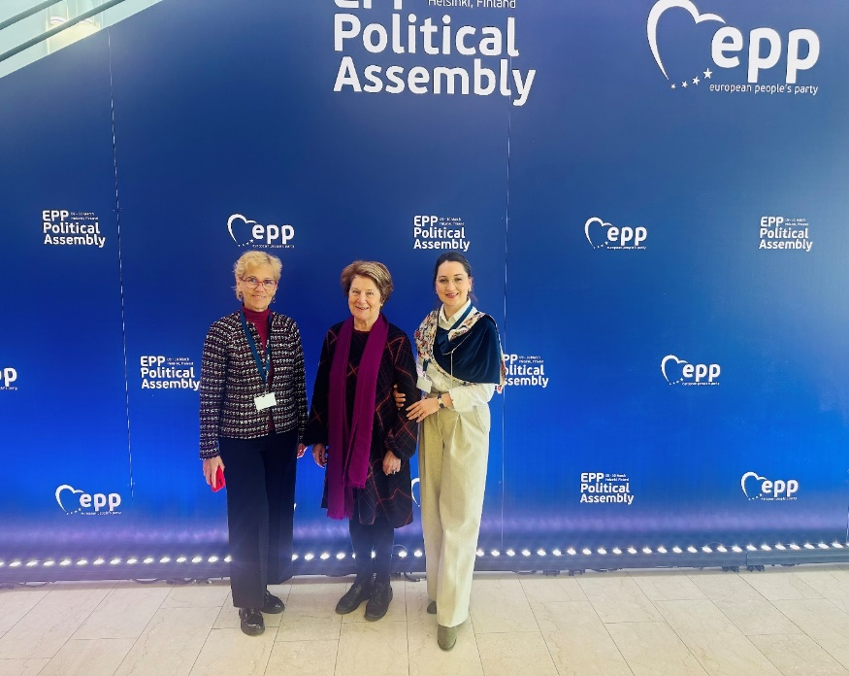
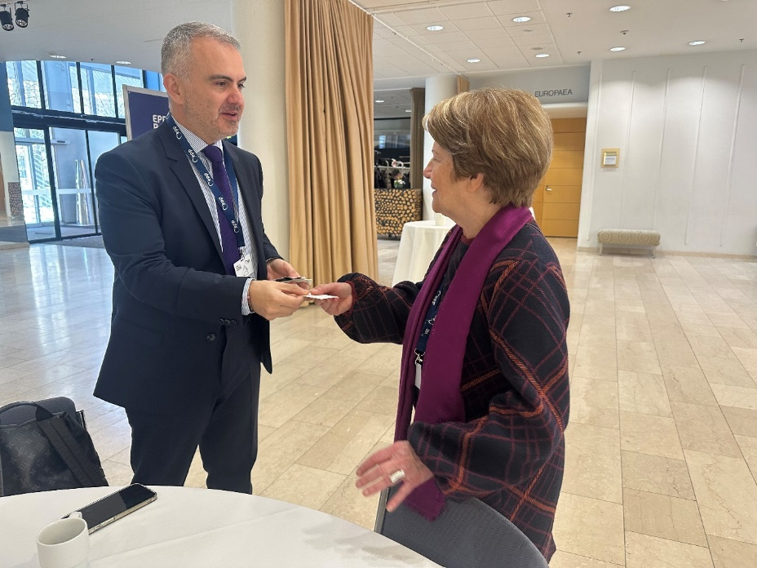
Advocacy Efforts

