Slide 1
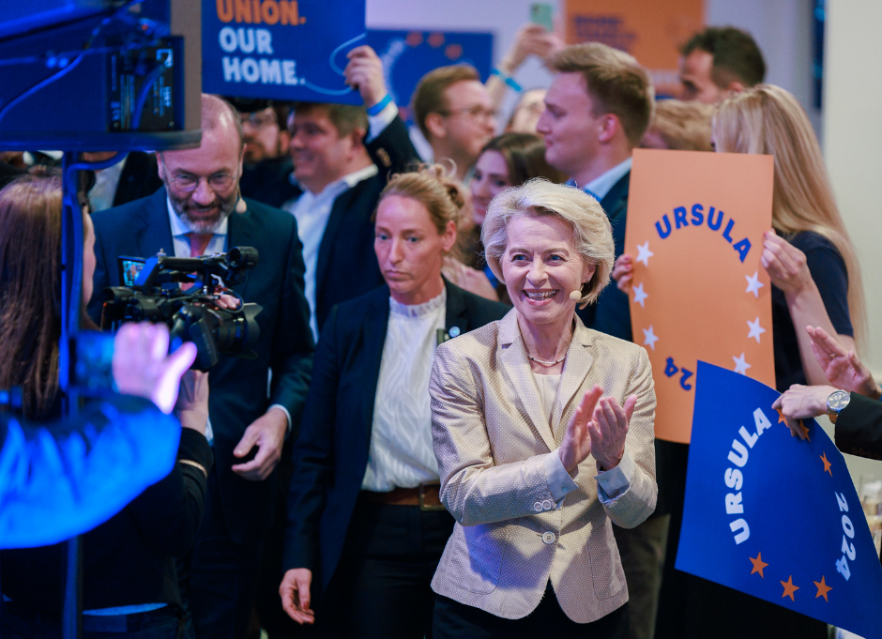
European Parliament Elections 2024: What to remember and to expect? 4 July 2024
Dra. Lien Jansen
Prof. Steven Van Hecke
Notes:
Picture: https://www.flickr.com/photos/eppofficial/53782003224/

Slide 2
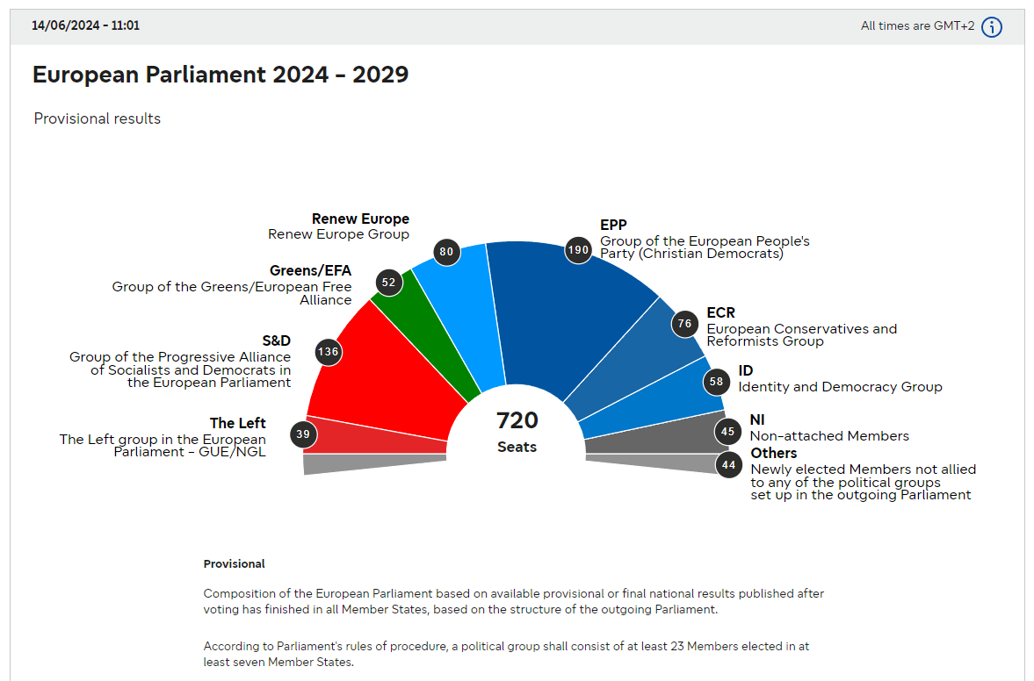
10 points (1 macro + 4 meso + 5 micro)
Source: https://results.elections.europa.eu/en/
Notes:
Source: https://results.elections.europa.eu/en/

Slide 3
Macro: pro-Ukraine versus pro-Russia
far-left + far-right = +/- 30%
all other political forces = +/- 70%
(same figures for regional [Flanders] and federal elections in Belgium)
Notes:
Picture: https://www.eppgroup.eu/newsroom/epp-group-policy-lines-for-the-immediate-response-to-the-ongoing-russian-invasion-and-aggression-in-ukraine

Slide 4
Meso: 4 P’s
Politics = (in)formal electoral rules (Spitzenkandidaten) + role of the Parliament → no change (no transnational lists + no treaty change)
Policies = shift took already place in Spring 2023 (from climate change to agriculture, economy and security) → no change
Power = shift to the right (confirming shift in policies) → change [see next slide]
People = new MEPs + von der Leyen / Macron / Scholz / Meloni → change + same key persons but in changed balance of power [see next slide]

Slide 5
Micro: 5 conclusions (1/2)
Turn-out: stabilised at relative high level = important for political legitimacy of Parliament vis-à-vis Commission and member states
Shift to the right: no earthquake but rather evolution in line with opinion polls (albeit less strong)
Largest member states: 2 winners and 2 losers
- Tusk (Poland/EPP) + Meloni (Italy/ECR)
- Scholz (Germany/Socialists) + Macron (France/Liberals)
Notes:
Less strong shift to the right: as strong as expected in France, less than expected in Portugal, Netherlands, Czechia, Belgium; as expected poor result in Italy
Scholz → elections next year → CDU/CSU → Friederich Mertz
Main issues (according to Eurobarometer)
West: purchasing power, migration and health
South: purchasing power and migration
East: security
Macron: bet but 2 things to consider:
Single official to be elected for a given area with absolute majority → speculate that other parties will cooperate to prevent RN to gain an absolute majority → will just propose one candidate per circumscription (as was the case in the past)
Counts on the voters from traditional parties to be extra motivated to go vote

Slide 6
Micro: 5 conclusions (2/2)
Other member states: no single message ~ no single election
- Nordic countries = victory left parties - Hungary = high turn-out + defeat Fidesz - Romania = success for cartel EPP-Socialists
Von der Leyen: elections create much better starting position to get a majority in Parliament for 2nd term as Commission President

Slide 7
Ursula von der Leyen
CDU/CSU victory in Germany
EPP Group won +/- 10 seats
ECR won while Socialsts, Liberals and Greens lost
Scholz and Macron weakened
Tusk and Meloni strengthened
Notes:
Source: https://x.com/CDU/status/1800128841161072699
Some critics of von der Leyen with weak results vs. win CDU/CSU
Tusk: won elections + reintegrated again fully in the EU mainstream
Italy: parties of the Italian government have been confirmed in these elections

Slide 8
Parliament’s new balance of power
+/- 100 MEPs (Fidesz, M5S etc.) still need to decide
No more ‘progressive’ majority left from/without the EPP
EPP + ECR + ID = theoretical majority on the right
EPP + Socialists + Liberals = still +/- 55% majority (core stability)
EPP + Socialists + Liberals + some Greens + some ECR (Fratelli d’Italia, ODS and N-VA) = VDL majority? (pro-European, pro-Ukraine, pro-democracy and rule of law and pro-transatlantic cooperation)
…
Notes:
Constructive right (= accept and respect the EU → ready to make compromises) vs. destructive rights (= wants to destroy)
→ Very clear in Migration Pact
European Parliament Elections 2024 & The Future Of Europe – Thinking Talks Ep. 16 with Klaus Welle
https://www.youtube.com/watch?v=GBCADoJhKE0
https://legrandcontinent.eu/fr/2023/05/30/le-nouveau-visage-des-droites-en-europe-et-le-conservatisme-du-futur/

Slide 9
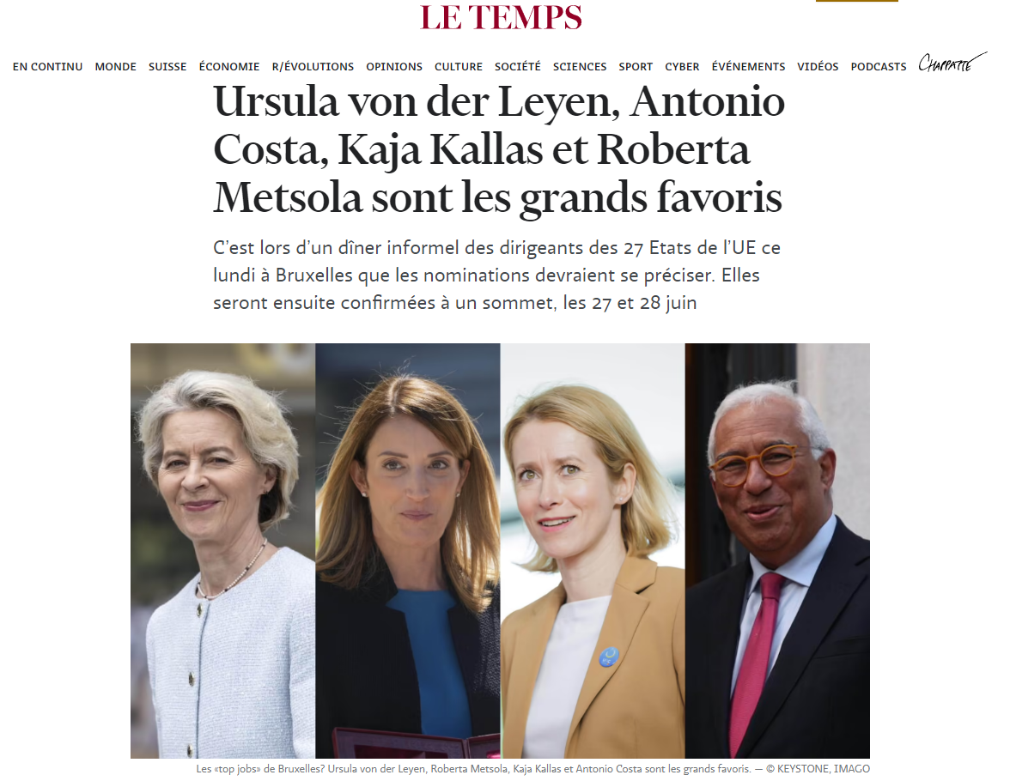
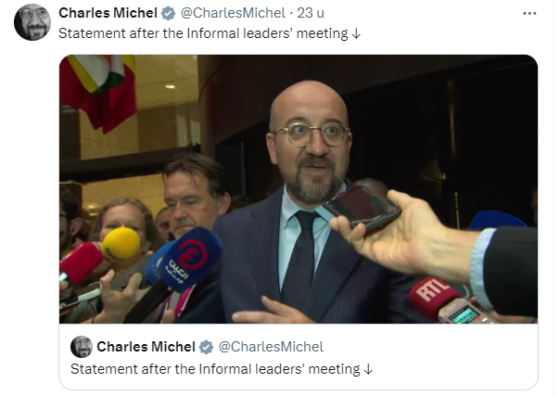
Notes:
https://x.com/CharlesMichel/status/1802823389171925171
https://www.letemps.ch/monde/europe/les-top-jobs-de-bruxelles-ursula-von-der-leyen-antonio-costa-kaja-kallas-et-roberta-metsola-sont-les-grands-favoris

Slide 10
European Parliament Elections 2024: What to remember and to expect? 4 July 2024
Dra. Lien Jansen
Prof. Steven Van Hecke
Notes:
Picture: https://www.flickr.com/photos/eppofficial/53782003224/

Slide 11
EPP perspective
Won 6th election in a row (1979-1994: Socialists)
No more ‘progressive’ majority left from the EPP
Only party family with MEPs from all member states
Notes:
2. 10-20% of the time → EPP was put in majority by forces left from the EPP (now +- 300 seats)

Slide 12
Policies
Defence
2 crucial questions
Where to get the money?
How far should countries cooperate on defense projects? (ID >< ECR)
Economic growth
Budget → how do we find the necessary budgetary means?
Climate policies, enlargement, …
Notes:
For the left, defense is not natural territory for further spending, since it could also imply cuts to the welfare state. On the right wing, nationalists are divided: Members of the far-right Identity and Democracy Group have said no to more defense integration, while the ECR is so in favor that the group co-chair Nicola Procaccini has advocated for an EU army.
Ukraine impact? Short term: NO because ECR also in favour (Meloni) BUT long term: YES because EU enlargement requires adaptation budget and voting rules → more difficult to reach compromises in divided parliament
https://www.politico.eu/article/european-election-right-wing-parliament-would-mean-for-eu-policy/
https://www.europarl.europa.eu/topics/en/article/20240524STO21649/next-term-which-laws-will-parliament-continue-to-work-on

Slide 13
What role for extreme right/left?
Centre is strong → inside the EP not a big role
Also potential for extreme left group → SMER, Wagenknecht, 5 Star Movement
Constructive right (= accept and respect the EU → ready to make compromises) >< destructive right (= wants to destroy the EU)
Notes:
→ Very clear in Migration Pact
Nordic countries so left leaning?
Turnout relatively low compared to national elections → favours green and left parties → care more about EU elections
Migration is less of an issue here → even left parties are already strict on migration

Slide 14
Next crucial dates
16 July: EP president elected + committees
16 September: Election Commission president
Oct-Nov: EP committees’ hearings Commissioners-designates
13-14 Nov: consent appointment Commission as a body
1 Dec: Start of new Commission mandate

